Slide 1
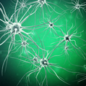
Clinical Cannabis Interprofessional Education: Program Development and Provider Knowledge
Cameron, M.H. ^{1,2} & Jones, K.D.^{3,4}
1. VA Portland Health Care System, MS Center of Excellence West, Portland, Oregon
2. Oregon Health & Science University, Department of Neurology, Portland, Oregon
3. Oregon Health & Science University, School of Nursing, Portland, Oregon
4. Oregon Health & Science University, Department of Anesthesiology & Perioperative Medicine, Portland, Oregon

Slide 2
Disclosures
Dr. Jones and Dr. Cameron have no relevant disclosures.

Slide 3
Background
Although federally prohibited (Schedule 1), clinical cannabis, sometimes called medical marijuana, has been approved in 29 states and the District of Columbia, with many other states considering approval in 2018/19.
Clinical cannabis has been shown to have a range of clinical effects, including improving multiple sclerosis (MS) related symptoms of spasticity and pain.
Providers who care for patients with MS have little education regarding potential benefits and risks.
Continuing education on this topic is recommended but little is available.

Slide 4
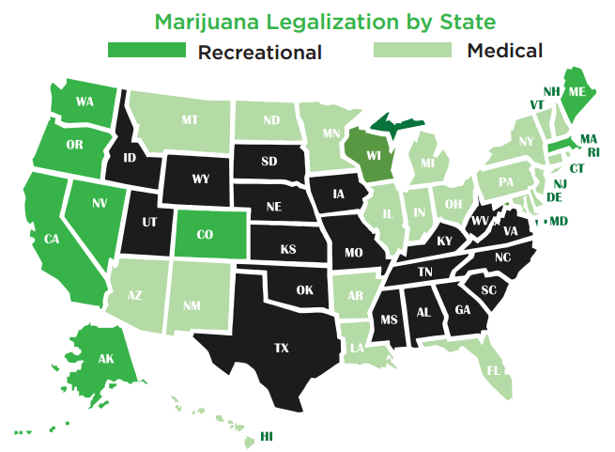

Slide 5
Objectives
Describe the development of an interprofessional clinical cannabis education program recently launched in Oregon.
Present original data about provider knowledge of clinical cannabis.

Slide 6
Methods
In 2017, an interprofessional team consisting of neurology, physical therapy, pharmacy, and nursing, identified an unmet need for clinical cannabis education.
Key stakeholders from an academic health center therefore developed an evidence-based program on clinical cannabis.
There was an urgency for this initiative because in April 2017 the Oregon Medical Board recommended providers obtain three hours of continuing medical education on this topic.

Slide 7
Why this program?
Patients keep asking
Growing body of evidence
29 states and DC have some form of medical marijuana
9 states and DC have legalized marijuana for recreational use
Physicians can sign qualifying letters in all states with medical marijuana
NPs can sign qualifying letters in Maine, Washington State, New Mexico, California, New York, (Rhode Island recently overturned)
RNs are on the front line with patients with qualifying conditions

Slide 8
Course Objectives
Describe the clinical pharmacology and pharmacodynamics of cannabis and its active components
Identify potential drug-drug interactions with cannabinoids
Discuss potential uses of cannabis and cannabinoids for chronic pain, insomnia, MS symptoms and seizure disorders
Understand potential adverse effects of cannabis and cannabinoids
Understand the Oregon and Washington requirements and recommendations for cannabis referral

Slide 9
Agenda
8:30am | Welcome and Background – Michelle Cameron, MD, PT, MCR
8:40am | The Pharmacology of Cannabis – Joseph Bubalo, Pharm D, BCPS, BCOP
9:30am | BREAK – please visit the exhibitors!
9:45am | Potential Benefits in Selected Populations Chronic Pain & Insomnia – Kim Jones, RNC, PhD, FNP, FAAN Multiple Sclerosis Symptoms – Michelle Cameron, MD, PT, MCR Epilepsy, with a Focus on Children – Colin Roberts, MD
11:15am | BREAK – please visit the exhibitors!
11:30am | Potential Adverse Effects & Risks – Kim Jones, RNC, PhD, FNP, FAAN
Noon | The Cannabis Dispensary & Products – Michelle Cameron, MD, PT, MCR
 | OR and WA Recommendations - Michelle Cameron, MD, PT, MCR
12:30 | Q & A – please put questions on the cards provided
1pm | ADJOURN

Slide 10
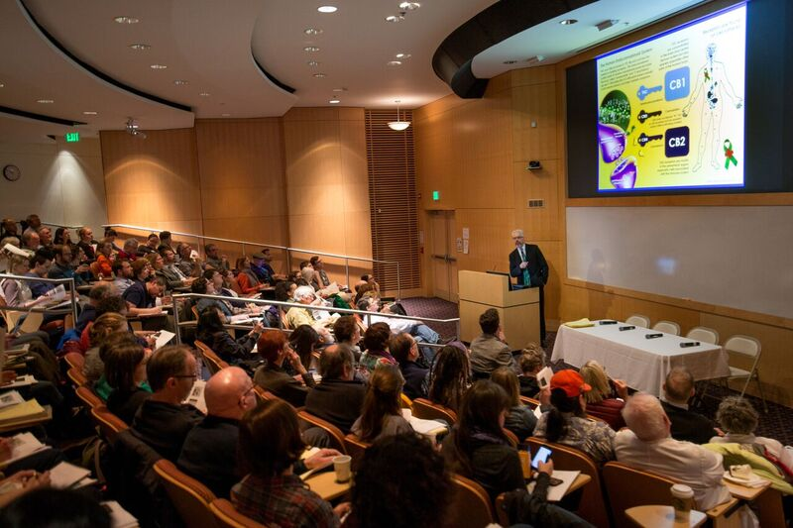
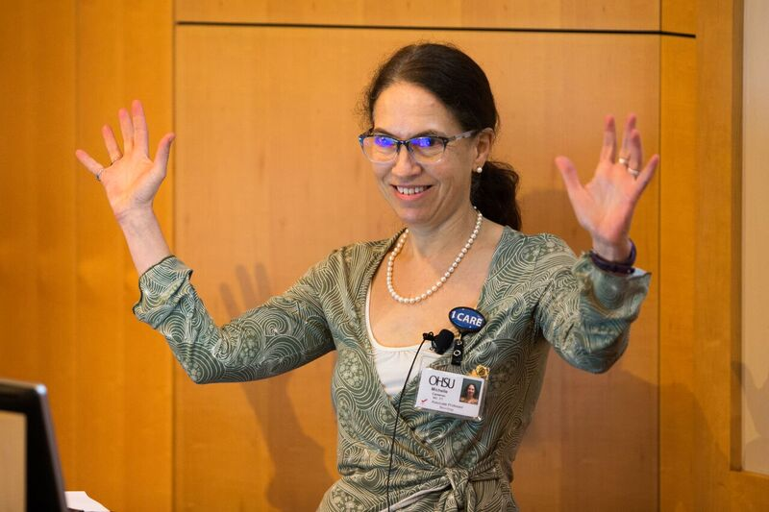
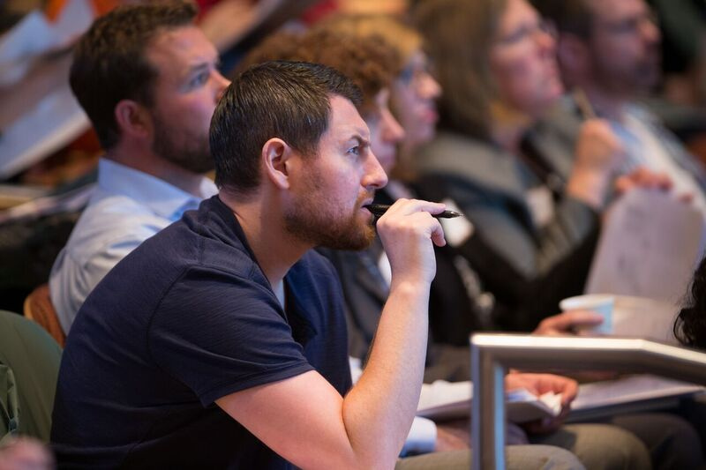

Slide 11
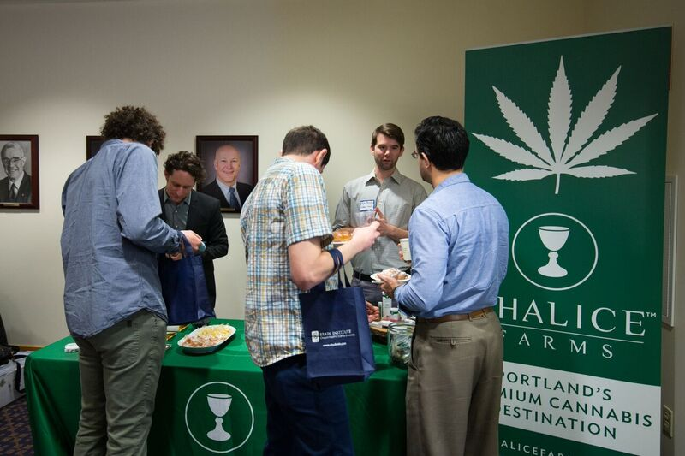
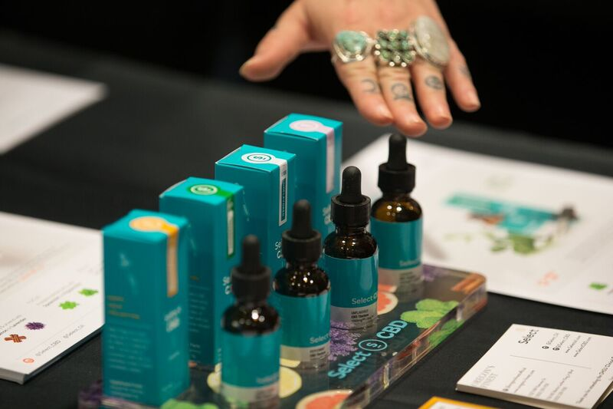

Slide 12
Results
Attendance
Total professional attendance at this program was 138, with the majority (102) being medical prescribers (MD, DO, NP or PA). Additionally, 12 exhibitor representatives attended the scientific session for a total attendance of 150.
Oregon | 109 |  | MD | 72
Washington | 24 |  | DO | 8
Colorado | 1 |  | NP | 18
Maryland | 1 |  | PA | 4
Idaho | 1 |  | RN | 5
California | 2 |  | Other | 25
 |  |  | PT | 3

Slide 13
Knowledge pre/post test
Pre-test score means
56% (57% median; 10%-89% range)
Post-test score means
84% (84% median; 36%-100% range)
Similar for all attendee professions
Most improvement: childhood epilepsy, insomnia and safety

Slide 14
Course evaluation
Speaker ratings 4.65/5 (5=excellent, 1=poor)
What new clinically-relevant information or strategies did you learn?
Tons! I feel much more prepared to answer my patients questions with real data
Be able to discuss the issues better with patients and staff
Learned more about what preparations my patients encounter at pharmacies/dispensaries
Clearer understanding of the state of science
What to ask and watch for– use, drug abuse, side effects,
More aware of available research, or lack thereof
Interactions with medications and cannabis
CBD in epilepsy and MS
Can site some studies of pharmaceutical based findings
The populations that might be helped/harmed by cannabis
More knowledge regarding potential benefits/harms for some chronic pain conditions
I am better equipped to convey the truth about what we do and do not know regarding cannabinoids and their place in current western medicine, and I understand better the differences between CBD and THC
Requested more regarding CBD and common terminology

Slide 15
Summary
We successfully developed and held an interprofessional clinical cannabis education program in Oregon.
This program was well attended by a wide range of providers.
This program was well received and increased clinically-applicable knowledge.

Slide 16
Budget
$12,525 expenses
$25,000 income
Bigger ticket items: CME $3,208, program development: faculty and staff time 4,600

Slide 17
Thank you for your support!
Greenwich Biosciences – unrestricted educational grant
EXHIBITORS
  SILVER LEVEL
  Siskiyou Sungrown
  BRONZE LEVEL
  Empower Body Products
  Farma
  Gnome Grown
  Golden Brands
  Grὄn Chocolate
  Little House Food
  Luminous botanicals
  Panacea

Slide 18
Oregon Medical Board, (OMB) April 2017
A physician who recommends the medical use of marijuana should complete a minimum of three hours of category 1 continuing medical education related to medical marijuana.
Ideally, this should be before the physician begins making recommendations for the medical use of marijuana to patients.
Such a program should explain the proper use of marijuana, including the endo-cannabinoid system, pharmacology and effects of marijuana (e.g., distinction between cannabidiol [CBD] and tetrahydrocannabinol [THC]; methods of administration; and potential side effects or risks).

Slide 19
Oregon Medical Board, (OMB) April 2017
Physicians who recommend marijuana should closely follow the emerging evidence on the use of marijuana for therapeutic purposes and adopt consistent best practices.
Physicians recommending marijuana for minors also should be keenly aware and up-to-date on the peer-reviewed literature regarding the effects of THC on children and young adults’ developing brains.
http://www.oregon.gov/omb/Topics-of-Interest/Pages/Medical-Marijuana.aspx

