Slide 1
Inpatient Multidisciplinary Rehabilitation: Long-Term Effectiveness on Health-Related Quality of Life in MS Patients - The Danish MS Hospitals Rehabilitation Study
Michael Nørgaard, MSc, Researcher.¹
Finn Boesen, MD, Senior Consultant.¹
Peter Vestergaard Rasmussen, PhD, Senior Consultant.²
Thor Petersen, DMSc, Senior Consultant. ²
Anders Guldhammer Skjerbæk, MSc, Development Manager. ²
Brita Løvendahl, MSc, Director.¹
Philipp Trénel , PhD, Senior Specialist.³
¹The Danish MS Hospitals, Denmark.
²Department of Neurology, Aarhus University Hospital, Denmark.
³Danish Technological Institute, Denmark.

Slide 2
Disclosure of Conflicts of Interests
All authors:
Michael Nørgaard,
Finn Boesen,
Peter V. Rasmussen,
Thor Petersen,
Anders G. Skjerbæk,
Brita Løvendahl
and Philipp Trénel,
declare that they have no competing interests regarding this work.

Slide 3
Learning Objective - in rehabilitation research
Research on the effectiveness of rehabilitation interventions is of great importance for professional treatment providers, therefore todays learning objective will be:
To get insight into the advantages of combined multiple outcome model analysis in rehabilitation research, when dealing with low statistical power and risk of multiple testing problems.

Slide 4
Table of Contents
Learning objective
Objectives of this presentation.
Background and introduction to The Danish MS-Hospitals Rehabilitation Study.
Health-Related Quality of Life (HR-QoL) at 12 months follow-up (MFU).
Results from a cohorte.
The challenge! – Measuring the effectiveness of MDR.
A combined multiple outcome model by multivariate multivariable linear mixed effects model.
Reanalysis of 6 months data using a combined multiple outcome model.
A post-hoc reanalysis of previously reported 6 months data.
Summary

Slide 5
The Objectives
Of the study
To investigate the long-term effectiveness of four weeks of inpatient multidisciplinary rehabilitation on the health-related quality of life in MS patients.
For this presentation
To increase statistical power in a post-hoc reanalysis of previously reported 6 months data.

Slide 6
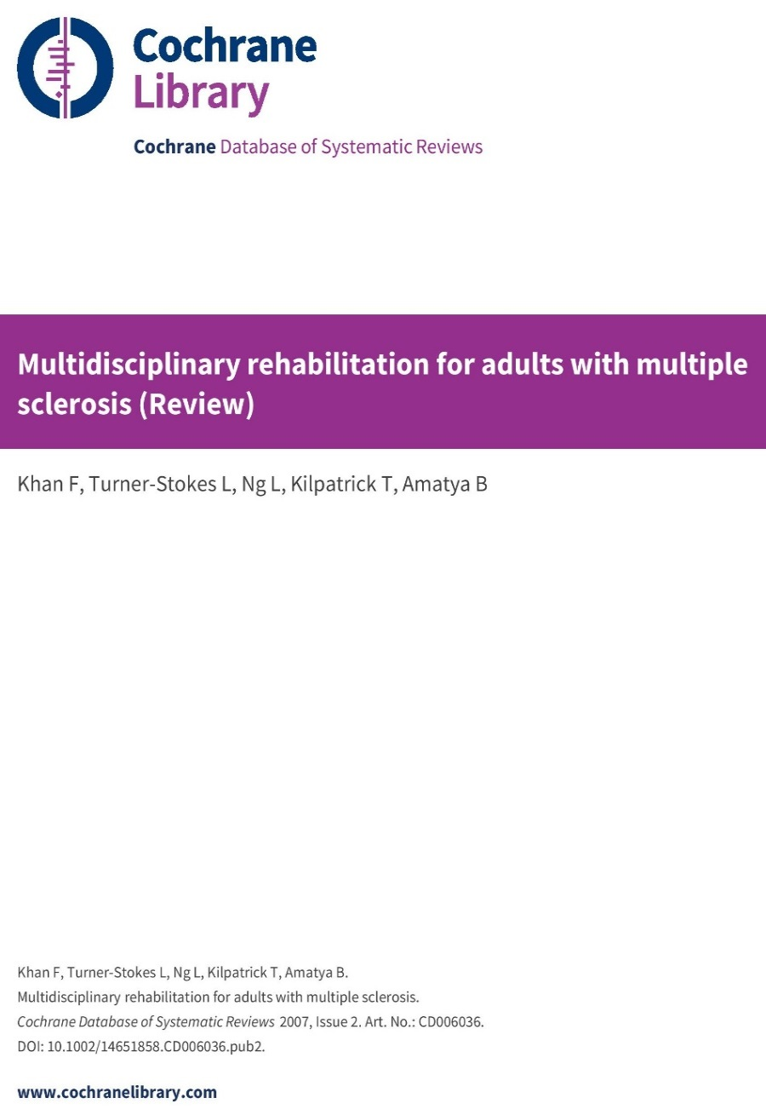
Background
MS can lead to continuing decline in quality of life (QoL).
Research suggests that inpatient MDR can improve QoL in MS patients.
Evidence of the effectiveness on a long-term basis is limited.
Previous studies generally suffered from lack of statistical power, including our own study.

Slide 7
Trial Design Intro to The Danish MS-Hospitals Rehabilitation Study
The study was a pragmatic semi cross-over randomized controlled clinical trial with MS patients, aged 18-65, and Expanded Disability Status Scale score ≤7.5.
Start of RCT
End of RCT
Discharge
B
6-MFU
Wait-list control period
Admission
Patient Group
Discharge
A
6-MFU
12-MFU
Admission
12
0
Time period 1
6
Time period 2
Time line
A1, A2, B1, B2: Patient group-time periods, MFU: Month Follow-Up.

Slide 8
First Published Results Intro to The Danish MS-Hospitals Rehabilitation Study
Results from 6 months follow-up
Multiple Sclerosis Journal 2018: Vol 24, Issue 3, pp. 340 – 349.
First Published Online October 6, 2017.
In conclusion the study results indicated the longer-term effectiveness of inpatient MDR on HRQoL in MS patients. Future studies are needed to confirm and strengthen our results.........

Slide 9
The MDR Programme Intro to The Danish MS-Hospitals Rehabilitation Study
4 weeks of continuous hospitalization with 20 days of scheduled rehabilitation.
The MDR programme was provided by many different MS professionals.
A case manager and a team of MS specialists were assigned to every patient based upon personal needs and goals.
The MDR programme was individualized, holistic and balanced, with input from the different disciplines depending on the patient’s main focus area.
The MDR programme consisted of a mean of approximately 3.5 hours of therapy per day (range 1.9-6.9), including consultation with the neurologist, individual and group-based physiotherapy and occupational therapy, sessions with neuropsychologists and psychologists, lessons on different topics either group-based or individual discussions.
No continuation or repetition of the MDR programme was available after discharge.

Slide 10
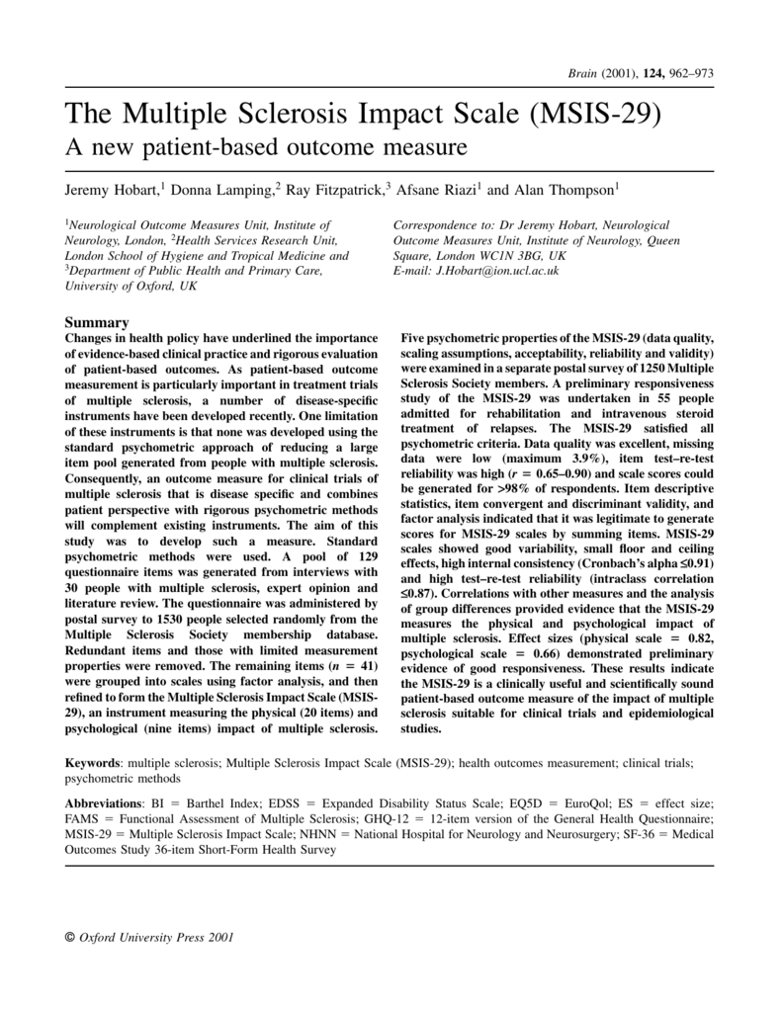
HR-QoL Instruments Intro to The Danish MS-Hospitals Rehabilitation Study
Primary outcome: HRQoL measured by MS-specific questionnaires
MSIS-29
FAMS

Slide 11
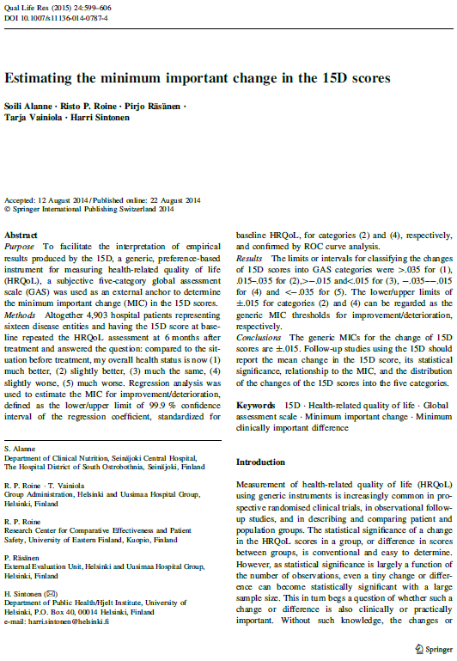
HR-QoL Instruments Intro to The Danish MS-Hospitals Rehabilitation Study
Secondary outcome: HR-QoL measured by generic questionnaires
15D
EQ-5D-5L

Slide 12
Trial Profile 12-MFU Intro to The Danish MS-Hospitals Rehabilitation Study
CONSORT Flow Diagram

Slide 13
Baseline Statistics 12-MFU Intro to The Danish MS-Hospitals Rehabilitation Study
 |  | Treatment (A) | Wait-list control (B)
No. of patients |  | 214 | 213
Location | Haslev | 98 | 97
 | Ry | 116 | 116
Age | Years | 51 (44-58) | 51 (44-56)
Sex | Female | 145 | 146
 | Male | 69 | 67
MS type | RR | 89 | 85
 | SP | 90 | 92
 | PP | 35 | 36
EDSS | Range 0-10 | 5 (3.5-6.5) | 4.5 (3.5-6.5)
Time since diagnosis | Years | 9 (4-15) | 7 (3-14)
Time since first symptoms | Years | 15 (9-23) | 14 (8-21)
Immuno-treatment | No | 101 | 98
 | Yes | 113 | 115
Outcome measures |  | n=209 | n=203ª
FAMS Total |  | 115 (98-134) | 114 (96-132)
MSIS-29 Physical |  | 40 (25-53) | 38 (27-54)
MSIS-29 Psychological |  | 33 (19-44) | 30 (15-44)
15D Index |  | 0.77 (0.71-0.83) | 0.77 (0.72-0.83)
EQ-5D-5L Index |  | 0.70 (0.62-0.76) | 0.69 (0.61-0.79)
EQ-VAS^{b} |  | 60 (50-75) | 65 (50-80)
Continuous data are presented as median with interquartile range. ªOne patient did not complete the web-based questionnaires at baseline. ^{b}n = 173 and 165.
From Boesen et al. MSJ 2018; 24:340–349

Slide 14
Results from12-MFU Estimated mean differences
 |  | Adjusted LS-means | Baseline adjusted mean changes from baseline
Outcome measures |  | Baseline | Discharge | 6-MFU | 12-MFU
 | n | Mean (95%-CI) | Mean (95%-CI) | Mean (95%-CI) | Mean (95%-CI) | P-value
FAMS
Treatment (A) | 209 | 115.9 (111.0, 120.8) | 12.6 (10.0, 15.2) | 0.6 (-2.1, 3.5) | 2.0 (-0.8-4.7) | 0.162
Wait-list control (B) | 204 | 115.1 (110.0, 120.4) |  | -1.0 (-3.5, 1.6)
MSIS-29Phys
Treatment (A) | 209 | 40.8 (37.0, 44.6) | -12.0 (-14.1, -10.2) | -0.2 (-3.0, 2.3) | 0.3 (-2.1-2.8) | 0.777
Wait-list control (B) | 204 | 41.0 (37.1, 45.1) |  | 0.4 (-2.1, 2.8)
MSIS-29 Psych
Treatment (A) | 209 | 31.8 (27.9, 35.2) | -9.7 (-11.6, -7.9) | -1.2 (-3.8, 1.2)^{A} | 0.1 (-2.4-2.6) | 0.918
Wait-list control (B) | 204 | 29.8 (25.7, 33.3) |  | 1.5 (-0.7, 3.6)
15D-Index
Treatment (A) | 209 | 0.771 (0.754, 0.789) |  | 0.011 (-0.007, 0.027)^{A} | 0.017 (0.006-0.028)^{B} | 0.004
Wait-list control (B) | 204 | 0.777 (0.762, 0.794) |  | -0.006 (-0.023, 0.008)
EQ-5D-5L-Index
Treatment (A) | 209 | 0.638 (0.606, 0.669) |  | -0.032 (-0.070, 0.001) | -0.015 (-0.038-0.008) | 0.194
Wait-list control (B) | 204 | 0.638 (0.605, 0.669) |  | -0.038 (-0.075, -0.002)
EQ-5D-5L-VAS
Treatment (A) | 173 | 60.4 (56.7, 64.1) | 9.7 (7.1, 12.4) | 3.8 (-0.1, 7.1) | 4.1 (0.9-7.2)^{B} | 0.016
Wait-list control (B) | 165 | 62.9 (58.9, 66.6) |  | 1.2 (-2.5, 4.8)
Neurological status
EDSS |  | Median (IQR) |  | Median (IQR) | Median (IQR)
Treatment (A) | 209 | 5.0 (3.5-6.5) |  |  | 5.0 (4.0-6.5)
Wait-list control (B) | 204 | 4.5 (3.5-6.5) |  | 4.5 (3.5-6.5)
^{A}Significant difference between groups. ^{B}Significant different from baseline. MFU: Month follow-up. IQR: Interquartile range
6 months data from Boesen et al. MSJ 2018; 24:340–349
Notes:
Meetings with case manager, ikke supervisor. Receiving ikke recieving

Slide 15
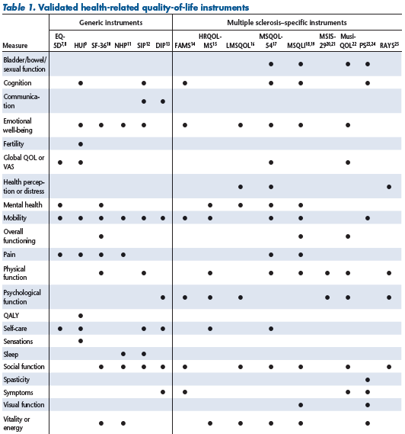
The Challenge! Measuring the effectiveness of MDR
No ”gold-standard” QoL measure in MS rehabilitation research.
Present QoL scales measures different dimensions and aspects of QoL, with some overlap.
Generic QoL scales often lacks domains important to MS patients.
Many questions concerns symptoms and disability – but the goal of MDR is functioning.
Floor/ceiling effects limits the sensitivity to treatment effects.
Benefits gained by MDR will not be optimally detected by present QoL scales
They will underestimate the advantages of MDR.
15D
•
•
•
•
•
•
•
•
•
•
•
•
•
From Bandari et al. Int J MS Care. 2010;12:34–41.

Slide 16
Combined Multiple Outcome The Challenge! – Measuring the effectiveness of MDR
Be it as it may, lets gets the best out of it!
Taking advantage of the high correlation between the HR-QoL outcome measures.
In a combined multiple outcome model.
Using a multivariate multivariable linear mixed effects model (M-LMM).
Possible to simultaneously analyze all six HR-QoL outcome measures.
Reducing the six HR-QoL outcome measures into one single combined outcome.
Enhancing sensitivity – the likelihood of detecting a true positive respondent.
Increasing power.

Slide 17
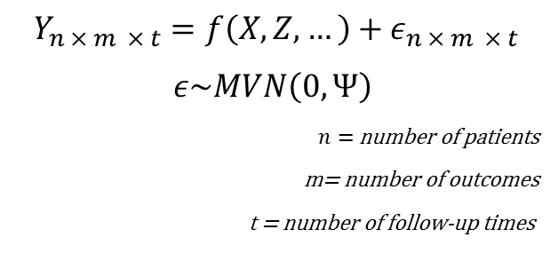
Combined Multiple Outcome Why and how?
Improved statistical power, especially when outcomes are highly correlated.
It is possible to estimate a joined treatment effect across outcomes, as long as there is no significant interaction between outcomes and treatment. This can be tested!
Explicit estimation of correlation among outcomes (no redundant conclusions!)
No multiple testing issues!
Multivariate Linear Mixed Effects Model
Mean-center and standardize all outcomes aka Cohens effect size.
Align sign in all outcomes (f. ex. positive means better).
Fit a linear mixed effects model in order to account for:
Repeated measurements within patient.
Correlation structure among outcomes
$$Y_{n × m × t}=f\left(X, Z, …\right)+ε_{n × m × t}$$
$$ε\sim MVN\left(0, Ψ\right)$$
$n=$number of patients
m= number of outcomes
t = number of follow-up times
In practice, vector stacking is used in order to convert a multidimensional response into a one-dimensional response vector. Snijders & Bosker 2012. Multilevel Analysis, Sage, L.A.

Slide 18
Reanalysis of 6 Months Data In a combined multiple outcome model using a M-LLM
Pooling data from group A1 and group B2 into a single treatment group.
Increasing the number of observations in the treatment group from 209 to 406.
Baseline values were similar between the two groups.
The treatment effect was the same for the two groups (no statistical significant differences).
Adjusting for correlated observations

Slide 19
Baseline Statistics 6-MFU Reanalysis of 6 months data using a M-LLM
 |  | Treatment (A1+B2) | Wait-list control (B1)
No. of patients |  | 411 | 213
Location | Haslev | 187 | 97
 | Ry | 224 | 116
Age | Years | 51 (44-57) | 51 (44-56)
Sex | Female | 283 | 146
 | Male | 128 | 67
MS type | RR | 166 | 85
 | SP | 181 | 92
 | PP | 64 | 36
EDSS | Range 0-10 | 4.5 (3.5-6.5) | 4.5 (3.5-6.5)
Time since diagnosis | Years | 8 (3.5-14.5) | 7 (3-14)
Time since first symptoms | Years | 14 (8-22) | 14 (8-21)
Immuno-treatment | No | 191 | 98
 | Yes | 220 | 115
Outcome measures |  | n=406 | n=203ª
FAMS Total |  | 113 (96-131) | 114 (96-132)
MSIS-29 Physical |  | 40 (27-53) | 38 (27-54)
MSIS-29 Psychological |  | 33 (19,44) | 30 (15-44)
15D Index |  | 0.77 (0.71-0.83) | 0.77 (0.72-0.83)
EQ-5D-5L Index |  | 0.70 (0.62-0.78) | 0.69 (0.61-0.79)
EQ-VAS^{b} |  | 65 (50-80) | 65 (50-80)
Continuous data are presented as median with interquartile range. ªOne patient did not complete the web-based questionnaires at baseline. ^{b}n = 332 and 165.

Slide 20
Results from 6-MFU Reanalysis of 6 months data using a M-LLM
Estimated mean differences
 |  |  | Adjusted LS-means | Baseline adjusted mean changes |  |  | Mean differences between groups
Outcome measures |  |  | Baseline |  | Discharge | 6-MFU | 6-MFU
 | n |  | Mean (95%-CI) |  | Mean (95%-CI) | Mean (95%-CI) | Mean (95%-CI) | P-value
FAMS¹
Treatment (A1+B2) |  | 406 | 115.0 (111.6-118.4) |  | - | 2.0 (0.4-3.6) | 3.3 (0.5-6.1) | 0.012^{A}
Wait-list control (B1) |  | 204 | 114.2 (110.8-117.6) |  |  | -1.3 (-3.3-0.7) | Ref.
MSIS-29Phys¹
Treatment (A1+B2) |  | 406 | 39.5 (37.1-41.9) |  | - | -1.0 (-2.2-0.3) | -1.2 (-3.4-1.0) | 0.337
Wait-list control (B1) |  | 204 | 39.8 (37.5-42.3) |  |  | 0.2 (-1.3-1.8) | Ref.
MSIS-29 Psych¹
Treatment (A1+B2) |  | 406 | 32.4 (29.8-35.1) |  | - | -1.6 (-3.2-(-0.2)) | 3.1 (-5.7-(-0.5)) | 0.022^{A}
Wait-list control (B1) |  | 204 | 30.5 (27.9-33.3) |  |  | 1.4 (-0.4-3.3) | Ref.
15D-Index
Treatment (A1+B2) |  | 406 | 0.769 (0.758-0.781) |  | - | 0.012 (0.007-0.018) | 0.014 (0.004-0.024) | 0.004^{A}
Wait-list control (B1) |  | 204 | 0.775 (0.763-0.788) |  |  | -0.002 (-0.010-0.006) | Ref.
EQ-5D-5L-Index
Treatment (A1+B2) |  | 406 | 0.687 (0.670-0.703) |  | - | 0.010 (-0.002-0.021) | 0.021 (-0.002-0.044) | 0.054
Wait-list control (B1) |  | 204 | 0.687 (0.667-0.708) |  |  | -0.011 (-0.029-0.006) | Ref.
EQ-5D-5L-VAS
Treatment (A1+B2) |  | 332 | 62.1 (59.6-64.8) |  | - | 4.0 (2.4-5.7) | 3.1 (0.4-6.0) | 0.030^{A}
Wait-list control (B1) |  | 165 | 63.9 (61.3-66.6) |  |  | 0.9 (-1.3-3.1) | Ref.
MV-LMM
Treatment (A1+B2) |  | 406 |  |  |  | 0.081 (0.039-0.125) | 0.018 (0.065-0.298) | 0.001^{A}
Wait-list control (B1) |  | 204 |  |  |  | -0.099 (-0.184-(-0.015)) | Ref.
^{A}Significant difference between groups. MFU: Month follow-up.

Slide 21
Summary
The results at 12-MFU indicate that inpatient multidisciplinary rehabilitation can set the ground for long lasting improvements in health-related quality of life in MS patients.
The result from the combined multiple outcome model analysis strengthens the results from the 6-month follow-up previously reported.
Combined multiple outcome model analysis increases sensitivity and power and it could be an alternative to multiple testing in future reporting.
Until the “ultimate” QoL outcome measure has been developed for clinical studies in rehabilitation research, researcher may be encouraged to use 2 or more QoL outcome measures to make use of a combined multiple outcome model analysis in future studies.

Slide 22
Thank You for Listening
It has been a real pleasure to be here and a great honour.
Thank you very much
”In God we trust, all others bring data” ^{William Edwards Deming}

