Slide 1
Imaging cognitive fatigue in multiple sclerosis:
A preliminary quantification of global cerebral blood flow using ASL perfusion fMRI
Lisa Walker, Ph.D., C.Psych.
Neuropsychologist
The Consortium of Multiple sclerosis centers
May 30, 2018

Slide 2
Disclosures
No disclosures/conflicts of interest
This study was funded through surplus funds

Slide 3
Learning objective
To understand the concept of cognitive fatigue as it relates to MS
To learn how functional neuroimaging might serve as one tool for objective measurement of cognitive fatigue

Slide 4
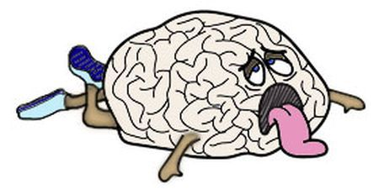

Slide 5
Cognitive fatigue (cf)
Can be defined as a decrease in, or inability to sustain, optimal task performance throughout the duration of a continuous cognitive task.
Individuals with MS are more susceptible to CF and become cognitively fatigued sooner than controls.
  Reflected by an earlier breakdown in task performance across the task
Focus of research has been on determining appropriate CF measures
CF has thus far been a largely unverifiable subjective experience
Notes:
Typically assessed using tasks where attention must be sustained for long periods of time
Not unique to those with MS; expect even HCs to show CF as well
Typically self-reports measures have been used, though these present with limitations
Focus has shifted to finding objective measures to evaluate CF

Slide 6
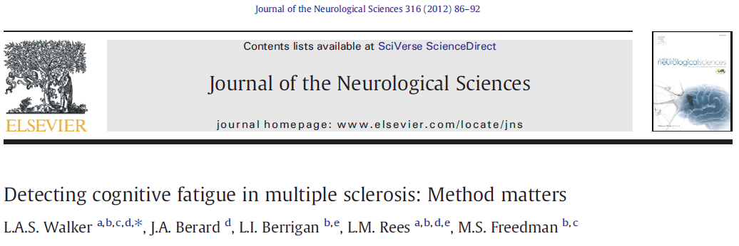
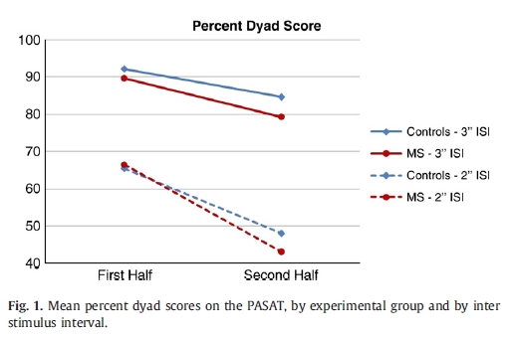
Measurement of Cognitive Fatigue
Notes:
- The PASAT is a sensitive measure of CF & scoring methodology can impact it’s sensitivity
- Percent dyad is the most sensitive measure of CF on the PASAT

Slide 7
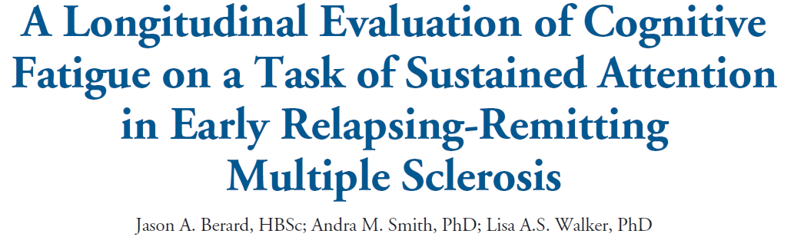
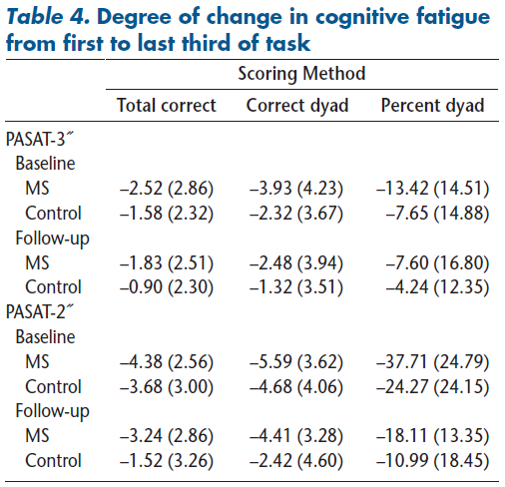
Longitudinal measurement of Cognitive Fatigue
Notes:
Individuals with MS remain vulnerable to CF at 3-year follow-up, though the severity does not seem to increase with time. (Berard, et al. (2018))
CF may be a more sensitive marker of cognitive impairment than overall task performance in those with early-phase RRMS given that we detected differences in CF between groups even when there were no performance differences on the PASAT in this early-phase RRMS group. (Berard, et al. (2018))

Slide 8
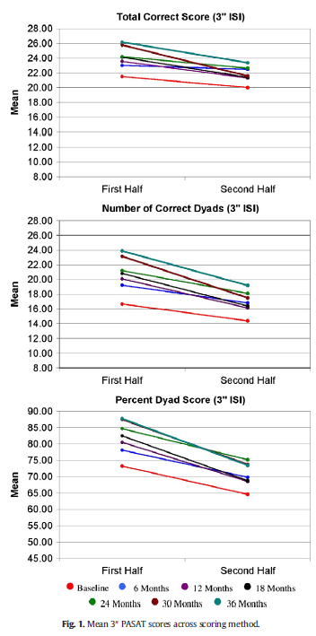
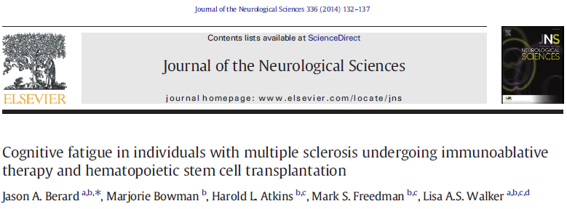
Cognitive Fatigue in IA-HSCT
Notes:
Evaluated CF in a sample of individuals undergoing IA-HSCT procedure. Despite the aggressive nature, it does not seem to exacerbate CF. (Berard, et al. (2014))
Paired sample t-tests showed no significant differences in the degree of CF from baseline to any follow-up session post-tx

Slide 9
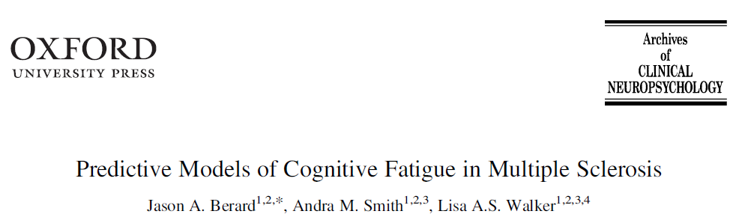
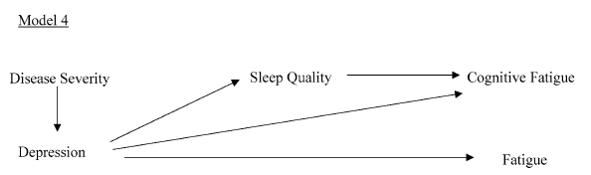
Statistical models of Cognitive Fatigue
Notes:
When evaluating possible predictors of CF, sleep quality is the most significant predictor in MS. (Berard, et al. (2018))
Depression has only a very small predictive value wrt CF

Slide 10
cognitive fatigue and neuroimaging
One promising objective evaluation of CF comes from the use of neuroimaging techniques
Challenging due to methodological limitations
  Typical neuroimaging techniques show poor sensitivity at tracking neural activity changes over a time scale longer than a few minutes.
  It is critical to select a methodology capable of measuring these slower variations in neural activity.
Arterial spin labelling (ASL) fMRI provides a non-invasive imaging method of quantifying cerebral blood flow with excellent reproducibility over long periods of time
Notes:
Conventional fMRI is a problem as eliciting CF requires a relatively long duration task
ASL can evaluate slow neural changes; uses magnetically labelled water in blood as the tracer

Slide 11
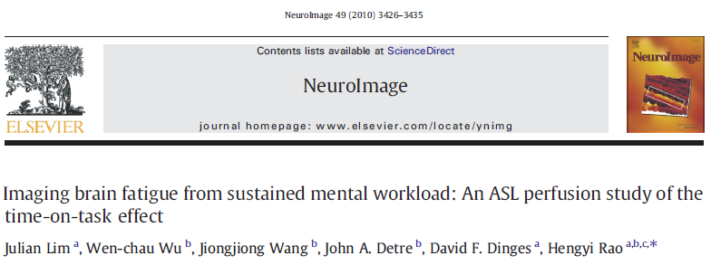
Lim, et al. (2010)
ASL was used to investigate the neural correlates of time-on-task effects (i.e. CF.) in a group of 15 healthy individuals
Performed a 20-minute continuous psychomotor vigilance test (PVT).
  Mean reaction time, number of lapses (RT > 500ms), & whole brain/regional cerebral blood flow (CBF)
The task was divided into 4-min quintiles
  Allows for the examination of: changes in performance/blood flow as the task progresses over time
CBF was also examined at task-free resting baselines both pre- and post- PVT.
Notes:
Psychomotor vigilance test (PVT) requires Ss to press a button to stop a counter
Once the counter is stopped the Ss can see how quick they were to respond

Slide 12
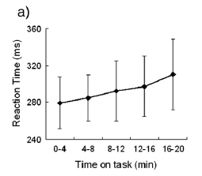
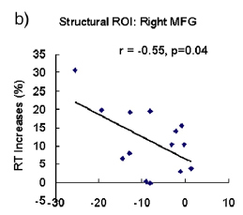
Lim, et al. (2010)
Results:
  Evidence of CF was noted in this group of controls, with participants showing increased RTs as the task progressed.
  No whole brain CBF differences were noted between any of the task conditions (Pre- vs. PVT vs. Post)
  Decreased regional CBF was noted in the fronto-parietal network during post-task rest vs. pre-task rest
    Correlated with performance declines (i.e. CF) across the task
Notes:
Those individuals who showed smaller declines in CBF in the fronto-parietal network had better-preserved performance across the PVT task (i.e. were less susceptible to CF)
Example: Lower regional CBF in the right MFG (medial frontal gyrus) at pre-task resting baseline was associated with smaller reaction time increases during the PVT
Our group aimed to replicate this study in a sample of individuals with MS

Slide 13

Our sample
9 individuals with relapsing-remitting MS
  Sex = 2 males / 7 females
  Age = 35.67 (9.43)
  Education = 15.67 (4.00)
  EDSS = 1.78 (0.83)
  Disease Duration = 7.56 (5.88)
6 matched healthy controls
  Sex = 2 males / 4 females
  Age = 36.00 (12.63)
  Education = 16.33 (3.20)

Slide 14
Hypotheses
MS group will demonstrate longer RTs across the task & produce more lapses (RTs > 500ms).
Both the MS and HC groups will show susceptibility to CF; though the MS group will demonstrate greater susceptibility.
The MS group will show whole brain CBF values comparable to HCs both pre- and post- PVT, though greater CBF values will be seen in the MS group during the PVT task.
Distinct patterns of regional activation (in particular, in the fronto-parietal network) will be noted for the MS group vs. HCs.
  The data for this hypothesis is still being analysed.

Slide 15
Results
The MS group demonstrated longer RTs across the task.
The MS group also produced significantly more lapses.
Susceptibility to CF was noted for only the MS group with a significant difference observed between RTs at the 5th vs. 1st quintile.
Notes:
HCs did not show evidence of CF as we expected

Slide 16
Results
No whole brain CBF differences were noted between groups nor between the PVT and Pre-/Post- resting baselines.
Percent change in mean CBF values showed that HCs had a significantly larger decrease (-18.98%) in CBF during the 5th quintile vs. the 1st.
Notes:
No whole brain CBF differences is consistent with Lim et al. (2010)
The amount of global, whole brain blood flow decreased for controls as the task progressed

Slide 17
Discussion
As expected, the MS group displayed longer RTs on the task. The greater number of lapses suggest an inability to process the stimuli within the 500ms window.
  Future studies should evaluate whether a longer RT window may be more appropriate.
The MS group were susceptible to CF as evidenced by longer RTs across the quintiles.
  This susceptibility was not paralleled by whole brain CBF changes though regional changes in CBF blood flow may have differed (still being analysed)
HCs showed reduced CBF later in the task suggesting they may habituate to the task while still maintaining comparable performance.
Notes:
Because they can’t respond in time, we cannot get an “accurate representation” of what their RTs truly would be.
The brains of the controls appear to need less blood flow as the task progresses in order to be successful at the task.

Slide 18


Acknowledgements
  Cognitive Health in Multiple Sclerosis Lab
  Jason Berard – Graduate Student – University of Ottawa
  Leila Osman – Research Assistant – Ottawa Hospital Research Institute
  Collaborators
  Andra Smith – Neuroscientist – University of Ottawa
  Mark Freedman – Neurologist – Ottawa Hospital Research Institute
  Ian Cameron – Medical Physicist – Ottawa Hospital Research Institute
  Santanu Chakraborty – Neuroradiologist – Ottawa Hospital Research Institute
  Greg Cron – Research Associate - Ottawa Hospital Research Institute
  Roxana Cruce – Research and Clinical Fellow – The Ottawa Hospital

