Slide 1

Optimal Inter-Eye Difference Thresholds in Retinal Nerve Fiber Layer Thickness for Predicting a Unilateral Optic Nerve Lesion in Multiple Sclerosis An International Collaborative Study
Rachel Nolan
NYU School of Medicine
Notes:
My name is Rachel Nolan, and I am a PhD student at the NYU School of Medicine Sackler Institute of Biomedical Sciences. Thank you for the opportunity to present our data on optimal inter-eye differences in RNFL and GCIPL thicknesses for predicting a unilateral optic nerve lesion in multiple sclerosis patients.

Slide 2
The author has no financial disclosures

Slide 3
Learning Objective
To determine how OCT can be used to identify an optic nerve lesion in MS
This has relevance to future inclusion of the optic nerve as a lesion site for diagnostic criteria
Notes:
The purpose of this investigation was to determine optimal thresholds for inter-eye difference in RNFL and GCIP thickness as measured by OCT that are most predictive of a history of acute unilateral ON, and that can thus identify the presence of an optic nerve lesion by an imaging criteria. We also sought to evaluate how inter-eye differences affected low-contrast letter acuity and vision specific quality of life.

Slide 4
Optic Nerve in MS
The optic nerve is a frequent site for involvement in MS
Current international diagnostic criteria for MS do not include the optic nerve as an imaging lesion site despite the high prevalence of acute optic neuritis (ON) in MS
Notes:
Optic nerve disease is nearly ubiquitous in MS. For 20% of patients with MS, acute optic neuritis (ON) is the first clinical manifestation. Fifty percent of patients experience ON at some point in the course of their disease, and optic neuropathy is present post-mortem in 95%. MS is a demyelinating disease of the central nervous system that is currently diagnosed using the McDonald Criteria. Heavily based upon brain MR imaging, existing lesion sites that qualify towards an MS diagnosis include periventricular, juxtacortical or infratentorial brain lesions or spinal cord lesions; these require proof of dissemination in space and time for an MS diagnosis to be confirmed. Optic nerve lesions are currently considered only by clinical history but there are no recognized imaging criteria for this lesion site for diagnosis of MS despite the high prevalence of ON among early MS and clinically isolated syndrome (CIS) patients. When the committee met last year to revise the diagnostic criteria, the optic nerve was identified as a high priority area of research to gather evidence to support adding the ON as a lesion site to the criteria.

Slide 5
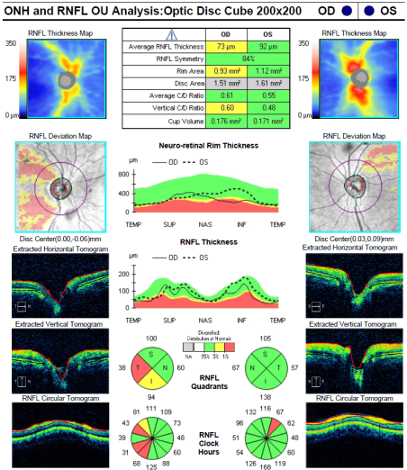
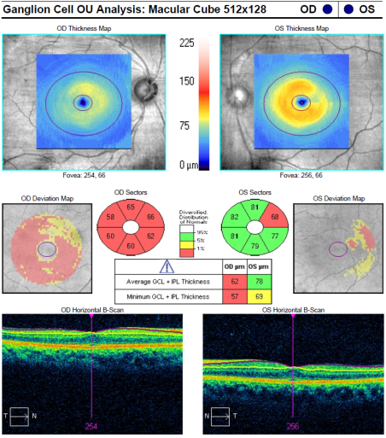
Optic Neuritis: Significant Axonal and Neuronal Loss
Optical coherence tomography (OCT) detects thinning of the retinal nerve fiber layer (RNFL) and ganglion cell + inner plexiform layer (GCIPL)
RNFL and GCIPL thinning substantial (20-40%)
Occurs early!
Notes:
Spectral-domain optical coherence tomography (SD-OCT) is a high-resolution imaging technique that detects thinning of the retinal nerve fiber layer (RNFL, includes ganglion cell layer axons) and the ganglion cell + inner plexiform layer (GCIP) with great precision and reproducibility in eyes of patients with MS. Studies of Drs. Fiona Costello, David Miller and others have established that acute optic neuritis is anything but benign with respect to axonal and neuronal loss captured by OCT. A paper published last year by Dr. Mark Kupersmith showed us some evidence that RNFL and ganglion cell layer thinning occur quite early in the course of optic neuritis. What would be the inter-eye difference in these measurements that correlates with the presence of an optic nerve lesion?

Slide 6
Purpose
To determine optimal thresholds for inter-eye difference in RNFL and GCIPL thicknesses in an international cohort that are most predictive of an optic nerve lesion
To determine how vision and vision-specific QOL are affected above these threshold values
Notes:
The purpose of this investigation was to determine optimal thresholds for inter-eye difference in RNFL and GCIP thickness as measured by OCT that are most predictive of a history of acute unilateral ON, and that can thus identify the presence of an optic nerve lesion by an imaging criteria. We also sought to evaluate how inter-eye differences affected low-contrast letter acuity and vision specific quality of life.

Slide 7
Participants
Collaborative study of visual outcome measures in MS
Nine centers part of IMSVISUAL
Disease-free controls
No history of comorbid ocular conditions
Notes:
Participants with MS and disease-free controls aged 18 years or older were included for this analyses as part of a multi-site 9 center collaborative study of IMSVisual. We now have collaborations from 11. We are putting together manuscript. Patients with acute ON, ocular co-morbidities or other conditions that could affect RNFL or ganglion cell layer thinning not related to MS were excluded from this convenience sample study.

Slide 8
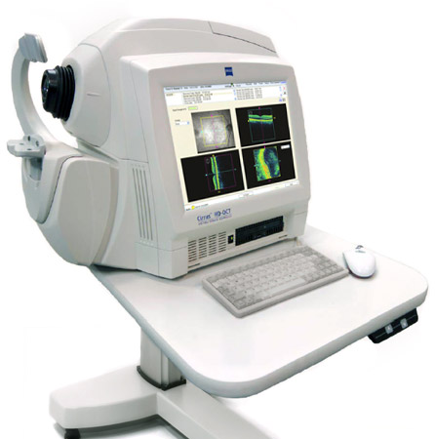
Optical Coherence Tomography (OCT)
SD-OCT
Peripapillary retinal nerve fiber layer (RNFL) thickness
Macular ganglion cell + inner plexiform layer (GCIPL) thickness
Notes:
Spectral-domain OCT imaging was performed by a trained technologist using either Spectralis or Cirrus OCT. Peripapillary RNFL thickness was measured on Spectralis using a 3.5 mm diameter circle centered on the optic disc. On the Cirrus OCT, the ONH Cube 200x200 scan was used to measure peripapillary RNFL thickness and the the standard macular volume cube 512x128 was used to measure macular ganglion cell layer thickness.

Slide 9
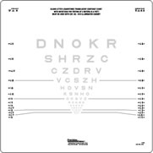
Vision Testing
High-Contrast Visual Acuity (various methods)
Low-contrast letter acuity (Sloan 2.5% and 1.25% charts)
Monocular and binocular acuities
Notes:
Visual assessments were performed by trained technicians.
Low-contrast letter acuity testing was performed for each eye at 2.5% and 1.25% contrast levels using standardized Sloan charts.
All charts were scored by counting the numbers of letters read correctly; both monocular and binocular acuities with both eyes open were measured.

Slide 10
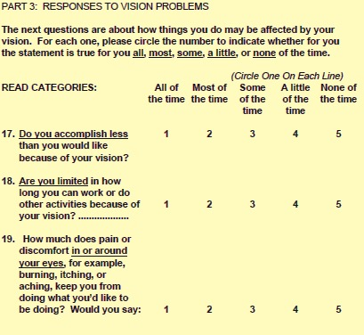

Quality of Life (QOL) Scales
25-Item NEI Visual Functioning Questionnaire (NEI-VFQ-25)
10-Item Neuro-Ophthalmic Supplement
Notes:
Participants self-administered the 25-Item National Eye Institute Visual Functioning Questionnaire (NEI-VFQ-25) and the 10-Item Neuro-Ophthalmic Supplement.
The Supplement was developed as a useful measure of vision-specific QOL that complements the NEI-VFQ-25 in people with neuro-ophthalmologic conditions, including optic neuritis and MS.
Questions for the NEI-VFQ-25 and 10-Item Supplement are in a Likert scale format with responses on a 1-5 scale.

Slide 11
Results
The 95th percentile value for inter-eye RNFL difference was 7.0 microns among healthy controls (n=348); for GCIPL, 3.0 microns
Optimal RNFL inter-eye difference of 5 microns for identifying patients with unilateral ON (n=404) in the MS cohort
Optimal GCIPL inter-eye threshold of 4 microns
Notes:
RNFL and GCIP thicknesses were similar between right and left eyes among 1346 patients with MS and 348 disease-free controls. The 95th percentiles for RNFL and for GCIPL thickness inter-eye differences in the healthy control group were calculated to be 7 microns for RNFL and 3 microns for GCIPL. Receiver operating characteristic (ROC) curve analysis examining RNFL thickness inter-eye difference as a continuous variable demonstrated an optimal threshold of 5 microns; this is the value on the ROC curve that optimizes both sensitivity and specificity for distinguishing patients with MS with vs. without a history of acute unilateral ON in the convenience sample cohort. For GCIPL, the ROC curve demonstrated an optimal value of 4 microns.
And we found that, among 247 patients with MS analyzed in the cohort with complete measures of vision, OCT and quality of life, 128 had a history of acute optic neuritis, about 52%.
This number is representative of reports from previous MS cohorts.
Vision-specific quality of life was reduced even among the subset of patients with history of optic neuritis and 20/40 or better visual recovery.
And those patients with history of ON overall had better QOL scores if their binocular low-contrast acuities were greater.

Slide 12
Inter-Eye Differences
RNFL
GCIPL
Notes:
These boxplots demonstrate the spread of the inter-eye differences for RNFL on the left and GCIPL on the right. On the left hand side of each graph is the controls, and the right side the MS patients. Both mean and median inter-eye differences were higher in the MS group. Median values, Box is IQR range. Different measures (different scales on Y axis) for what’s expected. In healthy controls, expect RNFL total of 100 microns, 7 microns is upper boundary of what’s expected, with a few outliers)

Slide 13
Receiver Operating Characteristic (ROC) Curves
RNFL
GCIPL
Notes:
A receiver operating characteristic (ROC) curve was constructed to identify the cutoff value for inter-eye RNFL thickness difference that optimizes both sensitivity and specificity for distinguishing convenience sample MS patients with vs. without a history of acute unilateral ON. The left graph is for RNFL and the right is for GCIPL. The red arrow denotes where the tangent line to the curve is, and thus where the maximum point for sensitivity and specificity is. The optimal point for RNFL is 5 microns, and GCIP is 4 microns. The area under the curve is a measure for how well these thresholds can distinguish between those who have a history of ON and those who do not have a history of ON. The areas under the curves are similar for both RNFL and GCIP ( 0.74 and 0.73 respectively).

Slide 14
Inter-eye LCLA and GCIPL
Notes:
The relation of low-contrast acuity, to inter-eye differences in RNFL and GCIP thickness was examined using linear regression models, accounting simultaneously for age. There was a clear positive correlation between inter-eye LCLA and GCIPL inter-eye differences; as the inter-eye GCIPL increases, the inter-eye LCLA increases, with a p-value of 0.002. This graph shows the GCIPL inter-eye difference on the y-axis and the inter-eye LCLA differences at the 2.5% contrast level on x-axis. There was a similar trend for RNFL thickness with a p-value of 0.001.

Slide 15
Conclusions
Optimal thresholds for validating an optic nerve lesion:
5-micron difference in RNFL thickness
4-micron difference in GCIP thickness
Identify visual impairment in MS
Further studies underway to validate use in diagnostic criteria for MS
Notes:
We have learned an enormous amount over the past decade about optic neuritis in MS. OCT RNFL and ganglion cell layer thickness measurements can strengthen clinical and radiological MS diagnostic criteria and may be able to identify subclinical optic nerve demyelination. Adding evidence of an optic nerve lesion to the diagnostic criteria for MS may further refine the accuracy of diagnosis. A 5-micron difference in RNFL thickness and a 4-micron difference in GCIP thickness are robust measures for predicting an optic nerve lesion. Further, inter-eye differences above these thresholds correlate with visual disability in MS. Further studies are underway to maximize the accuracy, precision, generalizability and utility for these thresholds for use in the diagnostic criteria for MS.
Notes:
This is a starting point. Add in methods data sharing agreement. Ask Shiv if he has a word file for Annals.

