Slide 1


Derivation and Validation of a Predictive Model for 30-day Readmission Risk in Patients with Multiple Sclerosis
Kanika Sharma, MD
Yubo Gao, PhD
Junlin Liao, PhD
John A Kamholz, MD, PhD
Frank Bittner, DO
Piyush Kalakoti, MD
Department of Neurology
University of Iowa Hospitals and Clinics, IC, IA
2018 CMSC Annual Meeting

Slide 2
Derivation and Validation of a Predictive Model for 30-day Readmission Risk in Patients with Multiple Sclerosis
I have no conflicts related to this talk
Kanika Sharma, MD

Slide 3

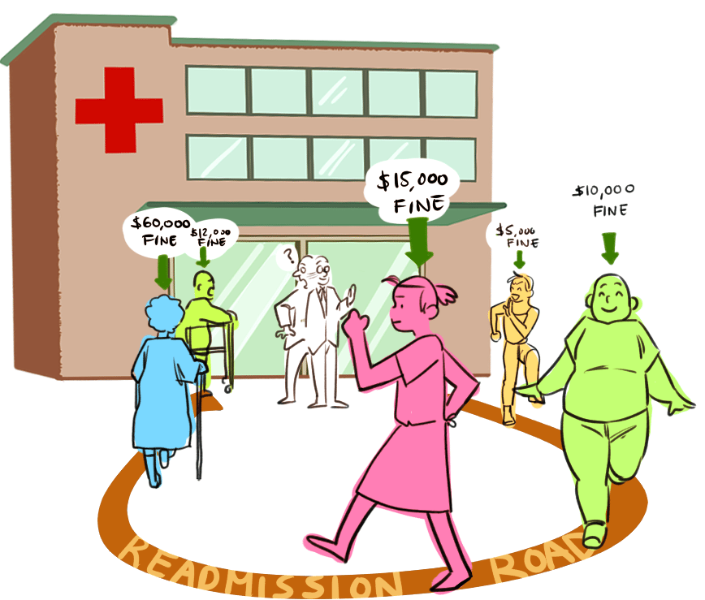
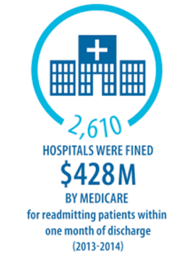
Background
Recent seismic reforms in healthcare impose financial penalties on hospitals based on their performances that includes assessment of readmission rates.
Notes:
Recent seismic reforms such as the HRRP (Hospital Readmission Reduction Program) impose financial penalties on hospitals based on their performances that includes assessment of readmission rates. In 2013-2014, the CMS penalized over 2600 hospitals cumulative of $428 million for 30-day readmissions.

Slide 4
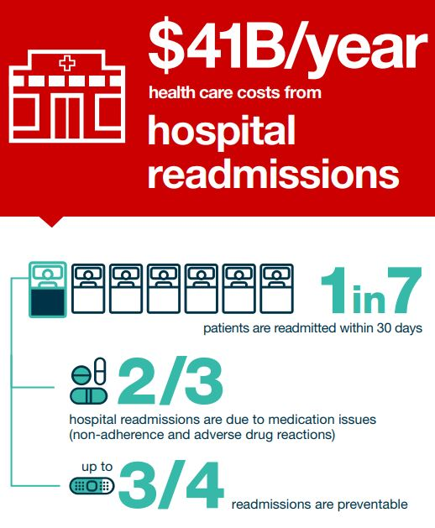
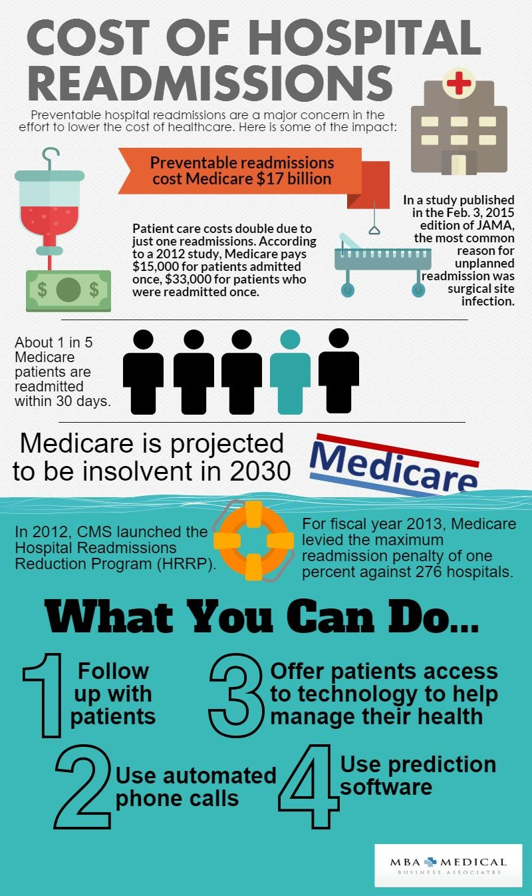
Colossal economic implications!
Notes:
Annual costs associated with readmissions account for a staggering $41 billion. Medicare alone bears $17 billion annually for preventable readmissions with 1 out of 5 Medicare beneficiaries incurring a 30-day readmission.

Slide 5
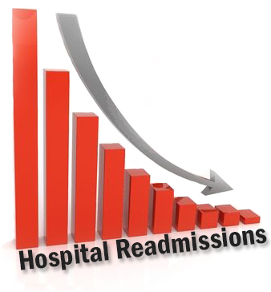
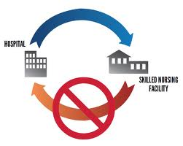
Background
To optimize outcomes and enhance quality of care delivered to patients with multiple sclerosis (MS), identifying inherent risks associated with readmissions to implement appropriate preventive measures for modifiable risk-factors is warranted.

Slide 6
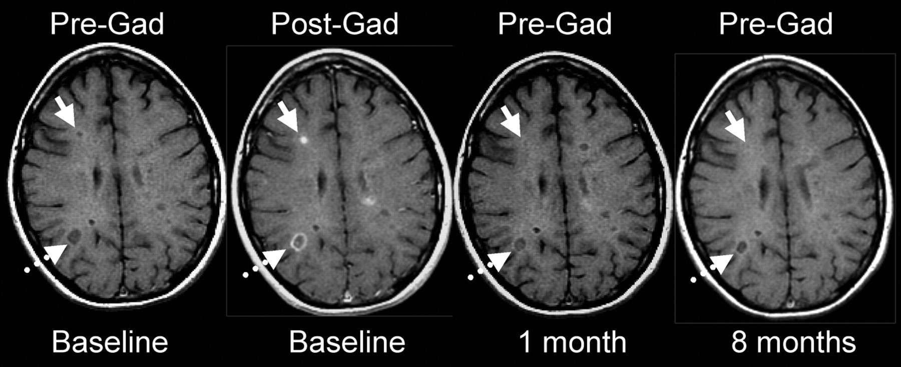
Objective
The current study seeks to develop and validate a predictive model of 30-day readmission risk in MS patients.

Slide 7
Materials and Methods
National Readmission Database (NRD) 2013-2014
Over 14 million discharges each year (unweighted) from 20+ HCUP State Inpatient Databases (SIDs)
When weighted, NRD represents approximately 50 percent of all US hospitalizations for a given year (>35 million discharge/year).
Database allows longitudinal tracking of patients using unique linkage identifiers
Cohort: All patients discharged following index hospitalization with MS identified by ICD-9
diagnosis code 340
Adults ≥ 18 years of age and non-elective admissions
Exclusion: December admissions, transfers, same day events and those dead during initial hospitalization were excluded for 30-day readmission analysis
Notes:
In an observational cohort study, we utilized the National Readmission Database (NRD) for the years 2013-14. The NRD is a relatively new HCUP dataset compiled by the AHRQ [Agency for Healthcare Research & Quality].
The NRD contains data from State Inpatient Databases and contains over 14 million discharge records for each year.
The dataset contains weights provided by the HCUP to produce national estimates. When weighted, the NRD presents approximately 50 percent of all US hospitalizations for a given year, translating to over 35 million discharge/year.
Using appropriate ICD9 coding definitions, adult patients discharged following index hospitalization with Multiple Sclerosis were tracked to identify 30-day readmission status. Diagnosis of MS relied upon the use of ICD-9 coding definition, i.e. diagnosis code 340.
For analysis pertaining to 30-day readmission risks, the cohort was subjected to appropriate filtering. December admissions, transfers, same day events and those that were coded as incurring mortality during initial hospitalization were excluded.

Slide 8

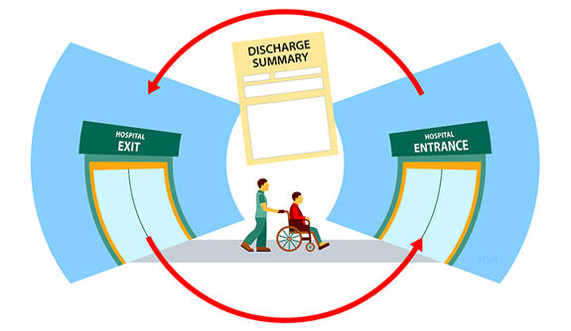
Materials and Methods
Primary outcome measures:
Common causes of 30-day readmissions
Risk factors associated with readmission
Notes:
Primary outcome measures were common causes of 30-day readmissions in MS patients and also to identify factors associated with it.

Slide 9

Materials and Methods
Exposure variables:
Patient demographics (age, gender, payer, income)
Hospital characteristics (bedsize, teaching status, ownership)
Admission characteristics (weekend, # inpatient procedures)
Smoking, alcohol abuse, and 26 comorbidities
Treatment characteristics
Disease modifying therapy
Intravenous steroids
Plasmapheresis
Diagnostic procedures
Imaging (CT, MRI)
Lumbar puncture
Complications
Venous thromboembolism
Acute renal failure
Discharge disposition
Notes:
The model was adjusted for patient demographics, hospital and admission characteristics, and clinical parameters. The latter included list of 26 general and MS specific comorbidities, treatment and diagnostic procedures, complications (renal and venous thromboembolic events), addictions (smoking, drug/alcohol abuse) and discharge disposition

Slide 10
Statistical Analysis
Multivariable log-binomial model fitted with generalized estimating equation to account for clustering of outcomes by hospitals was employed to identify factors independently associated with 30-day readmission risk.
Model validation was performed by evaluating the impact on c-statistics (area under curves) using 50-bootstrapped replacement samples and comparing the area under the receiver-operating characteristics (AUROC) curve with the derivation model.
Notes:
Taking into account the structure of the database, multivariable log-binomial model fitted with generalized estimating equations (GEE) to account for clustering of outcomes by hospitals was employed,
The model was adjusted for all exposures/risk factors previously listed and the impact of individual factor with the risk of 30-day readmission was assessed.
Following model derivation, internal validation was performed by evaluating the impact on c-statistics (area under curves) using 50-bootstrapped replacement samples, and comparing the area under the receiver-operating characteristics (AUROC) curve with that of the derivation model.

Slide 11
Results
15,687 patients registered in the NRD 2013-14 had a prior index admission for MS.
Median age: 44 years
73% female
Rate of 30-day readmission: 10.4% (n=1624)
Higher with advancing age (mean: 46 vs 44 years; p<0.001)
More in men (11.3% vs 10% in women; p=0.016)
Higher with Medicare (13.3% vs 8.7%; p<0.001) whereas significantly lower in privately insured patients (7.3% vs 11.8%; p<0.001) and uninsured patients (7.1% vs 10.5%; p=0.002)

Slide 12
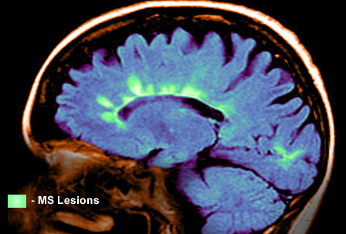
Results
Common causes of readmission:
Exacerbation of MS (44.5%)
Urinary tract infections (5.6%)
Ear related issues (5.23%)
Respiratory conditions (4.68%)
Gastro-intestinal conditions (3.82%)
Psychiatric disorders (3.69%)

Slide 13
Notes:
The forest plot diagram depicts factors associated with 30-day readmission risk in MS patients. Error bars on the right side of the vertical line demonstrates higher risk while those to the left represents low readmission risks.
Factors associated with lower odds of readmission include female gender(OR:0.8;p=0.002), private insurance(OR:0.7;p<0.001), private hospitals and those receiving steroids(OR:0.7;p=0.03).
Comorbidities [morbid obesity(OR:1.2; p=0.036), hypothyroidism(OR:1.2; p=0.045), diabetes (OR:1.3;p=0.003), fluid/electrolyte disorder(OR:1.3;p<0.001), hypertension(OR:1.2;p=0.001), arthritis(OR:2.0;p<0.001), depression (OR:1.2;p=0.025), psychosis(OR:1.3;p=0.002), bowel/bladder dysfunction(OR:1.4;p<0.001)], complications [venous thromboembolism(OR:1.9;p=<0.001), acute renal failure (OR:1.5;p=0.015)], patients leaving against medical advice(OR:2.2;p<0.001) and those on intravenous immunoglobulins(OR:1.6;p=0.002), were associated with higher odds of readmission.

Slide 14
Notes:
The forest plot diagram depicts factors associated with 30-day readmission risk in MS patients. Error bars on the right side of the vertical line demonstrates higher risk while those to the left represents low readmission risks.
Factors associated with lower odds of readmission include female gender(OR:0.8;p=0.002), private insurance(OR:0.7;p<0.001), private hospitals and those receiving steroids(OR:0.7;p=0.03).
Comorbidities [morbid obesity(OR:1.2; p=0.036), hypothyroidism(OR:1.2; p=0.045), diabetes (OR:1.3;p=0.003), fluid/electrolyte disorder(OR:1.3;p<0.001), hypertension(OR:1.2;p=0.001), arthritis(OR:2.0;p<0.001), depression (OR:1.2;p=0.025), psychosis(OR:1.3;p=0.002), bowel/bladder dysfunction(OR:1.4;p<0.001)], complications [venous thromboembolism(OR:1.9;p=<0.001), acute renal failure (OR:1.5;p=0.015)], patients leaving against medical advice(OR:2.2;p<0.001) and those on intravenous immunoglobulins(OR:1.6;p=0.002), were associated with higher odds of readmission.

Slide 15
Notes:
The forest plot diagram depicts factors associated with 30-day readmission risk in MS patients. Error bars on the right side of the vertical line demonstrates higher risk while those to the left represents low readmission risks.
Factors associated with lower odds of readmission include female gender(OR:0.8;p=0.002), private insurance(OR:0.7;p<0.001), private hospitals and those receiving steroids(OR:0.7;p=0.03).
Comorbidities [morbid obesity(OR:1.2; p=0.036), hypothyroidism(OR:1.2; p=0.045), diabetes (OR:1.3;p=0.003), fluid/electrolyte disorder(OR:1.3;p<0.001), hypertension(OR:1.2;p=0.001), arthritis(OR:2.0;p<0.001), depression (OR:1.2;p=0.025), psychosis(OR:1.3;p=0.002), bowel/bladder dysfunction(OR:1.4;p<0.001)], complications [venous thromboembolism(OR:1.9;p=<0.001), acute renal failure (OR:1.5;p=0.015)], patients leaving against medical advice(OR:2.2;p<0.001) and those on intravenous immunoglobulins(OR:1.6;p=0.002), were associated with higher odds of readmission.

Slide 16
Notes:
The forest plot diagram depicts factors associated with 30-day readmission risk in MS patients. Error bars on the right side of the vertical line demonstrates higher risk while those to the left represents low readmission risks.
Factors associated with lower odds of readmission include female gender(OR:0.8;p=0.002), private insurance(OR:0.7;p<0.001), private hospitals and those receiving steroids(OR:0.7;p=0.03).
Comorbidities [morbid obesity(OR:1.2; p=0.036), hypothyroidism(OR:1.2; p=0.045), diabetes (OR:1.3;p=0.003), fluid/electrolyte disorder(OR:1.3;p<0.001), hypertension(OR:1.2;p=0.001), arthritis(OR:2.0;p<0.001), depression (OR:1.2;p=0.025), psychosis(OR:1.3;p=0.002), bowel/bladder dysfunction(OR:1.4;p<0.001)], complications [venous thromboembolism(OR:1.9;p=<0.001), acute renal failure (OR:1.5;p=0.015)], patients leaving against medical advice(OR:2.2;p<0.001) and those on intravenous immunoglobulins(OR:1.6;p=0.002), were associated with higher odds of readmission.

Slide 17
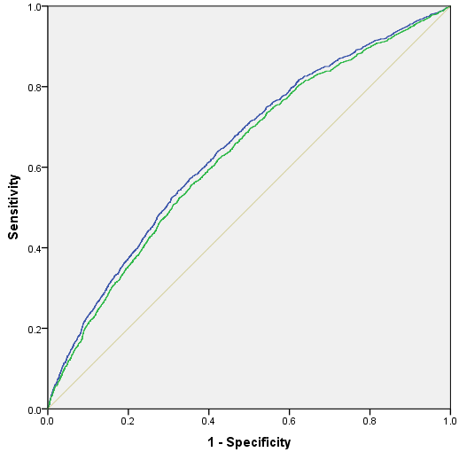

Model Validity
Notes:
The model depicted reasonable validity or discriminatory ability as demonstrated by an area under the receiver operating characteristic (ROC) curve of approximately 0.65.
The AUROC following model validation using bootstrapping was 0.64, demonstrating less than 2% difference in the c-statistics across derivation and internal validation.

Slide 18
Discussion
Using an all-payer, national database, the study quantified risk estimates associated with 30-day readmissions in MS patients.
Comorbidities and complication (“never events” such as thromboembolic events, acute renal failure) were associated with 30-day readmission rates.

Slide 19
Discussion
The proposed validated model (app) can potentially be utilized by patients, providers, stakeholders and policy makers to assess individualized risks, shared decision-making and guiding the process of patient counselling and informed consent.
Future implications is to integrate the model findings into publicly available web-based and mobile-based clinical utility apps aka “risk calculators” for wider dissemination for baseline estimation

Slide 20

Limitations
Administrative database
Coding inaccuracies
Residual confounding
Lack of pertinent parameters that may influence our derived estimates include pertinent functional outcome assessments, severity scores, granularity in pharmacological interventions and radiological findings.
Cannot predict causality but only tests for associations
Notes:
Limitations governing the use of administrative databases apply to the present investigation. This includes coding inaccuracies including underreporting of events. Residual confounding from lack of pertinent parameters that may influence our derived estimates include pertinent functional outcome assessments, severity scores, granularity in pharmacological interventions and radiological findings.

Slide 21

Thank You for your attention!
Notes:
I thank you for your attention.

