Slide 1

WWW.NARCRMS.ORG

Slide 2



  Kottil Rammohan, MD, University of Miami; Anne H. Cross, MD, Washington University in St. Louis; David Jones, MD, University of Virginia (UVA); June Halper, MSN, APN-C, MSCN, FAAN, Consortium of MS Centers (CMSC); Sara McCurdy Murphy, BA, Social & Scientific Systems, Inc. (SSS); Lisa Patton, BS, Social & Scientific Systems, Inc. (SSS); Edward Fox, MD, PhD, Central Texas Neurology Consultants; Lori Mayer, DNP, MSN, RN, Central Texas Neurology Consultants; Michael Racke, The Ohio State University (OSU)

Slide 3
Funding and Disclosures:
Supported by the Consortium of Multiple Sclerosis Centers and receives funding from several pharmaceutical industry sponsors including Biogen Idec, Inc., Celgene Corporation, EMD Serono, Genentech Inc., Genzyme, Novartis Pharmaceutical Corporation and Teva Pharmaceuticals.
Dr. Cross is funded in part by the Manny & Rosalyn Rosenthal-Dr. John L. Trotter MS Chair of Barnes-Jewish Hospital Fdn.
Dr. Cross has performed paid consulting for: AbbVie, Bayer, Biogen, EMD Serono, Genentech/Roche, Genzyme/Sanofi, Novartis and Teva within the past 3 years.
Dr. Rammohan receives support for Consulting and Ad Boards from Biogen, EMD Serono, Genzyme, Genentech , Novartis.
Dr. Rammohan has grants from Biogen, EMD Serono, Genzyme, Genentech, Novartis. Department of Defense,

Slide 4
Background of The North American Registry for Care and Research in MS (NARCRMS)
  Numerous databases exist internationally, but until recently a database linking MS centers in the US and Canada has been lacking.
  NARCRMS is the first database to link MS Centers in the US and Canada.
  This North American database will allow stakeholders to freely access de-identified data.

Slide 5
Goals of NARCRMS
  Develop a clinician-based database linking MS centers across North America
  Establish a national registry to acquire longitudinal data including clinical and patient-based information
  Establish “Cores” of repositories of clinical, genetic, and imaging data, and various biomaterials for developing biomarkers for MS
  Develop Research Interest Groups from within participating centers to address specific unanswered questions related to MS.
  Promote collaborative efforts to utilize the data as they become available

Slide 6
Design/Methods:
  NARCRMS is a special project of the Consortium of Multiple Sclerosis Centers (CMSC) with oversight by the CMSC Board of Governors
  Director: Kottil Rammohan MD, Professor of Neurology, University of Miami
  Associate Director: David K. B. Li MD, Professor of Radiology, University of British Columbia.
  Funding currently from CMSC and several industry supporters
  The NARCRMS Steering Committee sets operating policies, and is planning for collaborations with other registries
  HIPAA-compliant registry uses the OpenClinica application with password policies, audit history, and other safeguards.

Slide 7
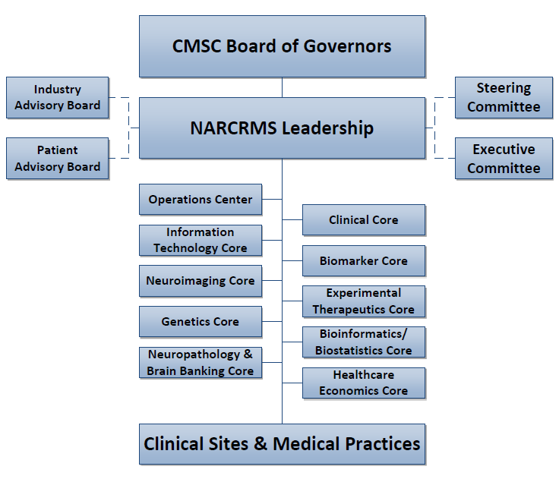
NARCRMS Org Chart

Slide 8
Neuroimaging Core
  The University of British Columbia (UBC) was selected to serve as the NARCRMS Neuroimaging Core.
  UBC is now working with the University of Miami to conduct test uploads of neuroimages and to finalize the Neuroimaging Core SROPs.
  The Neuroimaging Core will begin working with enrolling sites this year to collect neuroimages from previously enrolled and newly enrolled subjects.

Slide 9
Patient Advisory Board (PAB)
  Launched in early 2018 to advise NARCRMS on the following topics:
    What data should be shared with participants and the general public and when.
    How to disseminate data (web based; enduring programs; printed material)
    The PAB will review all material for patients and their families for appropriateness based on participants educational level, ethno-cultural background, and need for information.
    The PAB will also assist in participant recruitment as deemed necessary and appropriate by the scientific leadership.
  The PAB currently has 8 members who were recruited with assistance from the MSAA and is expected to grow to over 30 members in the future.

Slide 10
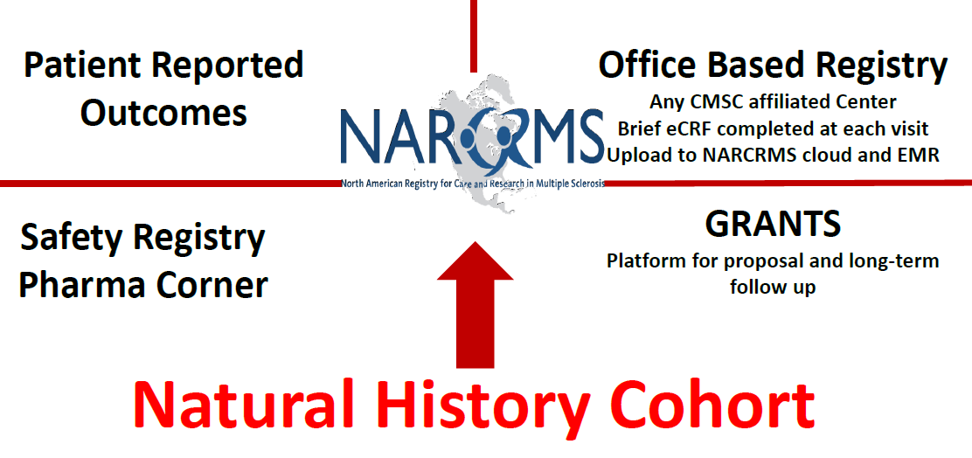
Many Faces of NARCRMS

Slide 11
Enrollment Criteria:
  Inclusion Criteria
  Age 18 to 65 years
  Relapsing-Remitting or Progressive MS with clear date of MS onset within prior 15 years
  In patients with Progressive MS (where the date of onset is sometimes less clear), the date of onset is the date at which the first neurological symptom was identified
  EDSS of 6.5 or less
  Evidence of Clinical Isolated Syndrome (CIS) typical of demyelination
  Willingness to participate and contribute data on an on-going basis
  Exclusion Criteria
  Unclear date of onset. Onset with symptoms of fatigue, malaise, pain and other vague symptoms without a definable neurological symptom-onset date.
  Concomitant confounding disorders like neuromyelitis optica and idiopathic isolated transverse myelitis, and/or known autoimmune disorders that can cause neurological disorders, etc.
  Participants with co-morbidities, including other autoimmune disorders, are eligible to participate as long as the diagnosis of MS is well established.
  Unwilling to participate for ongoing follow up collection of data.
  Any other factor that in the opinion of the PI will render the individual unsuitable for participation.

Slide 12
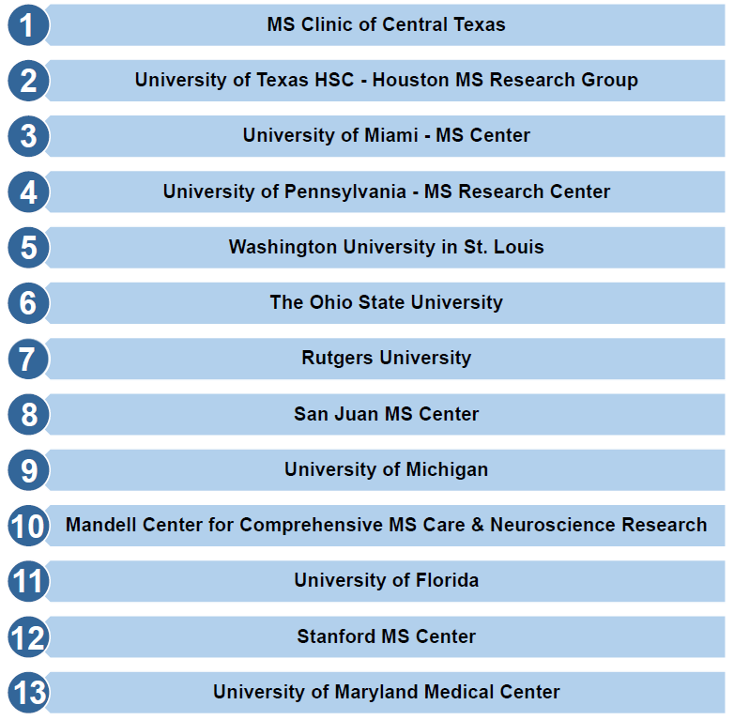
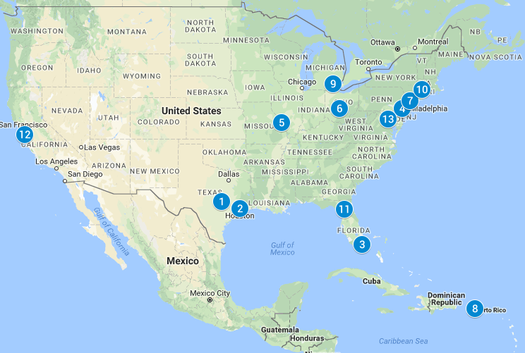
12 currently enrolling sites
(20 to 25 planned):

Slide 13
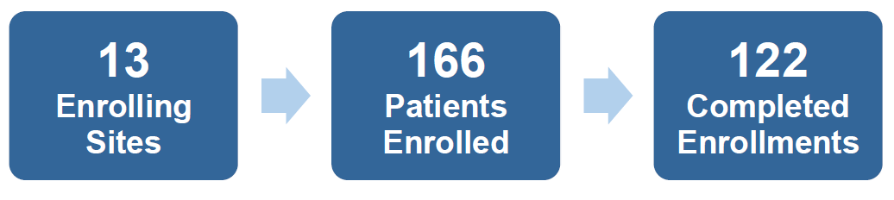
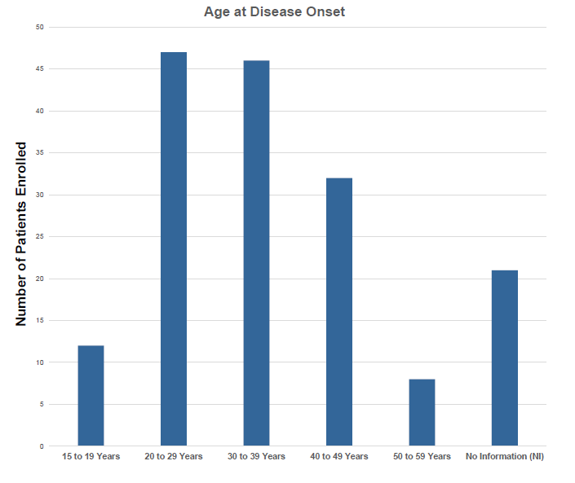
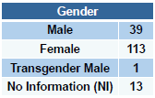
Results: Enrollment and Demographics*
74% female
* As of May 11, 2018

Slide 14
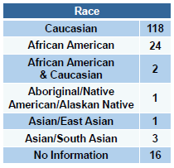
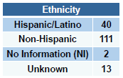
Results: Enrollment and Demographics*
24% Hispanic
71% Caucasian
14% African American
3% other
* As of May 11, 2018

Slide 15
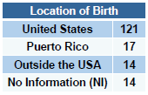
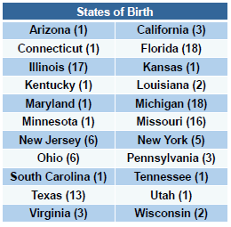
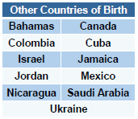
Results: Enrollment and Demographics*
83% US Born (22 states + Puerto Rico)
11 other countries of birth
* As of May 11, 2018

Slide 16
Summary
  20 to 25 sites planned
  Total enrollment planned at least 1,000
  Biomarkers (blood) and Neuroimaging repositories
  Current 155 enrolled:
    71% Caucasian, 14% African American, 3% other
    83% born in the USA, representing 22 states & Puerto Rico (10% born in Puerto Rico)
  11 other countries of birth represented

Slide 17
Future Plans
  Expand total sites to 20 to 25 with focus on sites west of the Mississippi and Canada
  Expand Repositories for biomaterials
  Develop Research Interest Groups within sites (including outside collaborators)
  Develop collaborations with other large databases
  Provide NARCRMS subjects with access to a subject-portal to collect patient reported outcomes

