Slide 1
Phase 2 Multicenter Study Results of Ublituximab, a Novel Glycoengineered Anti-CD20 Monoclonal Antibody (mAb), in Patients with Relapsing Forms of Multiple Sclerosis (RMS)
Edward Fox, MD, PhD

Slide 2
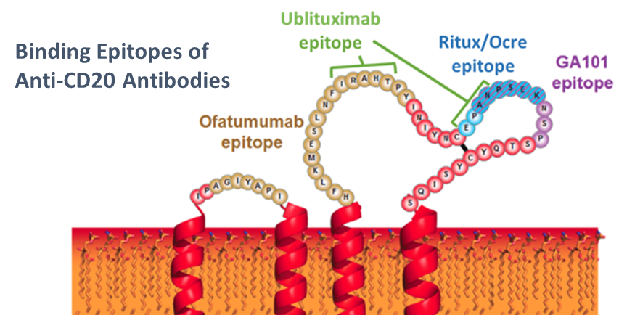
Ublituximab (TG-1101)
Novel Glycoengineered Anti-CD20 mAb
Unique protein sequence
Type 1 Chimeric IgG1 mAb
Potential advantages over current standard of care:
Glycoengineered for significantly enhanced ADCC
Activity in “low” CD20 expressing cell lines, a characteristic of rituximab resistance
Binds to a novel epitope on CD20
2
Source: Adapted from Ruuls et al 2008

Slide 3
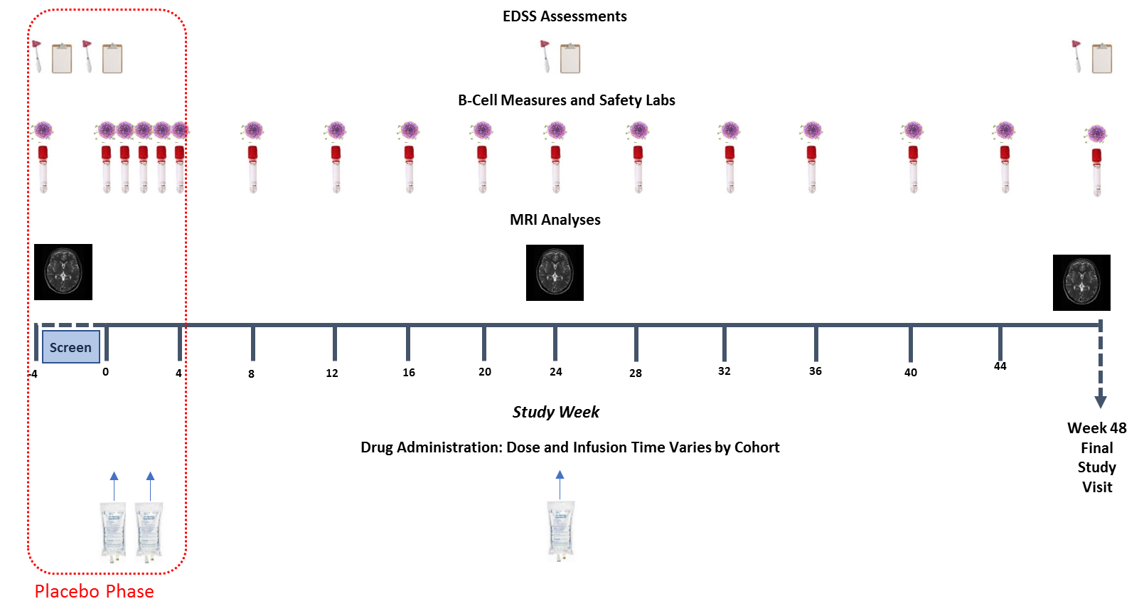
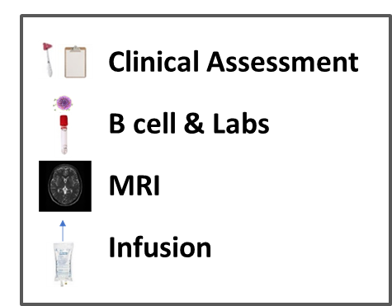
Ublituximab Phase II: Design
3

Slide 4
Ublituximab Phase II: Design
 | Randomization | Treatment Period
Cohort | Treatment | Day 1/ Infusion Time | Day 15/ Infusion Time | Week 24/ Infusion Time
1 | Placebo (n=2) | Placebo / 4h | Placebo / 3h | -
 | UTX (n=6) | 150 mg / 4h | 450 mg / 3h | 450 mg / 1.5h
2 | Placebo (n=2) | Placebo / 4h | Placebo / 1.5h | -
 | UTX (n=6) | 150 mg / 4h | 450 mg / 1.5h | 450 mg / 1h
3 | Placebo (n=2) | Placebo / 4h | Placebo / 1h | -
 | UTX (n=6) | 150 mg / 4h | 450 mg / 1h | 600 mg / 1h
4 | Placebo (n=2) | Placebo / 3h | Placebo / 1h | -
 | UTX (n=6) | 150 mg / 3h | 600 mg / 1h | 600 mg/ 1h
5 | Placebo (n=2) | Placebo / 2h | Placebo / 1h | -
 | UTX (n=6) | 150 mg / 2h | 600 mg / 1h | 600 mg/ 1h
6 | Placebo (n=2) | Placebo / 1h | Placebo/ 1h | -
 | UTX (n=6) | 150 mg / 1h | 600 mg / 1h | 600 mg/ 1h

Slide 5
TG1101-RMS201 Phase ii Results Week 24 Results (48 Week Study)

Slide 6
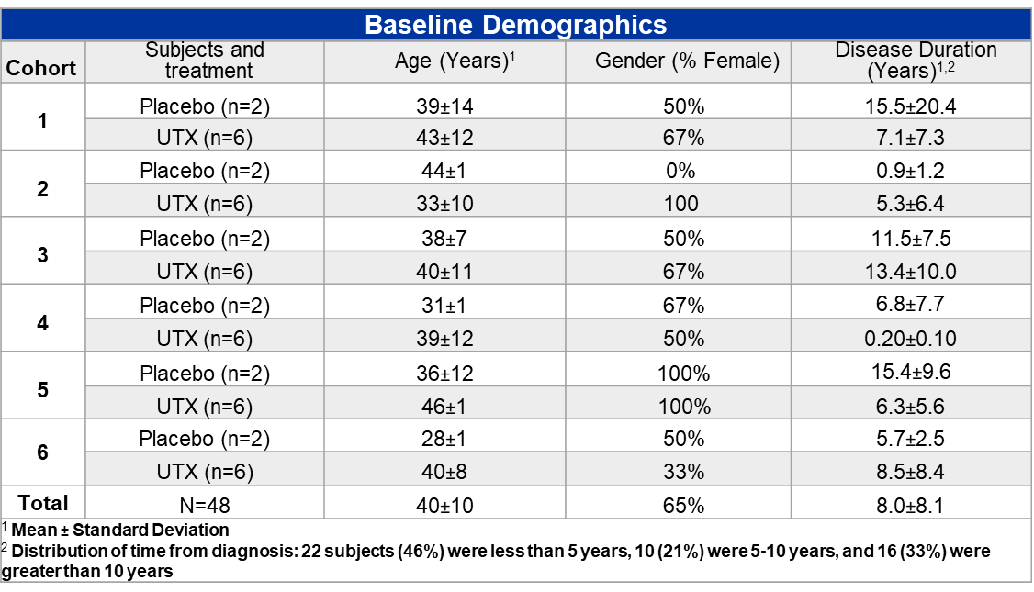
Ublituximab Phase II Week 24 Results: Baseline Characteristics

Slide 7
Ublituximab Phase II Week 24 Results: Patient Disposition
48 subjects were randomized to treatment in Cohort 1 through Cohort 6
46/48 subjects completed 6 months of ublituximab treatment; 12 (2 per cohort) received placebo infusions, before crossing over to the ublituximab arm
One subject in Cohort 2 withdrew from the study due to pregnancy, after having received 2 ublituximab infusions, but continued to be followed with safety lab monitoring and immunological analyses
One subject in Cohort 6 missed the week 24 infusion, and later withdrew

Slide 8
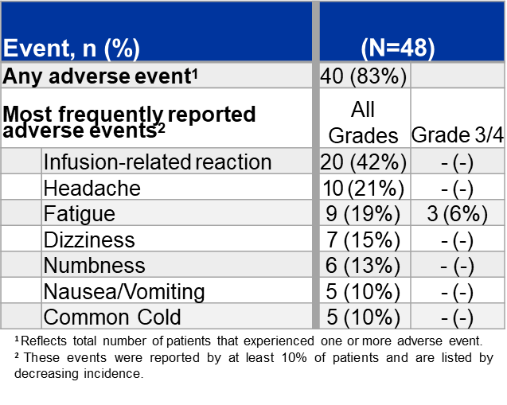
Ublituximab Phase II Week 24 Results: Safety & Tolerability
8

Slide 9
Ublituximab Phase II Week 24 Results: Safety & Tolerability
Ublituximab was well tolerated and no drug related discontinuations from study have occurred to date
No Grade 3/4 Adverse Events (AEs) were deemed possibly related to ublituximab
A total of 41 infusion related reactions (IRRs) were reported in 20 subjects. All were Grade 1 or Grade 2
There were no events of death reported on study
The Data Safety Monitoring Board (DSMB) has reviewed safety labs and adverse events for all subjects to date, and has not found any lab abnormalities or safety signals that would warrant a change in protocol

Slide 10
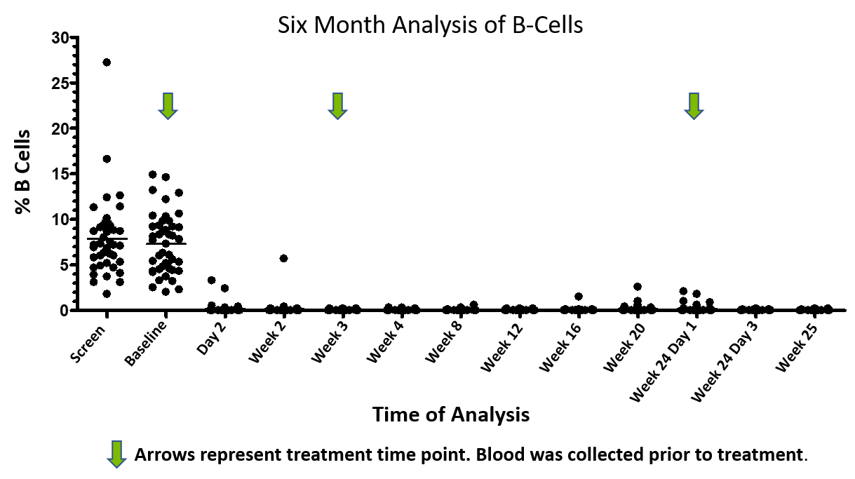
Ublituximab Phase II Week 24 Results: B-Cell Depletion
At week 4, median 99% B cell depletion was observed and maintained at week 24 (n=44)

Slide 11
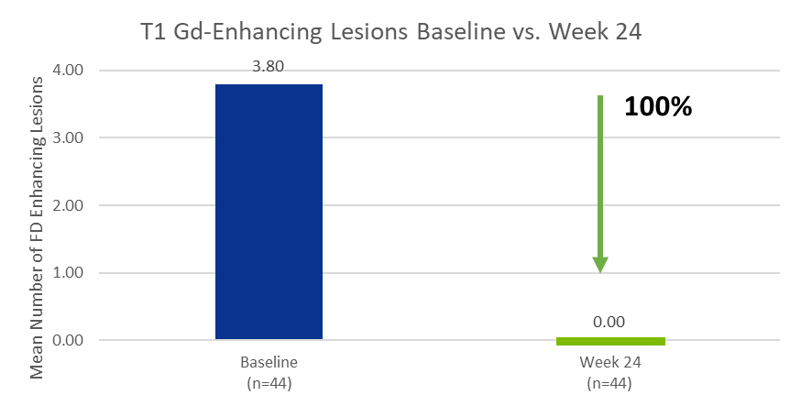
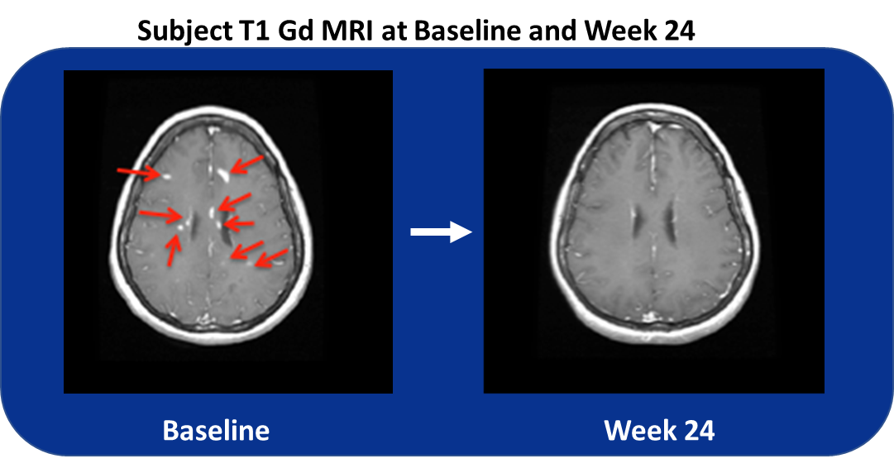
Ublituximab Phase II Week 24 Results: MRI-Gd Enhancing Lesions
No T1 Gd-enhancing lesions detected in any subjects at Week 24 (n=44; p=0.003)
Mean number of T1 Gd lesions at baseline was 3.80
11

Slide 12
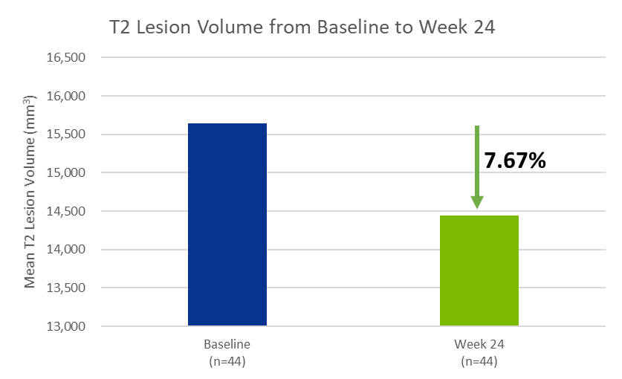
Ublituximab Phase II Week 24 Results: MRI-T2 Lesion Volume
There was a decrease of 7.67% (p=0.004) in T2 lesion volume at Week 24 compared to baseline
The mean number of New/Enlarging T2 lesions from baseline to Week 24 was 0.2 ± 0.45
12

Slide 13
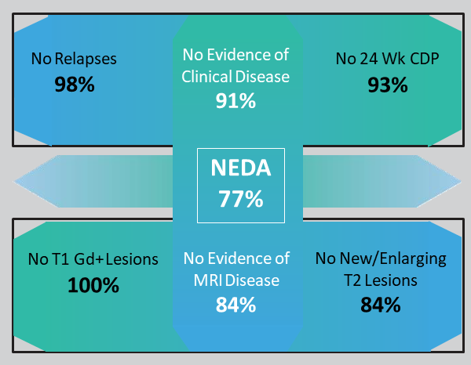
Ublituximab Phase 2 RMS Update: ARR/ NEDA
Annualized Relapse Rate (ARR): 0.05; (n=48)
At Week 24, 43* of 48 subjects had received all assessments to be evaluated for NEDA:
98% of subjects were relapse free
93% of subjects did not experience 24 week confirmed disability progression
100% of subjects did not have any Gd-enhancing lesions
84% of subjects did not have any new/enlarging T2 lesions
76% of subjects achieved clinical and MRI outcomes consistent with NEDA
3 of the total 48 patients did not have week 24 MRI, 1 patient did not have week 24 MRI or week 24 EDSS evaluation and 1 additional patient did not have a week 24 EDSS evaluation therefore only 43 patients had received all assessments to be evaluated for NEDA
CDP is defined as an increase of ≥ 1.0 point from the baseline EDSS score that is not attributable to another etiology (e.g. fever, concurrent illness, or concomitant medication) when the baseline score is 5.5 or less, and ≥ 0.5 when the baseline score is above 5.5.
13

Slide 14
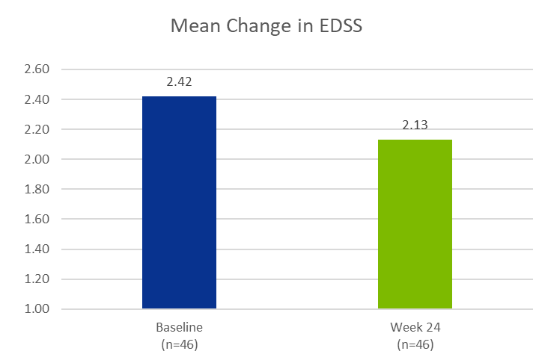
Ublituximab Phase II 24 Week Results: EDSS
* 2 of the total 48 patients did not complete the week 24 EDSS evaluation
83% of subjects showed improved or stable EDSS
Mean EDSS at baseline was 2.41 ±1.41; Median=2.5
At Week 24, the mean EDSS was 2.12. The mean change from baseline was an improvement of 0.29 ±0.93 points.
14

Slide 15
Conclusions
B-cells are efficiently depleted in most patients within 24 hours of receiving the first dose of ublituximab, with >99% depletion in all patients by Week 4, and significant reductions from baseline maintained at Week 24
Ublituximab was well tolerated and the most frequent AEs were infusion related reactions (IRRs); all Grade 1 or 2
A rapid infusion time, as low as one hour, of 450mg was well tolerated, produced high levels of B cell depletion and is now being studied in the Phase 3 ULTIMATE trials

Slide 16
Conclusions
An Annualized Relapse Rate (ARR) of 0.05 was observed at Week 24
No T1 Gd-enhancing lesions were detected in any subjects at Week 24
7.67% Reduction in T2 lesion volume at Week 24 from baseline, suggestive of a decrease in burden of disease
98% of subjects were relapse free at Week 24
83% of subjects showing improved or stable EDSS and Mean EDSS improvement from baseline of 0.29
Final results from this Phase 2 are expected to be presented at an upcoming major medical meeting and support the currently ongoing ULTIMATE Phase 3 trials in relapsing forms of Multiple Sclerosis (RMS)

Slide 17
Thank You to Our Study Sites
Hope Neurology, Knoxville, TN: Sibyl Wray, MD
Coordinator: Brenda Whitehead, CCRP
SC3 Research Group, Arcadia, CA: Richard Shubin, MD
Coordinator: Ngoc Nguyen
Ohio State University, Columbus, OH: Richard Kissel, MD
Coordinator: Misty Green
Associates in Neurology, Lexington, KY: Cary Twyman, MD
Coordinator: Laura Sanders, CCRC
Central Texas Neurology, Round Rock, TX: Edward Fox, MD, PhD
Coordinator: Lori Mayer, RN, PhD
University of Colorado, Aurora, CO: Timothy Vollmer, MD
Coordinator: Emil Diguilio
Neurology Center of San Antonio, TX: Ann Bass, MD
Coordinator: Tina Clements, RN, BSN
Holy Name Hospital, Teaneck, NJ: Mary Ann Picone, MD
Coordinator: Stacey Melvin, RN, BSN
Advanced Neurology, Fort Collins, CO: Tamara Miller, MD
Coordinator: Lillie Denny
Phoenix Neurological Associates: Barry Hendin, MD
Coordinator: Lynn Flynn

