Slide 1
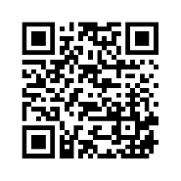


Prevalence of Cannabis Use and Associated Factors Among People With Multiple Sclerosis (PwMS): A 2020 NARCOMS Survey
Robert Fox MD,¹ Amber Salter PhD, MPH,² Gary Cutter PhD,³ Kathryn Nichol PhD,⁴ Joshua R. Steinerman MD,⁴ Karry M.J. Smith PhD, MPH⁴
¹Mellen Center for MS,Cleveland Clinic, Cleveland, OH, USA, MO, USA; ²Washington University
in St. Louis, St Louis; ³The University of Alabama at Birmingham, Birmingham, AL, USA;
⁴Greenwich Biosciences, Inc., Carlsbad, CA, USA
To obtain a PDF of this poster:
Scan the QR code or
Visit www.gwqrcodes.com/854813
Charges may apply. No personal information is stored.

Slide 2
Disclosures
This study was sponsored by GW Research Ltd (Cambridge, UK). All authors met the ICMJE authorship criteria and had full access to relevant data. Neither honoraria nor payments were made for authorship.
Author disclosures:
Amber Salter, Robert Fox, and Gary Cutter have consulted for, conducted studies funded by, or received honoraria for services provided to GW Pharmaceuticals companies.
Kathryn Nichol, Joshua R. Steinerman, and Karry M. J. Smithª are employees of Greenwich Biosciences, Inc.
Acknowledgments:
Medical writing and editorial assistance was provided to the authors by Jeanelle Spencer, PhD, and Dena McWain of Ashfield Healthcare Communications
First presented: American Academy of Neurology; Virtual Meeting; April 17–22, 2021
Contact Information: medinfo@greenwichbiosciences.com
ªKMJS was employed at Greenwich at the time work was completed.

Slide 3
Introduction
Approximately 95% of PwMS experience multiple symptoms, such as dysarthria, pain, fatigue, sleep disturbances, depression and anxiety, spasticity, mobility impairment, sexual dysfunction, and bladder and bowel dysfunction¹
Interest in the use of cannabis for managing multiple sclerosis symptoms continues to increase as more data become available and access becomes easier²
Recent regional surveys indicate that up to 74% of PwMS have considered cannabis products, and 25–54% have tried treating their symptoms with cannabis products^{3,4}
A supplemental survey was conducted on cannabis use in North American Research Committee on Multiple Sclerosis (NARCOMS) participants, evaluating:
demographic factors associated with cannabis use
symptoms PwMS attempt to treat with cannabis
patterns, preferences, and methods of use
reasons limiting cannabis use
References: 1. Henze T, et al. Der Nervenarzt. 2013;84(2):214-222. 2. Braley TJ, et al. Mult Scler J Exp Transl Clin. 2020;6(3):2055217320959816. 3. Rice J, et al. Mult Scler Relat Disord. 2020;6(41):102009. 4. Weinkle L, et al. Mult Scler Relat Disord. 2019;27:383-390.

Slide 4
Methods
Active US NARCOMS participants were invited to fill out an online supplemental survey
In the survey, “cannabis/marijuana” referred to products derived from the cannabis/marijuana plant
including smoking, vaping, eating, ingesting, or any other method of use
excluding hemp cannabidiol (CBD) or products marketed as CBD only
Level of spasticity, pain, and sleep symptoms were captured using a numeric rating scale
Prevalence of, and reasons for, using or not using cannabis were summarized using descriptive statistics
No Problems
Worst Problems
0
1
2
3
4
5
6
7
8
9
10
None
Mild
Moderate
Severe

Slide 5
Cannabis Use for MS and Baseline Characteristics
6934 active US NARCOMS participants were surveyed, of whom 3249 (47%) responded to the survey
 | Never users 69% (n=2228) | Past users 11% (n=376) | Current usersª 20% (n=636) | Total responders (N=3240)
Female, n (%) | 1745 (79) | 306 (83) | 465 (74) | 2516 (79)
Age in years at survey,^{b} mean (SD) | 62 (10) | 61 (10) | 59 (9) | 61 (10)
Age in years at diagnosis,^{b} mean (SD) | 39 (10) | 39 (10) | 38 (10) | 39 (10)
White, n (%) | 1989 (90) | 318 (86) | 537 (85) | 2844 (89)
Unemployed, n (%) | 1318 (65) | 256 (77) | 377 (71) | 1951 (68)
Taking DMT,^{b} n (%) | 1349 (63) | 208 (59) | 357 (62) | 1914 (63)
NRS: Spasticity,^{b} median [Q1,Q3] | 3 [1,6] | 5 [3,7] | 5 [3,7] | 3 [1,6]
NRS: Pain,^{b} median [Q1,Q3] | 3 [1,5] | 5 [2,7] | 5 [3,7] | 3 [1,6]
NRS: Sleep,^{b} median [Q1,Q3] | 3 [1,6] | 5 [2,7] | 5 [2,7] | 4 [2,7]
ªCurrent use is defined as use within the last 30 days; ^{b}Data not available for all participants.
DMT, disease-modifying therapy; MS, multiple sclerosis; NRS, numeric rating scale; SD, standard deviation.

Slide 6
Most Common Reasons for Not Using Cannabis
Never users (n=2228)
Of the 636 current users, 51% reported using less cannabis than they otherwise might; most common reasons were cost, insurance, and legality concerns

Slide 7
Current Users: Frequency and Routes of Administration
Smoke it
Eat it
Vaporize/vape/dab it using highly concentrated material
Swallow it
Current users (n=636)
Administer sublingually
Vaporize/vape it as dried flower
Topically
Drink it
No preference
Average cannabis use was 20 days in the past month
40% use cannabis daily

Slide 8
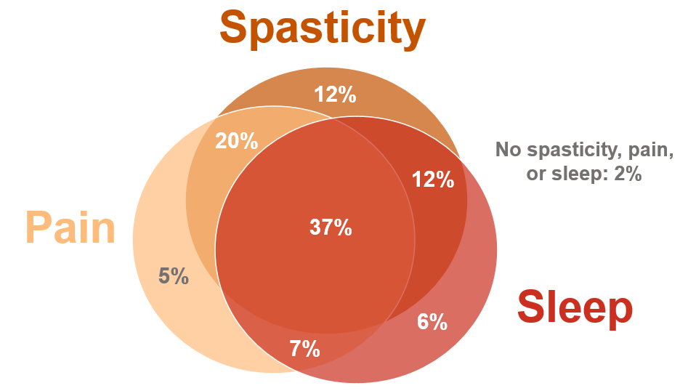
Symptoms Current Users Most Frequently Try to Treat
Spasticity, muscle spasms, cramps
Pain
Overlap between 3 most common symptoms
Insomnia/ sleep problems
Anxiety
No spasticity, pain, or sleep: 2%
Depression
Overactive bladder
Nausea/gastrointestinal problems
Migraine/headache
Tremors
Other
Participants (%)

Slide 9
Cannabis Use and Additional Symptom Management Therapies
Current Users Treating Spasticity With Cannabis (n=511)
Cannabis
only
Cannabis + additional therapies
Of the 511 current users treating spasticity, cannabis was started before a prescription drug by 20% of responders and before rehabilitation therapy by 42%
Of the 511 current users treating spasticity with cannabis, the most common concomitant medications were oral baclofen (36%), gabapentin (17%), and tizanidine (14%)

Slide 10
Conclusions
Approximately one-third of people living with MS (PwMS) have tried cannabis for their MS symptoms, most frequently spasticity, pain, and/or sleep problems
Over one-third of current users treating spasticity were using only cannabis
Various administration modes were reported, most often smoking or eating
Most common reasons PwMS have not tried cannabis include unknown efficacy and safety, legality concerns, and insurance/access issues
Further research is needed to better understand the effect of cannabinoid treatments for MS symptoms

