Slide 1
Physical Activity Behavior in Persons Newly Diagnosed with Multiple Sclerosis: Patterns and Correlates
Trinh L. T. Huynh & Robert W. Motl

Slide 2
Acknowledgements
We would like to thank our participants for taking part in this study. We also want to thank the National MS Society and our community partners for their help during the recruitment process.

Slide 3
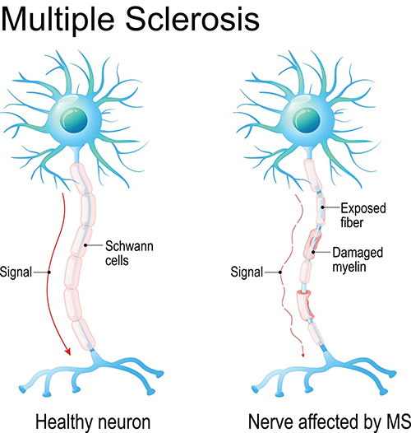
Multiple Sclerosis (MS)
Prevalent neurological disorder among adults
Autoimmune disease: demyelination and axonal transection
Lesions in brain and spinal cord
Debilitating symptoms due to location and extent of damage
Negative impacts on physical, cognitive, psychological health outcomes and quality of life
Source: OHSU-Brain Institute
(Walton et al., 2020; Olek, 2020; Trapp et al., 1998)
(Trapp & Nave, 2008; Khan Academy, 2015)

Slide 4
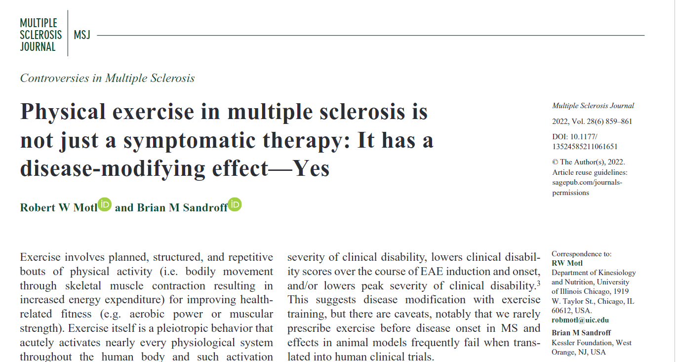
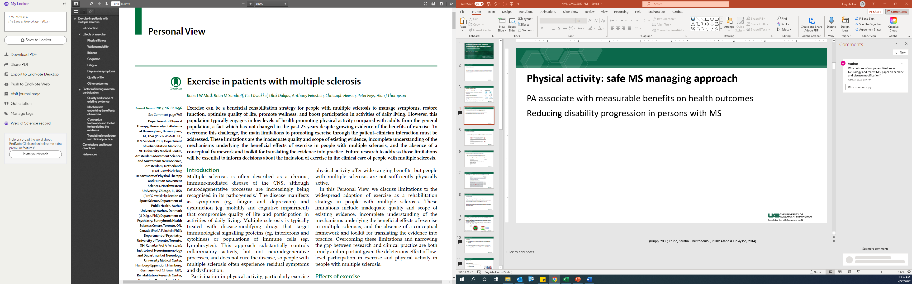
Physical activity: safe MS managing approach
PA associate with measurable benefits on health outcomes
Reducing disability progression in persons with MS
(Krupp, 2006; Krupp, Serafin, Christodoulou, 2010; Asano & Finlayson, 2014)

Slide 5
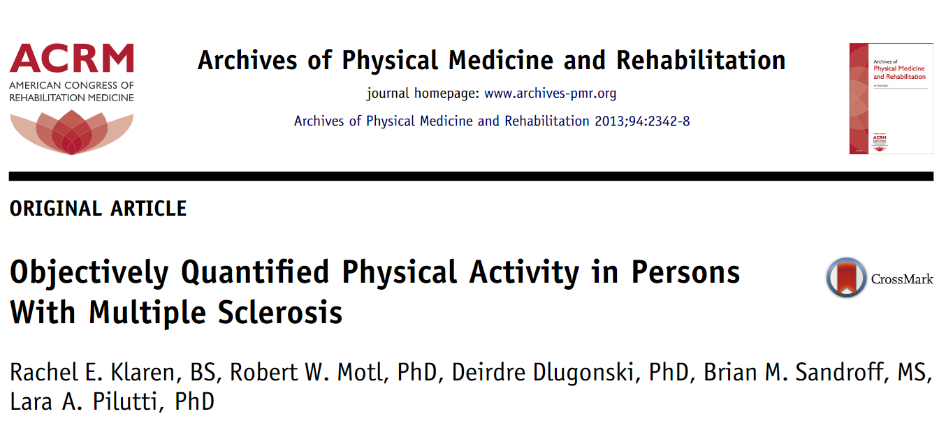
Physical activity in MS
Only 20% of persons with MS engaged in adequate levels of PA based on public health guidelines

Slide 6
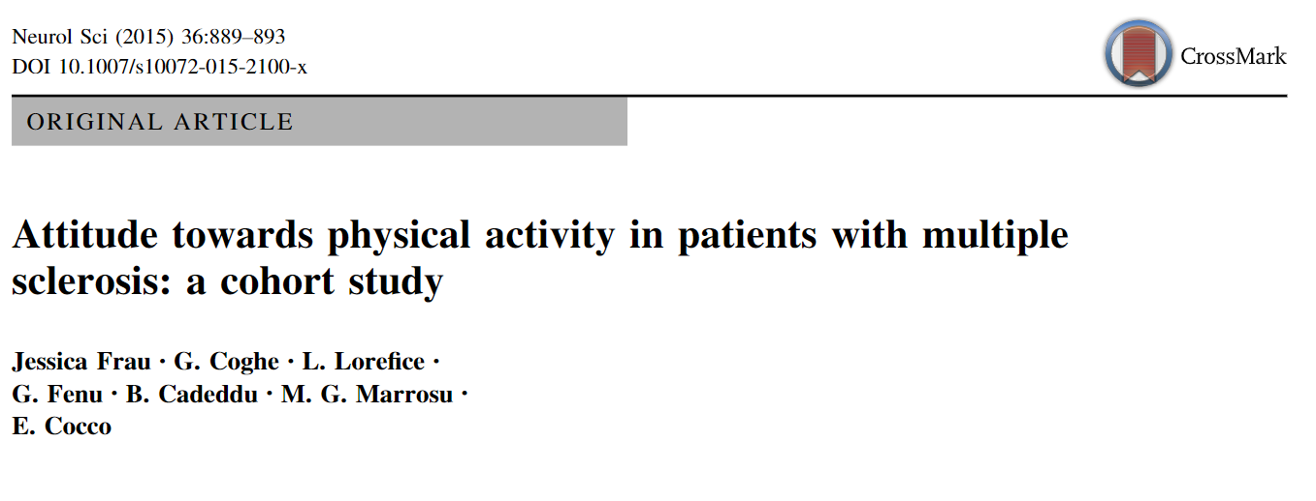
Physical activity in newly diagnosed with MS
38% stopped engaging in PA after being diagnosed
64% noticed negative changes in PA after the diagnosis

Slide 7
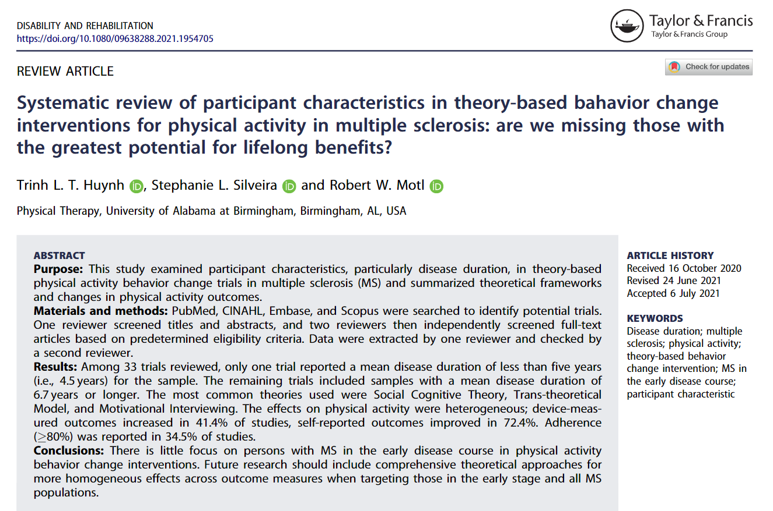
Gap in Physical activity Research in Newly Diagnosed MS
Notes:
Moderate effect in magnitude, almost half SD reduction in fatigue!

Slide 8
Research Gap
Physical activity could help to manage MS symptoms and comorbidities, but physical activity is reduced in persons with MS, including individuals newly diagnosed with MS.
How can we help people newly diagnosed with MS to be more physically active?

Slide 9
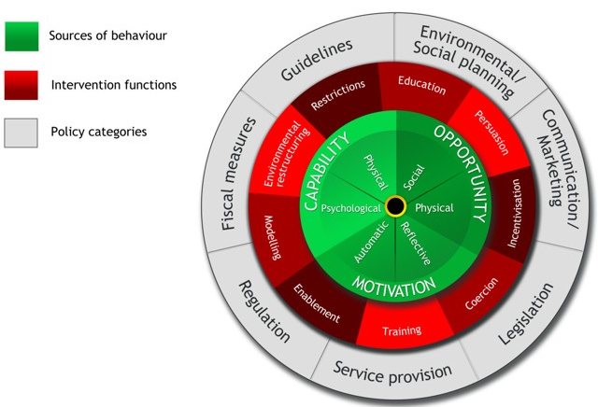
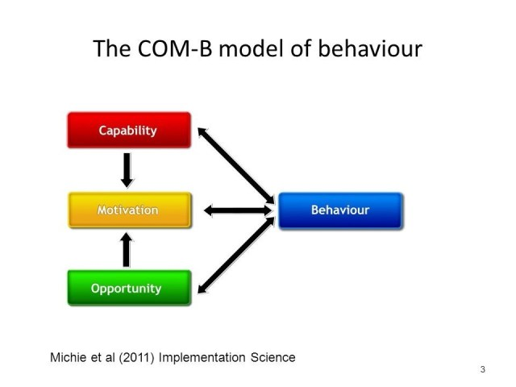
Capability-Opportunity-Motivation-Behavior (COM-B) Model for Behavior Change
Behavior is generated by the interaction of three components: Capability, Opportunity, Motivation
Link with Intervention Functions, Policy Categories, and Behavior Change techniques → guide Behavior Change Interventions
Behavior Change Wheel (BCW) Framework
COM-B Model
(Michie et al., 2011; Michie et al., 2014)
(Bandura, 1989; Bandura, 2004)

Slide 10
Purposes
Investigated the PA patterns in persons newly diagnosed with MS
Examined COM-B constructs as correlates of current and long-term PA in persons newly diagnosed with MS (i.e., ≤ 2 years) in the U.S.

Slide 11

Recruitment and inclusion
Inclusion criteria
Diagnosis of MS within the last two years
≥ 18 years of age

Slide 12
Measures
Data collection: Online Qualtrics Survey
Demographic and clinical characteristics
Patient Disease Determined Steps (PDDS)
Physical activity
Current PA: Godin Leisure-Time Exercise Questionnaire (GLTEQ)
Long-term PA: Physical Activity Staging Questionnaire (PASQ)
(Godin & Shephard, 1985; Hohol et al., 1999; Nigg et al., 2005)

Slide 13
Measures
COM-B Constructs
Capability | Information Provision | Self-developed questionnaire
 | Cognition | The Hamburg Quality of Life Questionnaire Multiple Sclerosis – Cognition Subscale
 | Fatigue | The Hamburg Quality of Life Questionnaire Multiple Sclerosis – Fatigue Subscale
 | Action Planning | Behavioral Regulation Action Planning Subscale
 | Action Control | Behavioral Regulation Action Control Subscale
 | Coping Planning | Behavioral Regulation Coping Planning Subscale
Opportunity | Physical Activity Social Support | The Physical Activity-Related Social Support Scale
 | Physical and Social Environment Barriers | Self-developed Questionnaire: Physical barriers & Social barriers Subscales
Motivation | Intention | Intention
 | Autonomy of Motivation | The Self-Regulation Questionnaire
 | Goal setting | Exercise Goal Setting Scale
 | Self-Efficacies | Self-Efficacy Subscales (Action, Recovery, Maintenance Subscale)
 | Illness Perception | The Brief Illness Perception Questionnaire
 | Outcome Expectations for Exercise | Multidimensional Outcome Expectations for Exercise Scale
 | Risk Perception | Self-developed aligned with Health Action Process Approach risk perception items Risk perception – probability & Risk perception – seriousness
 | Optimism | Life Orientation Test
 | Physical Activity Outcome Experiences | Physical Activity Outcome Experiences Scale [33]
 | Mood | The Hamburg Quality of Life Questionnaire Multiple Sclerosis – Mood Subscale
(Broadbent et al., 2006; Fuchs, 2013; Fuchs et al., 2008; Gold et al., 2001; Herzberg et al., 2006; Luszczynska & Sutton, 2006; McAuley et al., 2010; Rose et al., 2001; Rovniak et al., 2002; Sniehotta et al., 2005)

Slide 14
Statistical Analyses – SPSS Statistics ver. 28
Descriptive statistics
Analysis of Variance and χ2 tests
Multivariate Analysis of Variance (MANOVA)
Discriminant Function Analysis (DFA)

Slide 15
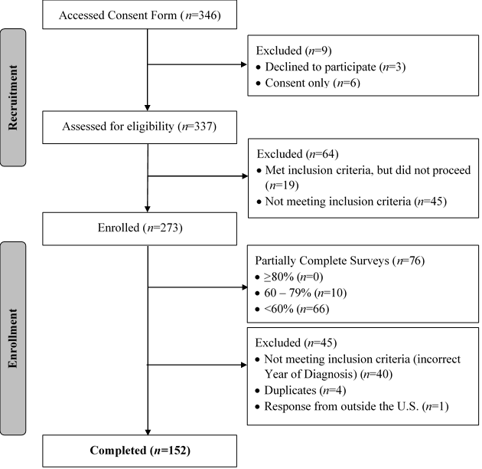
Flow diagram of participant recruitment and enrollment process

Slide 16
Table 2 Demographics and Clinical Characteristics of the sample of persons newly diagnosed with MS (n = 152)
Characteristic | Overall | GLTEQ Groups, p-value | PASQ Groups, p-value
Age, years (SD) | 41.0 (11.3) | > .05 | > .05
MS Duration, years (SD) | 1.1 (0.8) |  | > .05
PDDS, median (IQR) | 1.0 (2.0) | < .001 | < .05
Type of MS, n (%) Relapsing-remitting MS Progressive MS | 119 (78.3) 22 (14.4) | < .05 | > .05
Sex, n (%) Female Male | 127 (83.6) 25 (16.4) | < .05 | > .05
Marital Status, n (%) Married Other Status | 94 (61.8) 58 (38.2) | > .05 | < .05
Employed, n (%) Yes No | 105 (69.1) 47 (30.9) | > .05 | > .05
Race, n (%) Caucasian Other | 120 (78.9) 32 (21.1) | > .05 | > .05
Education, n (%) Less than College College Graduate or more | 35 (23.0) 117 (77.0) | < .05 | < .05
Household Income, n (%) Less than $50,000 $50,000 or greater | 36 (24.3) 112 (75.7) | < .05 | > .05
Notes. IQR = Interquartile Range; PDDS = Patient Determined Disease Steps

Slide 17
Physical Activity Patterns in newly diagnosed MS
39.5% of the sample reported being insufficiently active
34.2% regularly active
Consistent to findings in previous research in adults with MS in Germany and the U.S.
(Riemann-Lorenz et al., 2021; Silveira et al., 2021)

Slide 18
Results of Multivariate Analysis of Variance for GLTEQ Current Physical Activity Group by each Capability, Opportunity, Motivation, and Behavior (COM-B) Component and by all COM-B Components
Capability | Wilks’s λ = 0.63, F(12, 288) = 6.3, p < .001
 |  | F
Information Provision |  | 0.4
Cognition |  | 2.8
Fatigue |  | 14.7***
Action Planning |  | 20.1***
Action Control |  | 24.9***
Coping Planning |  | 3.7*
Motivation | Wilks’s λ = 0.52, F(26, 274) = 4.1, p < .001
Intention |  | 36.8***
Autonomy of Motivation |  | 11.8***
Goal Setting |  | 17.2***
Action Self-Efficacy |  | 22.8***
Maintenance Self-Efficacy |  | 10.0***
Recovery Self-Efficacy |  | 16.5***
Illness Perception |  | 5.5**
Outcome Expectations for Exercise |  | 17.9***
Risk Perception Probability |  | 0.2
Risk Perception Seriousness |  | 0.3
Optimism |  | 0.7
Outcome Experiences |  | 4.4*
Mood |  | 4.0*
Opportunity | Wilks’s λ = 0.80, F(6, 294) = 6.1, p < .001
Physical Environment Barriers |  | 13.2***
Social Environment Barriers |  | 11.5***
PA Social Support |  | 8.8***
Overall | Wilks’s λ = .42, F(44, 256) = 3.1, p < .001
Notes. GLTEQ=Godin Leisure Time Exercise Questionnaire; * p < .05, **p < .01, ***p < .001

Slide 19
Results of Discriminant Analysis of Capability, Opportunity, Motivation, and Behavior (COM-B) Predictor Variables for GLTEQ Current Physical Activity Group Classification
 | Correlations of Predictor Variables with Discriminant Function |  |  | Pooled Within-Group Correlations Among COM-B Predictor Variables
Predictor Variable | 1 |  | Univariate F(2, 149) | 1 | 2 | 3 | 4 | 5 | 6 | 7
1. Intention | 0.70 |  | 36.8 | - | 0.53 | 0.53 | 0.46 | 0.47 | 0.40 | 0.41
2. Action Control | 0.56 |  | 24.9 |  | - | 0.43 | 0.54 | 0.44 | 0.63 | 0.37
3. Action Self-Efficacy | 0.55 |  | 22.8 |  |  | - | 0.35 | 0.46 | 0.35 | 0.59
4. Action Planning | 0.51 |  | 20.1 |  |  |  | - | 0.34 | 0.54 | 0.36
5. Outcome Expectations | 0.50 |  | 18.0 |  |  |  |  | - | 0.48 | 0.45
6. Goal-Setting | 0.47 |  | 17.2 |  |  |  |  |  | - | 0.31
7. Recovery Self-efficacy | 0.46 |  | 16.5 |  |  |  |  |  |  | -
Canonical R |  | 0.71
Eigenvalue |  | 0.99
Notes. Variables reported in the table were based on coefficients exceeding 0.45 based on Comrey & Lee, 1992. GLTEQ = Godin Leisure Time Exercise Questionnaire.

Slide 20
Results of Multivariate Analysis of Variance for PASQ Stage of Change Group by each Capability, Opportunity, Motivation, and Behavior (COM-B) Component and by all COM-B components
Capability | Wilks’s λ = 0.54, F(12, 288) = 8.6, p < .001
 |  | F
Information Provision |  | 1.7
Cognition |  | 4.4*
Fatigue |  | 17.2***
Action Planning |  | 26.8***
Action Control |  | 43.5***
Coping Planning |  | 9.3***
Motivation | Wilks’s λ = 0.50, F(26, 274) = 4.4, p < .001
Intention |  | 38.4***
Autonomy of Motivation |  | 9.0***
Goal Setting |  | 24.8***
Action Self-Efficacy |  | 22.3***
Maintenance Self-Efficacy |  | 14.4***
Recovery Self-Efficacy |  | 19.3***
Illness Perception |  | 5.9*
Outcome Expectations for Exercise |  | 18.9***
Risk Perception Probability |  | 0.7
Risk Perception Seriousness |  | 1.2
Optimism |  | 0.5
PA Outcome Experiences |  | 3.4*
Mood |  | 7.1**
Opportunity | Wilks’s λ = 0.90, F(6, 294) = 2.7, p = 0.13
PA Social Support |  | 5.9*
Physical Environment Barriers |  | 3.8*
Social Environment Barriers |  | 4.2*
Overall | Wilks’s λ = 0.40, F(44, 256) = 3.3, p < .001
Notes. PASQ = Physical Activity Staging Questionnaire; COM-B = Capability-Opportunity-Motivation-Behavior; PA = Physical Activity. ***p=.001

Slide 21
Results of Discriminant Analysis of Capability, Opportunity, Motivation, and Behavior (COM-B) Predictor Variables for PASQ Long-term Physical Activity Group Classification
 | Correlations of Predictor Variables with Discriminant Function |  |  | Pooled Within-Group Correlations Among COM-B Predictor Variables
Predictor Variable | 1 |  | Univariate F(2, 149) | 1 | 2 | 3 | 4 |  | 5 | 6 |  | 7 | 8
Action Control | 0.74 |  | 43.6 | - | 0.45 | 0.49 | 0.58 |  | 0.37 | 0.40 |  | 0.32 | -0.15
Intention | 0.70 |  | 38.4 |  | - | 0.41 | 0.30 |  | 0.54 | 0.46 |  | 0.42 | -0.26
Action Planning | 0.58 |  | 26.8 |  |  | - | 0.51 |  | 0.31 | 0.31 |  | 0.33 | -0.15
Goal-Setting | 0.56 |  | 24.8 |  |  |  | - |  | 0.31 | 0.45 |  | 0.27 | -0.15
Action Self-Efficacy | 0.53 |  | 22.3 |  |  |  |  |  | - | 0.45 |  | 0.59 | -0.33
Outcome Expectation | 0.49 |  | 19.0 |  |  |  |  |  |  | - |  | 0.45 | -0.30
Recovery Self-Efficacy | 0.47 |  | 19.3 |  |  |  |  |  |  |  |  | - | -0.44
Fatigue | -0.46 |  | 17.2 |  |  |  |  |  |  |  |  |  | -
Canonical R |  | 0.72
Eigenvalue |  | 1.04
Notes. Variables reported in the table were based on coefficients exceeding .45 based on Comrey & Lee, 1992 [35]. PASQ = Physical Activity Staging Questionnaire.

Slide 22
COM-B Correlates in Current and Long-term Physical Activity
Capability and Motivation were the primary correlates with both current and long-term PA in newly diagnosed MS
Consistent with previous research in adults with MS who have longer disease duration.
Current PA | Long-term PA
Intention Action Control Action Self-Efficacy Action Planning Outcome Expectation Goal-Setting Recovery Self-Efficacy | Action Control Intention Action Planning Goal-Setting Action Self-Efficacy Outcome Expectation Recovery Self-Efficacy Fatigue
(Riemann-Lorenz et al., 2021; Silveira et al., 2021)
(Neal et al., 2020; Motl & McAuley, 2009; Motl, Weikert, Suh, & Dlugonski, 2010)

Slide 23

Implications
Prioritizing COM-B factors (Capability and Motivation) in designing interventions based on the targeted types of PA (i.e., current vs. long-term) in persons newly diagnosed with MS
Intention
Behavioral regulation
Goal-setting
Action & Recovery Self-efficacies
Outcome Expectations

Slide 24

Future Directions
Longitudinal studies
Larger sample size
Device-measured PA outcomes
Inactive persons newly diagnosed with MS
Samples with more diverse demographic characteristics

Slide 25

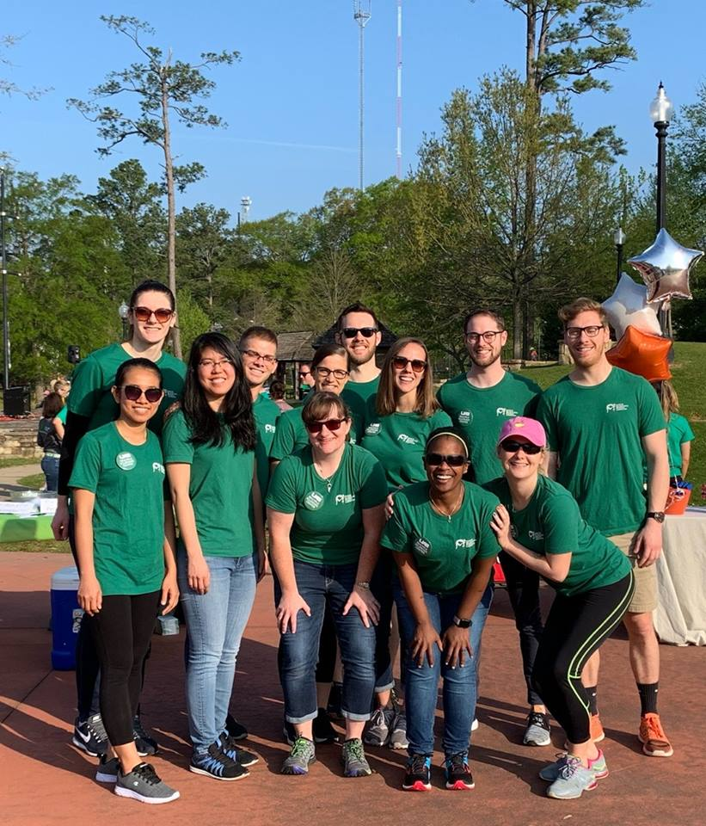
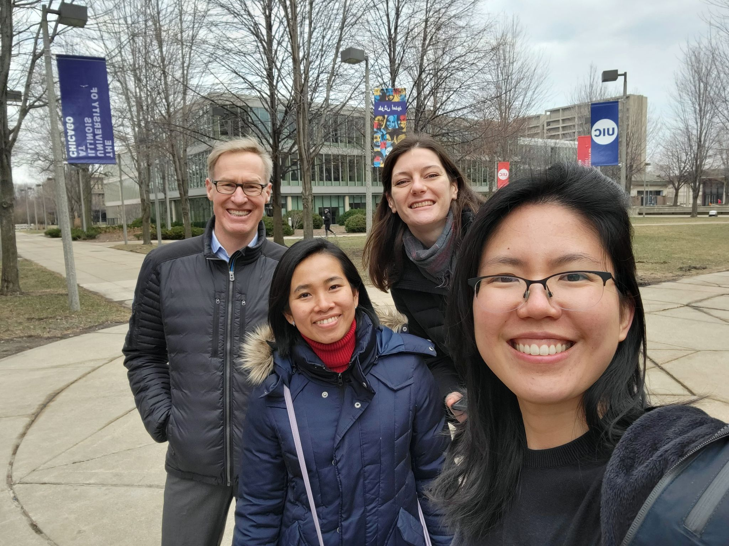
Thank you!

Slide 26
References
Broadbent E, Petrie KJ, Main J, Weinman J. The Brief Illness Perception Questionnaire. J. Psychosom. Res. 2006; 60(6): 631-637.
Comrey AL, Lee HB. Interpretation and application of factor analytic results. In Comrey AL, Lee HB, editors. A first course in factor analysis 2nd ed. New York: Psychology Press; 1992.
Fuchs R. Sportbezogene konsequenzerfahrungen: Das konstrukt und seine messung. Freiburg: Universität Freiburg; 2013.
Fuchs R, Göhner W, Mahler C, et al. Aufbau eines körperlich-aktiven lebensstils im kontext der medizinischen rehabilitation: Ein motivational-volitionales Interventionskonzept (MoVo-LISA Projekt): Unveröffentlichter Endbericht Freiburg: Universität Freiburg; 2008.
Godin G, Shephard RJ. A simple method to assess exercise behavior in the community. Can. J. Appl. Sci., 1985; 10(3): 141-146.
Gold SM, Heesen C, Schulz H, et al. Disease specific quality of life instruments in multiple sclerosis: Validation of the Hamburg Quality of Life Questionnaire in Multiple Sclerosis (HAQUAMS). Mult. Scler. 2001; 7(2): 119-130
Herzberg PY, Glaesmer H, Hoyer J. Separating optimism and pessimism: A robust psychometric analysis of the revised Life Orientation Test (LOT-R). Psychol. Assess. 2006; 18(4): 433-438.
Hohol MJ, Orav EJ, Weiner L. Disease steps in multiple sclerosis: A longitudinal study comparing Disease Steps and EDSS to evaluate disease progression. Mult. Scler. 1999; 5(5).
Luszczynska A, Sutton S. Physical activity after cardiac rehabilitation: Evidence that different types of self-efficacy are important in maintainers and relapsers. Rehabil. Psychol. 2006; 51(4): 314-321.
McAuley E, Motl RW, White SM, Wójcicki TR. Validation of the Multidimensional Outcome Expectations for Exercise Scale in ambulatory, symptom-free persons with multiple sclerosis. Arch Phys Med Rehabil. 2010; 91(1): 100-105.
Michie S, Atkins L, West R. The behaviour change wheel : A guide to designing interventions. Silverback Publishing; 2014.
Michie S, Stralen MMV, West R. The behaviour change wheel: A new method for characterising and designing behaviour change interventions. Implement. Sci. 2011; 6(1): 42.
Nigg C, Hellsten L, Norman G, et al. Physical activity staging distribution: Establishing a heuristic using multiple studies. Ann Behav Med. 2005; 29(2): 35-45.
Olek MJ. Multiple Sclerosis. Ann. Intern. Med. 2020; 174(6): Itc81-itc96.
Riemann-Lorenz K, Motl RW, Casey B, Coote S, Daubmann A, Heesen C. Possible determinants of long-term adherence to physical activity in multiple sclerosis-theory-based development of a comprehensive questionnaire and results from a German survey study. Disabil Rehabil. 2021; 43(22): 3175-3188.
Rose EA, Markland D, Parfitt G. The development and initial validation of the Exercise Causality Orientations Scale. J. Sports Sci. 2001; 19(6): 445-462.
Rovniak LS, Anderson ES, Winett RA, Stephens RS. Social cognitive determinants of physical activity in young adults: A prospective structural equation analysis. Ann Behav Med. 2002; 24(2): 149-156.
Silveira SL, Riemann-Lorenz K, Heesen C, Motl RW. Current and long-term physical activity among adults with multiple sclerosis in the united states: COM-B variables as explanatory factors. Int J Behav Med. 2021; 28(5): 561-574.
Sniehotta FF, Scholz U, Schwarzer R. Bridging the intention–behaviour gap: Planning, self-efficacy, and action control in the adoption and maintenance of physical exercise. Psychol Health. 2005; 20(2): 143-160.
Trapp, B. D., Peterson, J., Ransohoff, R. M., Rudick, R., Mörk, S., & Bö, L.. (1998). Axonal Transection in the Lesions of Multiple Sclerosis. New England Journal of Medicine, 338(5), 278–285.
Walton C, King R, Rechtman L, et al. Rising prevalence of multiple sclerosis worldwide: Insights from the Atlas of MS, 3rd edition. Mult. Scler. 2020; 26(14): 1816-1821.Bandura A. Health promotion by social cognitive means. Health Educ Behav 2004;31(2):143-64.

