Slide 1
Comparative Diagnostic and Therapeutic Strategies Among General and MS Subspecialist Neurologists
- Opportunities for Education -
Andrew Solomon, MD¹ ・Jiwon Oh, MD, PhD, FRCPC² ・Robert Bermel, MD³ ・Adnan Subei, DO⁴ ・Chloe Gianatasio, MS⁵ ・Natalie Goldberg, PhD⁵ ・Wendy Cerenzia⁶ ・ Brian Moss⁵
¹ Larner College of Medicine, University of Vermont, Burlington, Vermont • ² University of Toronto, Ontario, Canada • ³ Mellen Center for Multiple Sclerosis, Cleveland Clinic, Cleveland, Ohio • ⁴ Memorial Healthcare System Neuroscience Institute Hollywood, Florida • ⁵ EfficientCME, Fort Lauderdale, Florida • ⁶ CE Outcomes, Birmingham, Alabama

Slide 2
Disclosures
Dr. Oh reported the following financial relationships:
  ADVISOR/CONSULTANT: Alexion; Biogen; Bristol Myers Squibb; Novartis; Roche; Sanofi Genzyme
  GRANTS FOR CLINICAL RESEARCH: Biogen; EMD Serono; Roche
Dr Bermel reported the following financial relationships:
  PATENT HOLDER: Multiple Sclerosis Performance Test
  CONSULTING FEES: Biogen, EMD Serono, Genentech/Roche, Genzyme/Sanofi, Novartis, Viela Bio
  CONTRACTED RESEARCH: Biogen, Genentech/Roche, Novartis
Dr Solomon, Dr Subei, Chloe Gianatasio, Dr Goldberg, Wendy Cerenzia, and Brian Moss have no relevant financial relationships to report.

Slide 3
Background
A prior EfficientCME survey demonstrated discrepancies between the therapeutic decision-making patterns of MS experts (MSE) and general neurologists (GN).¹
Recent literature^{2,3} suggest that such discordance may be rooted in knowledge gaps.
This project examined potential underlying factors driving these observations
    Application of the McDonald Criteria (e.g., qualifying MRI lesions)
    Use of clinical factors in decision-making.
1. Subei A et al. Therapeutic practices in MS amongst general neurologists and MS specialists. Proc MSVirtual2020;Abstract P1365. 2. Solomon AJ et al. Challenges in MS diagnosis: Misunderstanding and misapplication of the McDonald criteria. MSJ; 2020: 1-9. 3. Solomon A. et al. MS diagnosis: Knowledge gaps and opportunities for educational intervention in neurologists in the United States MSJ 2021:1-9.

Slide 4
Methods
STUDY TYPE: Online survey administered in August 2021
PARTICIPANTS:
Twenty-six MS experts from diverse academic centers in the US and Canada
One hundred randomly selected practicing US-based neurologists that manage 3 to 15 patients with MS per week
SURVEY TOPICS: Questions designed to assess clinician understanding/application of the McDonald criteria as well as clinical decision-making strategies
STATISTICS: Pearson chi-square tests

Slide 5
Results: Clinical presentations of MS
Which of the following are considered typical clinical presentations of MS? (Select all that apply)
P< 0.01

Slide 6
Results: Qualifying lesions for DIS
Lesions in which of the following regions may be used to fulfill MS MRI dissemination in space (DIS) criteria? (Select all that apply)
GENERALISTS ONLY

Slide 7
Results: Lesion definitions
Which definition of a "juxtacortical" (JC) lesion is a correct application of the McDonald criteria?
Which definition of a "periventricular" (PV) lesion is a correct application of the McDonald criteria?
14% of GN chose the correct definition of BOTH JC and PV lesions
Note: Experts who received these same questions in a previous publication were removed from the analysis.

Slide 8
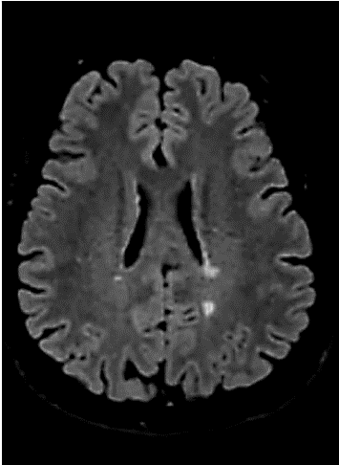
Results: identification of Periventricular Lesions
How many periventricular lesions are present in this patient’s MRI image below?
1
P < 0.01

Slide 9
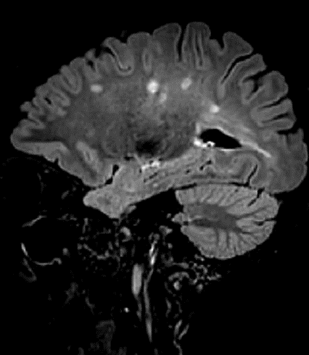
Results: identification of juxtacortical lesions
How many juxtacortical lesions are present in this patient’s MRI image below?
0
P<0.01

Slide 10
Results: understanding dissemination in time
Case 2:
A 28-year-old female presents due to subacute onset of sensory changes in her right arm, trunk, and right leg beginning 8 weeks ago. Symptoms have started to improve over the last week.
WORKUP
Personal and family medical history | None
Neurological exam | C4/C5 sensory level to pinprick on the right
CSF | Not performed
Spinal MRI | Non-enhancing T2 hyperintense lesion on C3/C4
Visual evoked potentials | Delayed P100 in left eye
Lab eval for MS mimics | Negative
Brain MRI | Multiple non-enhancing, ovoid T2 hyperintense lesions

Slide 11
Results: understanding dissemination in time
Does this patient's presentation fulfill dissemination in time (DIT) criteria for a diagnosis of MS?
This patient’s presentation currently does not fulfill DIT criteria.

Slide 12
Results: Treatment of newly diagnosed RMS
The patient recalled a previous episode of vision loss, allowing her to meet DIT.
While multiple options may be indicated, should the patient express no preference, which of the following agents would you recommend that she try first? (Select only one)
Use of high efficacy injection or infusion therapies
P< 0.01
32% Generalists
51% Experts

Slide 13
RESULTS: treatment of sensory relapse
CASE 2 CONT’D:
The 28-year-old patient with RMS is started on glatiramer acetate and reports good adherence. One year later, she returns with excessive fatigue and significant “pins and needles” in her bilateral lower extremities and a new thoracic lesion at T2-3 on MRI. Her attack is resolved successfully with steroids.
Which of the following are you most likely to recommend for this patient?
Obtain an MRI of the brain and cervical spine to assess for further new lesions. Consider switching therapies only if more than the single new lesion is found
P< 0.01

Slide 14
Summary of Differences
There were significant differences between MSE and GN in:
  Classification of clinical syndromes as typical of MS
  Correct classification and identification of PV and JC lesions
  Ability to apply DIS and DIT criteria
  Early use of and likelihood of switching to high efficacy therapies

Slide 15
Conclusions
Key elements of McDonald criteria may be misapplied in practice.
Therapeutic approaches in response to MS prognostic factors differed between MSE and GN.
There is a need for education on the application of diagnostic criteria and prognostic factors.

