Slide 1
TREATMENT WITH TRANSCRANIAL MAGNETIC STIMULATION
ASSOCIATED WITH PHYSICAL THERAPY ON BALANCE, GAIT AND FATIGUE OF PEOPLE WITH MULTIPLE SCLEROSIS: A PILOT STUDY
Dias AE; Telles JAR; Sciarinni BH; Bando MO; Caetano VAVS; Tessitore ME; Duque V; Santos FF; Martins LHQ; Agourakis, DC; Vidigal, GP; Monteiro CBM; Silva TD

Slide 2

SUMMARY
BACKGROUND
OBJECTIVE
METHODS
RESULTS
DISCUSSION
CONCLUSION

Slide 3
1
BACKGROUND

Slide 4
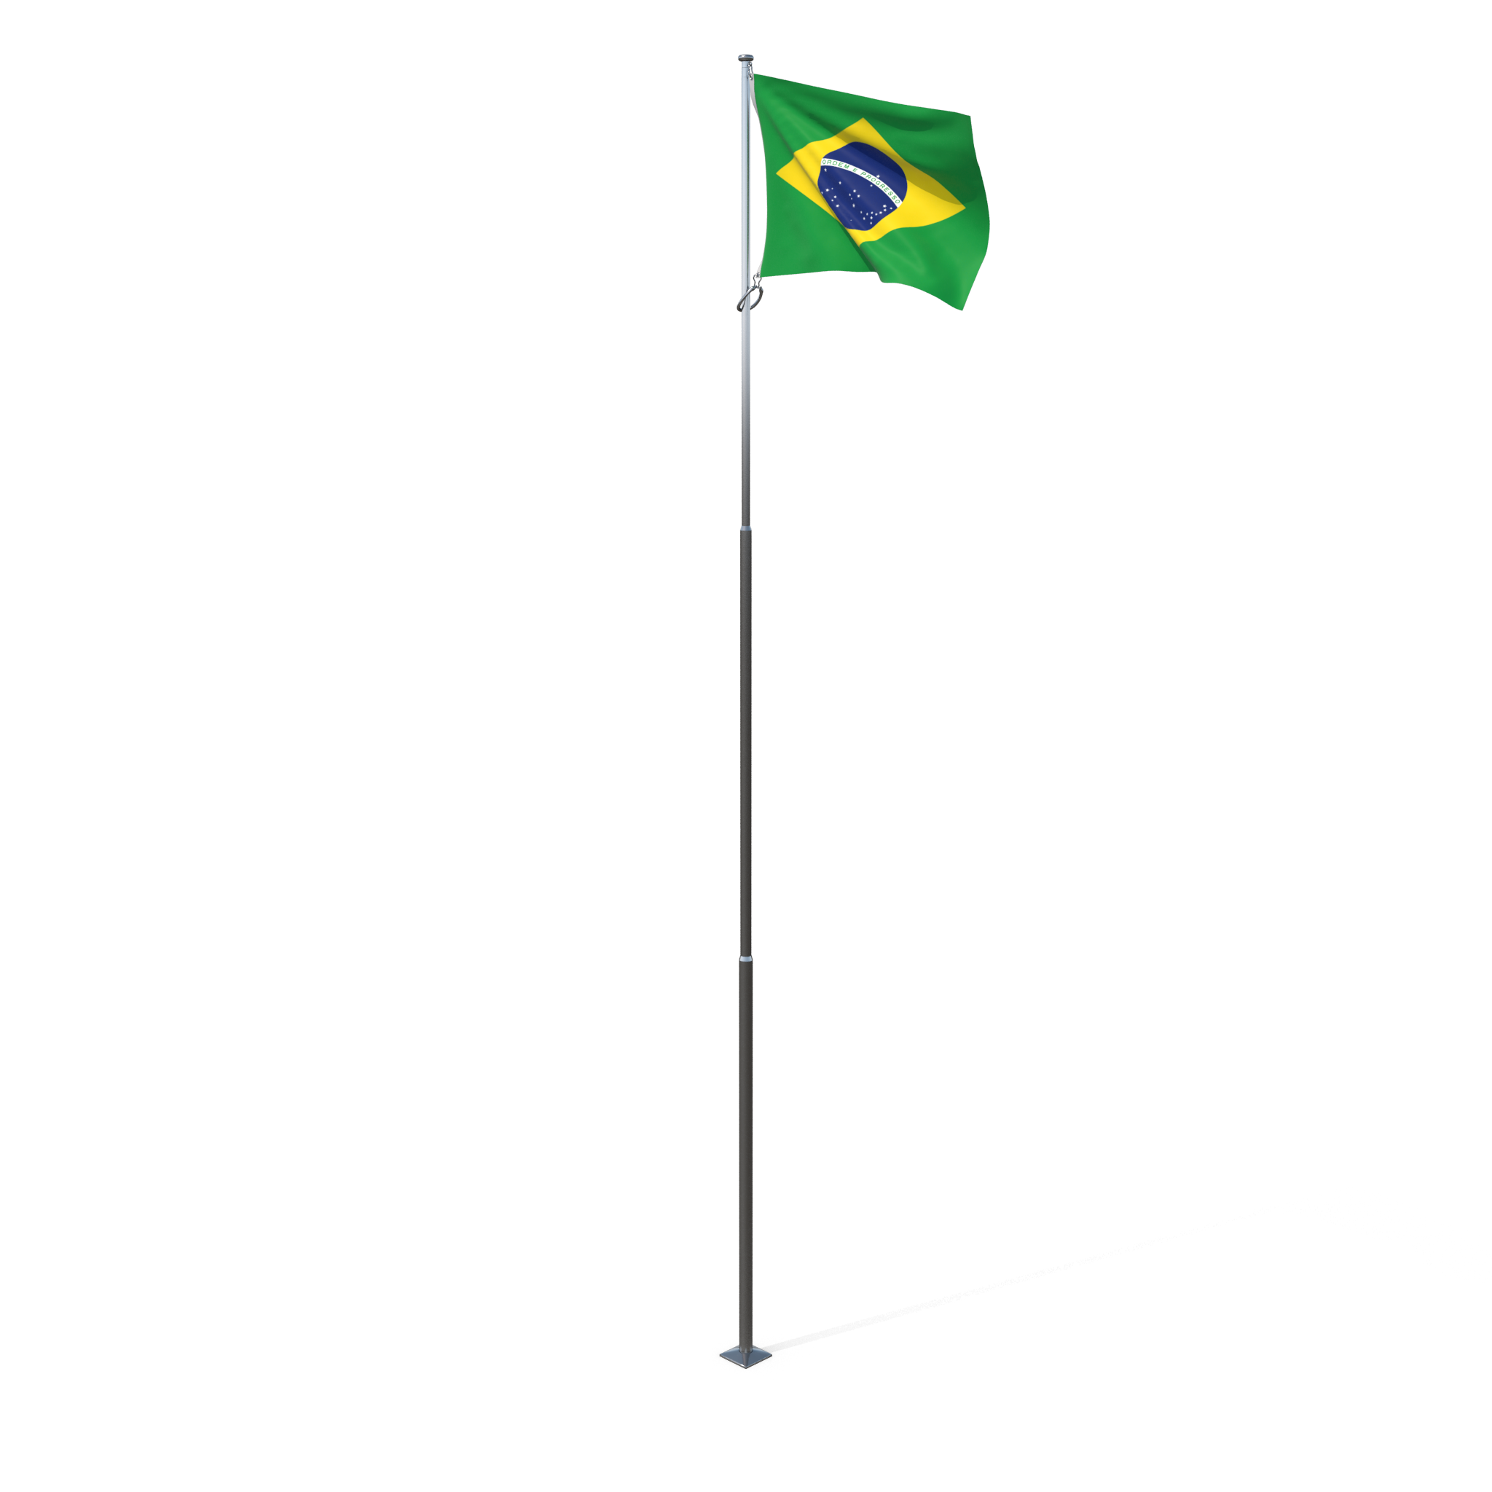
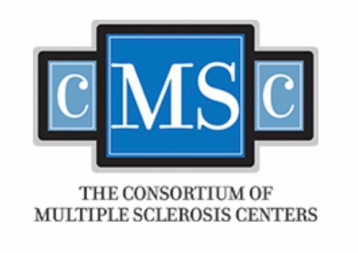


BACKGROUND
Multiple Sclerosis (MS) is a demyelinating autoimmune disease that causes CNS damage and disabling symptoms.
It results in the accumulation over the years of disabling motor and cognitive handicaps. Quality of life; personal, social, and professional status; and life expectancy are all significantly challenged by the disease
Cassani, R. et al, 2020; Ian, B, 2018; Nasios, G, et al., 2018

Slide 5
BACKGROUND
Transcranial magnetic stimulation (TMS) is a neurostimulatory and neuromodulatory technique, based on the principle of electromagnetic induction of an electric field in the brain.
TMS has benefits in the rehabilitation process when combined with therapeutic interventions.
Nasios, G. et al., 2018;Cassani, R. et al, 2020; Ian, B, 2018

Slide 6
2
OBJECTIVE

Slide 7
OBJECTIVE
To evaluate the influence of TMS combined with physiotherapy on the balance, gait and fatigue of people with MS.

Slide 8
3
METHODS

Slide 9
METHODS
12 relapsing remitting
2 secondary progressive
6 primary progressive
Type of study: Cross-over controlled longitudinal study
Participated of this study 20 people with MS:

Slide 10
METHODS
12 relapsing remitting
2 secondary progressive
6 primary progressive
14 women
6 men
Type of study: Cross-over controlled longitudinal study
Participated of this study 20 people with MS:

Slide 11
METHODS
12 relapsing remitting
2 secondary progressive
6 primary progressive
14 women
6 men
Kurtze Expanded Disability Status Scale (EDSS)
Between 0 and 6,5
Type of study: Cross-over controlled longitudinal study
Participated of this study 20 people with MS:

Slide 12
METHODS
12 relapsing remitting
2 secondary progressive
6 primary progressive
14 women
6 men
Kurtze Expanded Disability Status Scale (EDSS)
Between 0 and 6,5
Type of study: Cross-over controlled longitudinal study
Participated of this study 20 people with MS:
Aged 33 to 68 years (SD 50,0)

Slide 13
METHODS
Participants were randomly allocated by a blinded researcher into two groups: Active and Sham.
All participated in the two stimulations.
In the first part, half received active stimulation for 10 consecutive working days (except on weekends), while the other half received sham.
Then they had a four-week washout, that is, no stimulation. And then the groups were reversed: those who received active stimulation became sham, and vice versa.

Slide 14
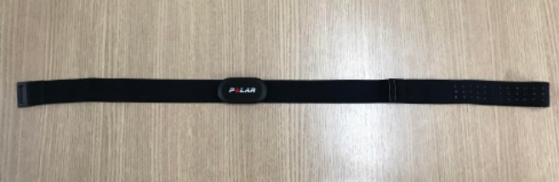
METHODS
On the first and tenth days, assessments of cardiac autonomic modulation were performed through Heart Rate Variability with a frequency meter (Polar), sending the signals to the EliteHRV application
Initially, the participant remained at rest for 15 minutes, sitting in a comfortable armchair, without speaking, without making sudden movements, without sleeping and without closing his eyes

Slide 15
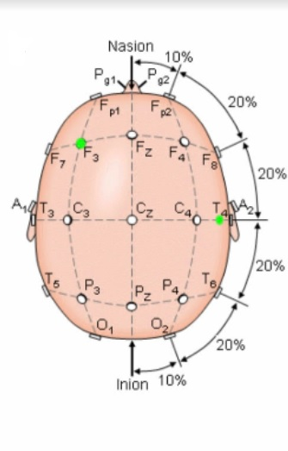
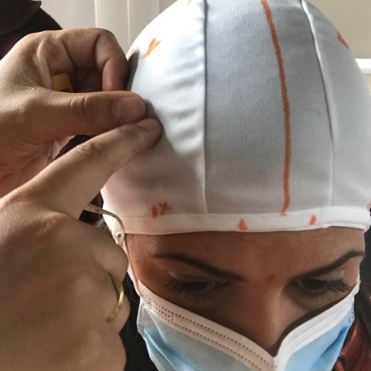
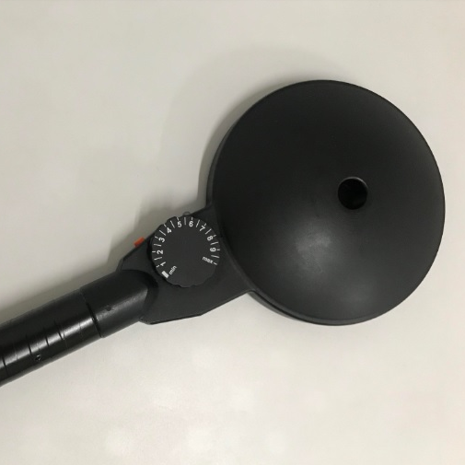
METHODS
PROTOCOL
After that, the cap was marked to find the measurements of the target points to be stimulated by Transcranial Magnetic Stimulation (TMS), being CZ and F3. Then the Hotspot was found to calculate the Rest Motor Threshold (RMT) with a parabolic coil.

Slide 16
METHODS
PROTOCOL
First, the first point stimulated was CZ (10 Hz, 50 pulses per train, 30 trains, 20 seconds apart), with a machine intensity of 90% of the RMT; then at F3 (10 Hz, 50 pulses per train, 40 trains, 20 seconds apart), with an intensity of 110% of the RMT.
The HRV was also captured in these two moments.
These points were stimulated with a circular coil.

Slide 17
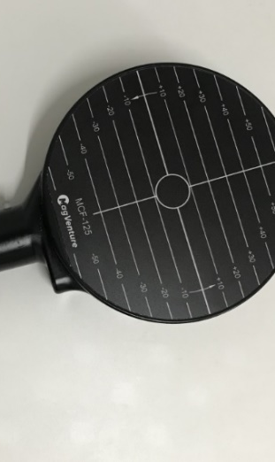
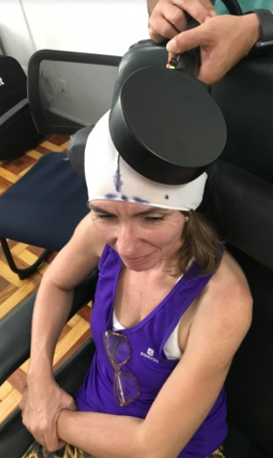
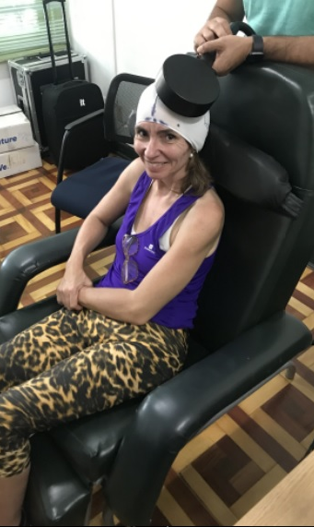
METHODS
PROTOCOL

Slide 18
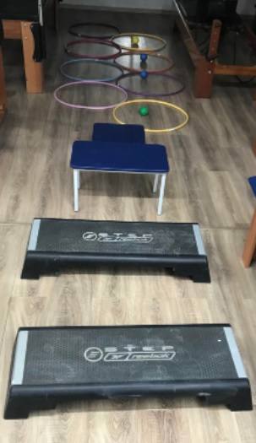
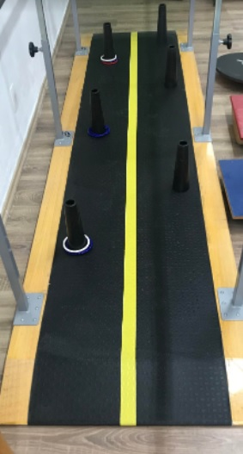
METHODS
After the session, the participants performed physiotherapy for 3 times a week.
A balance circuit was done.

Slide 19
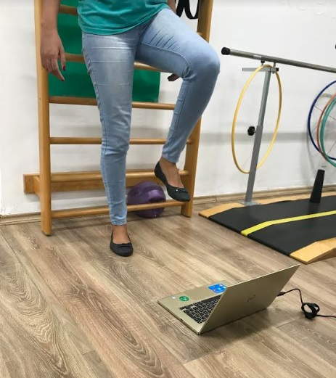
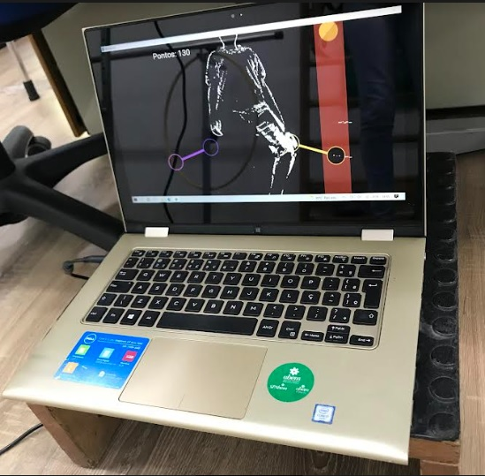
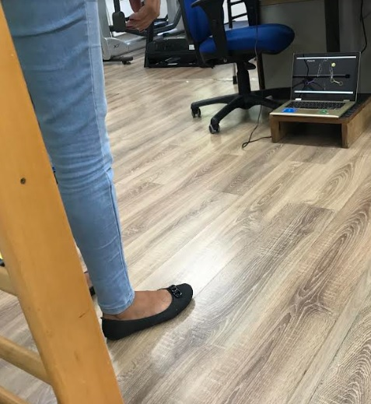
METHODS
In association with a virtual reality training with a game named
“Move Hero”

Slide 21
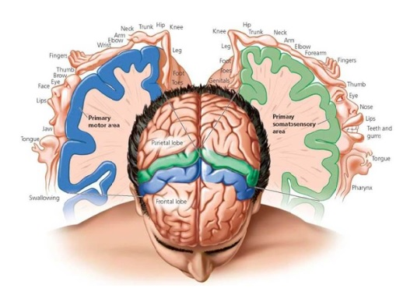
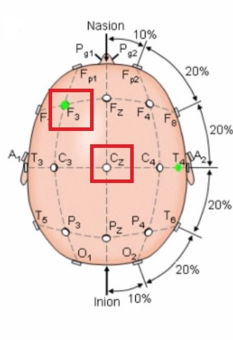
METHODS
On the other days, HRV was not captured; the RMT was measured in all sessions.
CZ represents the lower limbs area, while F3 represents depression area and cognition.

Slide 22
METHODS
Scales
The Berg Balance Scale
Timed up and Go Test (TUG)
Modified Fatigue Impact Scale (MFIS)
Was applied in 2 moments. Before the combined interventions, and in the end of the whole protocol, after 60 days.

Slide 23
4
RESULTS

Slide 24
RESULTS
Berg Balance Scale
It was found that 70% of participants showed improvement in balance, 20% a decrease and 10% a plateau on Berg Balance Scale.
70%

Slide 25
RESULTS
TUG TEST
30%
At the Timed up and Go Test, it was found 70% of improvement and 30% of decrease in performance.
Decrease
70%
Improvement

Slide 26
RESULTS
MFIS
30%
Decrease
Increase
Plateau

Slide 27
RESULTS
MFIS
30%
At the fatigue evaluation with
Modified Fatigue Impact Scale,
in Cognitive domain, it was
found 90% decrease in fatigue
values ​​and 10% increase.
In the psychosocial domain, 70% showed a decrease in fatigue levels, 20% an increase and 10% remained unchanged.
In the physical domain, it was analyzed that 65% had an improvement in the indexes, 25% a worsening and 10% remained the same.

Slide 28
5
DISCUSSION

Slide 29
DISCUSSION
Due to the lack of effective
pharmacological treatments
alone, rTMS in combination
with medication has been
used with significant efficacy
mainly for the improvement
of spasticity , fatigue and
depression, lower urinary
tract dysfunction, gait and
hand dexterity (Nasios, 2018)
The authors speculate
that TMS might be more
effective in signaling
disease progression that
leads to long-term disability,
compared to standard surrogate
markers, because it represents
a direct measure of synaptic
transmission (Muhannad, 2022)

Slide 30
6
CONCLUSION

Slide 31
CONCLUSION
This preliminary study suggests that TMS associated with physiotherapy has great potential in the rehabilitation of balance, gait and fatigue on people with MS.
The promising results encourage the acquisition of additional evidence.

Slide 32
REFERENCES
Cassani R, Novak GS, Falk TH, Oliveira AA. Virtual reality and non-invasive brain stimulation for rehabilitation applications: a Systematic reviews. Neuroeng Rehabil. 2020. 17(1):147.
Ian B. Maitin, Ernesto Cruz. Special Considerations and Assessment in Patients with Multiple Sclerosis. Phys Med Rehabil Clin N Am. 2018.
Gregorius, Nasisu, et al. Repetitive Transcranial Magnetic Stimulation, Cognition, and Multiple Sclerosis: An Overview. Behavioral Neurology. 2018: 1—8
Muhannad, M. et al. The Role of Transcranial Magnetic Stimulation as a Surrogate Marker of Disease Activity in Patients with Multiple Sclerosis: A Literature Review. Innov. Clin. Neurosc. 2022, 19 (1): 8-14
.

Slide 33
Thank you!

