Slide 1
The Effects of Functional Electrical Stimulation Cycling in People with Secondary Progressive Multiple Sclerosis
Alexandra Simpson, MD, Sandra D. Cassard, ScD, Jennifer Keller, MS, PT, Michael Comisac, Danielle Obando, Kathy M. Zackowski, PhD, OTR, Daniel Becker, MD, Scott Newsome, DO, MSCS, FAAN

Slide 2
Disclosures
None

Slide 3
Background
Individuals with secondary progressive multiple sclerosis (SPMS) experience worsening ambulation over time, often requiring the use of assistive devices
Exercise is beneficial in improvement of motor and ambulatory dysfunction in MS
Challenges exist in implementation of an exercise regimen for individuals with higher levels of disability
Functional electrical stimulation (FES) cycling is a well-tolerated, non-invasive intervention allowing for assisted exercise in people with moderate-to-severe disability
Ratchford et al. Neurorehabilitation. 2010.
Pilutti et al. Int J MS Care. 2019.

Slide 4
Objectives/Aims
To evaluate whether measures of walking performance, leg strength, and quality of life in people with SPMS improve with active FES cycling when compared to passive cycling

Slide 5
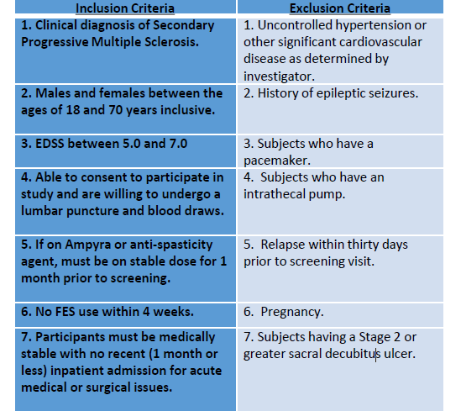
Methods
Recruitment: Participants with SPMS were recruited through the Johns Hopkins MS Center from 2012 to 2019

Slide 6
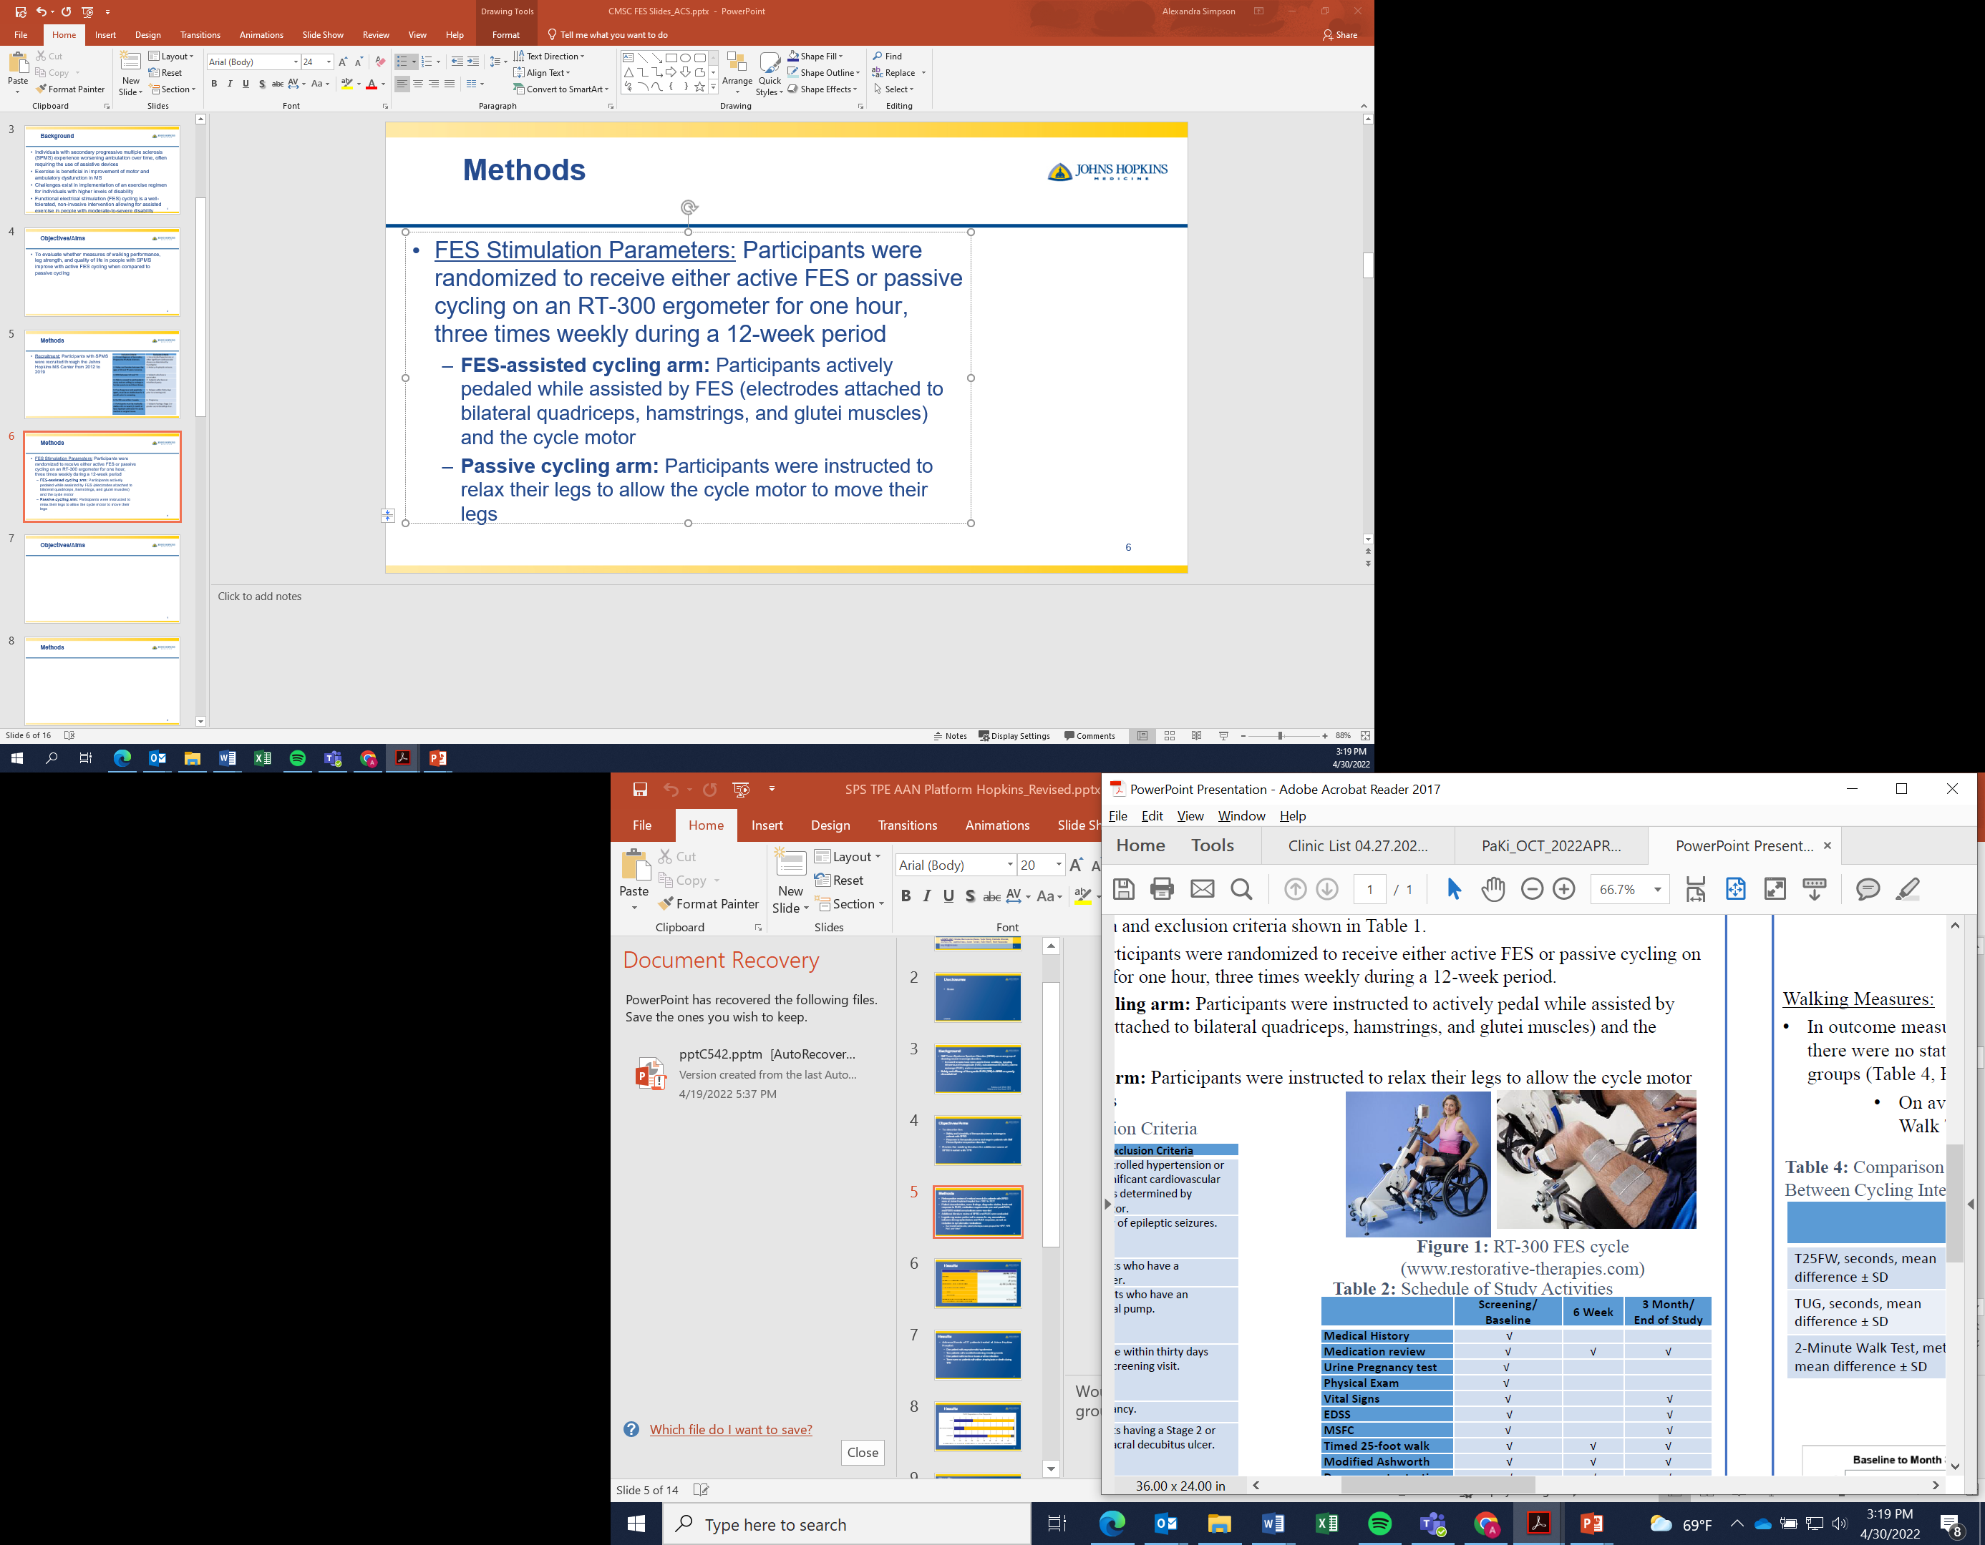
Methods
FES Stimulation Parameters: Participants were randomized to receive either active FES or passive cycling on an RT-300 ergometer for one hour, three times weekly during a 12-week period
FES-assisted cycling arm: Participants actively pedaled while assisted by FES (electrodes attached to bilateral quadriceps, hamstrings, and glutei muscles) and the cycle motor
Passive cycling arm: Participants were instructed to relax their legs to allow the cycle motor to move their legs

Slide 7
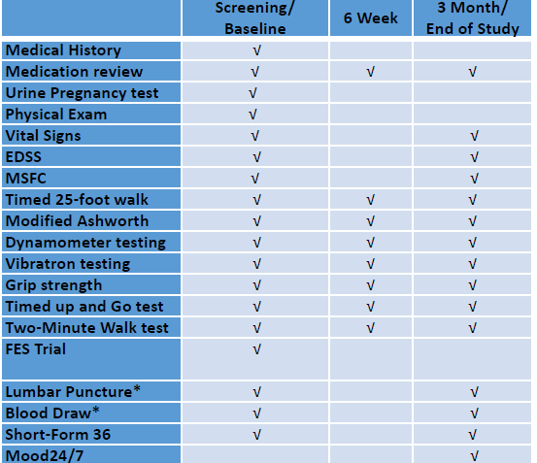
Methods
Outcome Measures: Participants underwent assessments for multiple outcome measures
Primary outcome: Timed 25-Foot Walk (T25FW)
Statistical Analyses:
For each participant, calculated the change in scores for each outcome measure over the study period
Means, standard deviations of each outcome score difference were calculated for intervention groups and compared using t-tests
Notes:
Other secondary measures included the EDSS, additional walking measures such as the Timed Up and Go (TUG) Test, 2-Minute Walk Test, MS Functional Composite (MSFC), Symbol Digit Modalities Test (SDMT), and quantitative sensorimotor testing in addition to other variables.
A dynamometer was used to measure power at the bilateral hip flexors and ankles
RAND 36-Item Health Survey scores were computed for the various domains of physical functioning, physical or emotional role-functioning, bodily pain, general health, vitality, social functioning, and mental health
The change in scores for each outcome measure over the study period was calculated by subtracting baseline scores from scores obtained at the end of the study
The data analysis was generated using SAS/STAT software

Slide 8
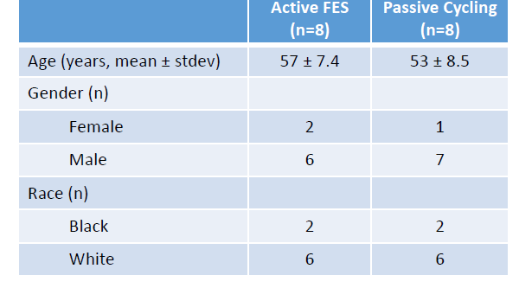
Results - Demographics
There were no significant differences in demographics between groups
Of the 16 patients who met enrollment criteria, 14 completed the study
Two passive cyclists did not complete the study
One FES-assisted cyclist suffered an unrelated shoulder injury and was excluded from analysis of walking outcome measures
Notes:
There were 8 participants in the FES-assisted cycling group and 8 in the passive cycling group
There were no significant differences in demographics between groups

Slide 9
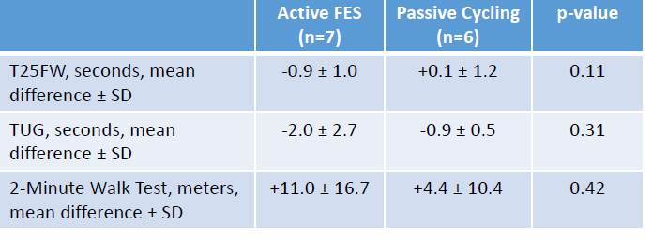
Results – Walking Measures
There were no statistically significant differences between the active FES and passive cycling groups in outcome measures of walking performance

Slide 10
Results – Walking Measures
On average, there were improvements in the speed in the Timed Up and Go test and distance walked in the 2-Minute Walk test with either intervention

Slide 11
Results – Dynamometry Data
There were no statistically significant differences between FES-assisted and passive cycling groups in the change in dynamometry measures of the bilateral hip flexors, hip extensors, or ankles

Slide 12
Results – RAND-36 Quality of Life Domains
 | Active FES (n=8) | Passive Cycling (n=6) | p-value
Physical Functioning | 4.2 ± 9.7 | +10.8 ± 21.8 | 0.51
Role-Functioning Physical | 0 ± 57.0 | +16.7 ± 51.6 | 0.61
Bodily Pain | +9.2 ± 15.3 | -2.1 ± 26.0 | 0.38
General Health* | -2.5 ± 12.1 | -4.0 ± 16.4 | 0.87
Vitality | -5.8 ± 15.3 | +11.7 ± 26.6 | 0.19
Social Functioning | -4.2 ± 10.2 | +22.9 ± 24.3 | 0.03
Role-Functioning Emotional | -11.1 ± 54.4 | +38.9 ± 64.7 | 0.18
Mental Health | -1.3 ± 15.5 | +7.3 ± 12.2 | 0.31
On average, participants receiving passive cycling reported an improvement in social functioning scores, while those receiving FES-assisted cycling did not
Notes:
- A statistically significant difference between groups was seen only in the social functioning domain of the RAND-36; all other domains did not differ between cycling groups

Slide 13
Limitations
The study is limited by the small sample size
The strict inclusion criteria of EDSS between 5.0 and 7.0 limited the ability to recruit participants
Some participants may have had limited motor response to functional electrical stimulation, which could skew added benefits of FES

Slide 14
Conclusions
Regardless of the cycling intervention, there was modest improvement in some walking measures (Timed Up and Go Test, Timed 2-Minute Walk) with either active FES or passive cycling
Social functioning may be positively impacted by passive cycling, but the average decrease in social functioning scores with active FES cycling requires further exploration
Integration of FES cycling into clinical practice for management of SPMS will require additional studies, but remains a promising form of exercise for individuals with more severe disability

Slide 15
Acknowledgements
This study was supported by a private donation for which we are very thankful.
FES Study Team
Scott Newsome, DO, MSCS, FAAN
Sandra D. Cassard, ScD
Jennifer Keller, MS, PT
Michael Comisac
Danielle Obando, BA
Kathleen M. Zackowski, PhD, OTR
Daniel Becker, MD
Our study participants and other people living with MS
Notes:
Discuss people’s roles
- On behalf of myself and the rest of the study team, we are deeply grateful to our study participants, in addition to all people living with MS, for their support in our research.

