Slide 1

Disproportionate Residence of Multiple Sclerosis Patients in Southeast Wisconsin: A Clue to Environmental Factors?
Mokshal H. Porwal, Aneri N. Shah, Samantha O’Dell, DeAnna Finnessy, Ahmed Z. Obeidat
Department of Neurology, Medical College of Wisconsin

Slide 2
Introduction
Environmental and lifestyle factors can contribute to the development of multiple sclerosis (MS) along with genetic predisposition
Earlier studies reporting on geographic MS clusters support the hypothesis that location of residence can affect exposure to various organic and inorganic substances linked to the development of MS
Ascherio A, Munger KL, Lünemann JD. The initiation and prevention of multiple sclerosis. Nature reviews Neurology. 2012;8(11):602. doi:10.1038/NRNEUROL.2012.198

Slide 3
Introduction
MS
EBV
Vitamin D
Smoking
Unknown?
Genetics
Notes:
Several of these factors tie into geography

Slide 4
Introduction
There is a global rise in MS, most notably in United States, Canada, Italy, Sardinia, Germany, Finland, and Sweden
Gradient of increased MS cases in northern regions of United States
Wisconsin is disproportionally affected by environmental factors such as decreased vitamin D due to low sun exposure
However, this cannot solely explain increased MS rates
Walton C, King R, Rechtman L, et al. Rising prevalence of multiple sclerosis worldwide: Insights from the Atlas of MS, third edition. Multiple Sclerosis Journal. 2020;26(14):1816-1821. doi:10.1177/1352458520970841
Wallin MT, Culpepper WJ, Campbell JD, et al. The prevalence of MS in the United States: A population-based estimate using health claims data. Neurology. 2019;92(10):e1029. doi:10.1212/WNL.0000000000007035
Notes:
Some regions of Canada more North than Wisconsin have lower prevalence of MS, therefore there must be missing piece(s) of the puzzle

Slide 5
Introduction
In addition to macrogeographic disproportionalities, understanding of MS and conducting impactful interventions requires analysis of more precise geographical data
Ideally on a ZIP code level
Anecdotally, disproportionalities in residence were noticed in our MS clinic in Milwaukee, Wisconsin, located in Southeast Wisconsin
Noticed many patients living near an aluminum factory
Notes:
Precise geographical analysis allows for analysis of specific environmental exposures that could be linked to MS

Slide 6
Introduction
MS
EBV
Vitamin D
Smoking
Unknown?
Genetics
Aluminum?
Notes:
What known factors could be contributing?

Slide 7
Objective
To investigate for possible location clusters of MS patients in Southeast Wisconsin
Explore the potential for environmental exposures.
Create observations about the possibility of higher clusters of MS located near areas of potential aluminum exposure

Slide 8
Methods
Retrospective, epidemiological study of MS patients within the Froedtert and Medical College of Wisconsin health network, located in Southeast Wisconsin
All MS diagnosed patient files within the Froedtert and Medical College of Wisconsin health network were retrieved using the i2b2 database and Honest Broker toolkit
Patient ZIP codes were utilized to extrapolate state and city data using a global geographical database called GeoNames; data from ZIP codes outside of Wisconsin were excluded
2010 United States Census ZIP Code Tabulation Area data was used to compile population numbers by ZIP code in Wisconsin. Microsoft Excel 365 (version 2108) was used to generate heatmaps for total MS patients, MS patients per 100,000 population, and Wisconsin population by ZIP code
Notes:
I2b2 database and honest broker toolkits allow for bulk filtering and retrieval of patient files using selected criteria and keywords

Slide 9
Results
Total of 6697 patients were identified (73% Female)
Clustered near the MS center (ZIP 53226)
Expected due to proximity to patients served
Density of MS patients within 100 kilometers of the MS center was 240 per 100,000 population
Disproportionalities were noted in patient density when compared to total population data

Slide 10
Demographics
Notes:
Age and gender distribution following similar trends to global MS cases with female predominance.

Slide 11
Twenty highest MS cases by ZIP codes within 100 kilometers of the MS center
County | City | Zip Code | Distance (KM) | Total MS | Population | MS per 100,000
Washington County | West Bend | 53095 | 41 | 141 | 27587 | 511
Washington County | West Bend | 53090 | 46 | 106 | 21415 | 495
Milwaukee County | Milwaukee | 53226 | 0 | 93 | 18907 | 492
Washington County | Germantown | 53022 | 20 | 91 | 19041 | 478
Milwaukee County | Milwaukee | 53223 | 14 | 132 | 28596 | 462
Waukesha | Menomonee Falls | 53051 | 13 | 161 | 36806 | 437
Milwaukee County | Milwaukee | 53213 | 3 | 119 | 27573 | 432
Milwaukee County | Milwaukee | 53222 | 4 | 110 | 26509 | 415
Milwaukee County | Milwaukee | 53225 | 7 | 106 | 26840 | 395
Milwaukee County | Milwaukee | 53214 | 4 | 132 | 35460 | 372
Waukesha | New Berlin | 53151 | 9 | 111 | 31360 | 354
Waukesha | Muskego | 53150 | 18 | 88 | 25622 | 343
Milwaukee County | Milwaukee | 53209 | 11 | 152 | 46008 | 330
Milwaukee County | Milwaukee | 53217 | 15 | 93 | 29184 | 319
Milwaukee County | Milwaukee | 53216 | 7 | 100 | 34313 | 291
Milwaukee County | Milwaukee | 53218 | 8 | 121 | 42780 | 283
Racine | Racine | 53402 | 37 | 94 | 33283 | 282
Milwaukee County | Oak Creek | 53154 | 22 | 101 | 35843 | 282
Milwaukee County | Milwaukee | 53219 | 7 | 96 | 34418 | 279
Milwaukee County | Milwaukee | 53221 | 13 | 96 | 40209 | 239
Location of MS center
Location of aluminum factory

Slide 12
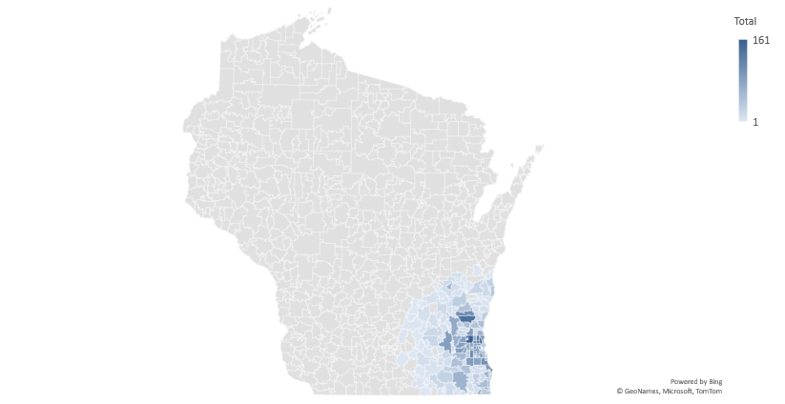
Density of MS (within 100km)
Notes:
Cluster around MS center as expected, low cases further away due to patients being treated elsewhere.

Slide 13
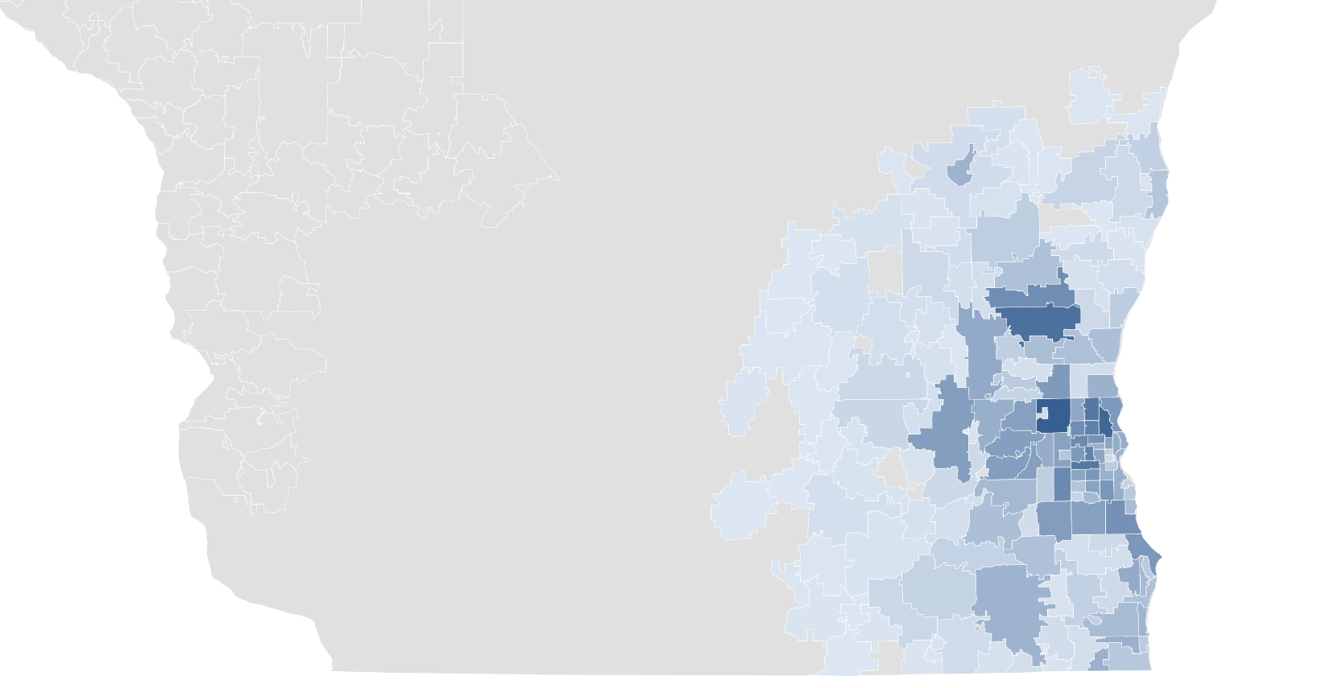
Density of MS (within 100km)
Location of aluminum
Factory (53095)
City | Zip Code | Distance (KM) | Total MS | MS per 100,000
West Bend | 53095 | 41 | 141 | 511
West Bend | 53090 | 46 | 106 | 495
Milwaukee | 53226 | 0 | 93 | 492
Germantown | 53022 | 20 | 91 | 478
Milwaukee | 53223 | 14 | 132 | 462
Menomonee Falls | 53051 | 13 | 161 | 437
Milwaukee | 53213 | 3 | 119 | 432
Milwaukee | 53222 | 4 | 110 | 415
Milwaukee | 53225 | 7 | 106 | 395
Milwaukee | 53214 | 4 | 132 | 372
Location of MS center (53226)
Notes:
Even in the raw MS cases, we can see some disproportionalities in SE Wisconsin

Slide 14
Twenty highest MS densities per 100,000 by ZIP codes within 100 kilometers of the MS center
County | City | Zip Code | Distance (KM) | Total MS | Population | MS per 100,000
Waukesha | Lannon | 53046 | 15 | 13 | 1177 | 1105
Waukesha | Butler | 53007 | 7 | 16 | 1835 | 872
Washington County | Hubertus | 53033 | 26 | 33 | 4992 | 661
Waukesha | Elm Grove | 53122 | 3 | 39 | 6172 | 632
Milwaukee County | Milwaukee | 53295 | 39 | 1 | 181 | 552
Washington County | Kewaskum | 53040 | 54 | 45 | 8154 | 552
Washington County | West Bend | 53095 | 41 | 141 | 27587 | 511
Washington County | West Bend | 53090 | 46 | 106 | 21415 | 495
Milwaukee County | Milwaukee | 53226 | 0 | 93 | 18907 | 492
Washington County | Jackson | 53037 | 32 | 49 | 9976 | 491
Dodge | Theresa | 53091 | 60 | 9 | 1855 | 485
Washington County | Germantown | 53022 | 20 | 91 | 19041 | 478
Waukesha | Okauchee Lake | 53069 | 33 | 3 | 633 | 474
Milwaukee County | Milwaukee | 53223 | 14 | 132 | 28596 | 462
Racine | Caledonia | 53108 | 26 | 15 | 3270 | 459
Sheboygan | Random Lake | 53075 | 58 | 15 | 3298 | 455
Waukesha | North Prairie | 53153 | 32 | 11 | 2434 | 452
Waukesha | Sussex | 53089 | 18 | 85 | 19151 | 444
Waukesha | Menomonee Falls | 53051 | 13 | 161 | 36806 | 437
Milwaukee County | Milwaukee | 53213 | 3 | 119 | 27573 | 432
Location of MS center
Location of aluminum factory

Slide 15
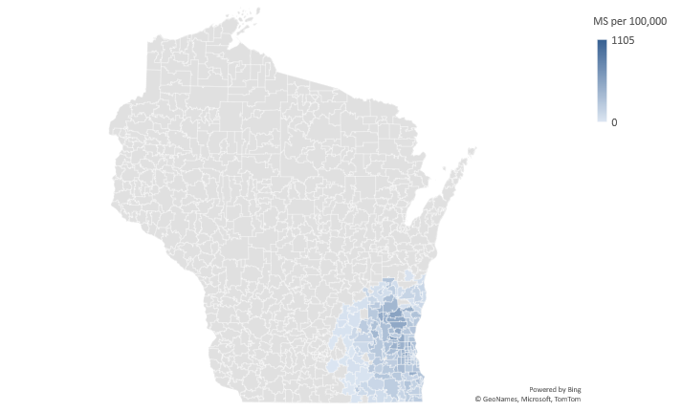
Density of MS per 100,000 population (within 100km)

Slide 16
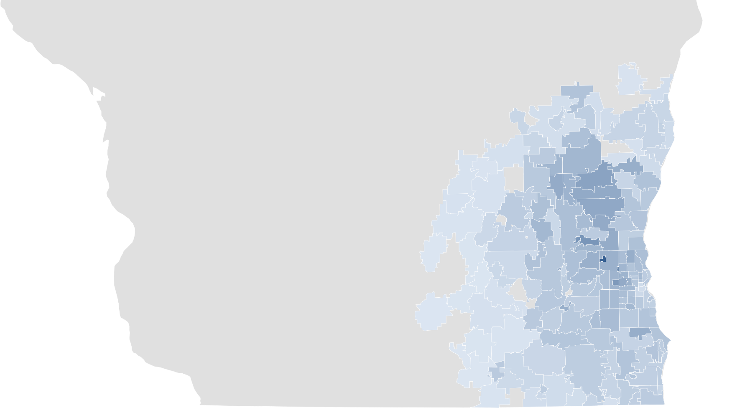
Density of MS per 100,000 population (within 100km)
Location of aluminum
Factory (53095)
City | Zip Code | Distance (KM) | Total MS | MS per 100,000
Lannon | 53046 | 15 | 13 | 1105
Butler | 53007 | 7 | 16 | 872
Hubertus | 53033 | 26 | 33 | 661
Elm Grove | 53122 | 3 | 39 | 632
Milwaukee | 53295 | 39 | 1 | 552
Kewaskum | 53040 | 54 | 45 | 552
West Bend | 53095 | 41 | 141 | 511
West Bend | 53090 | 46 | 106 | 495
Milwaukee | 53226 | 0 | 93 | 492
Jackson | 53037 | 32 | 49 | 491
Location of MS center (53226)

Slide 17
Twenty highest MS densities of total hospital patients by ZIP codes within 100 kilometers of the MS center
Placeholder slide for the above titled table (results pending)

Slide 18
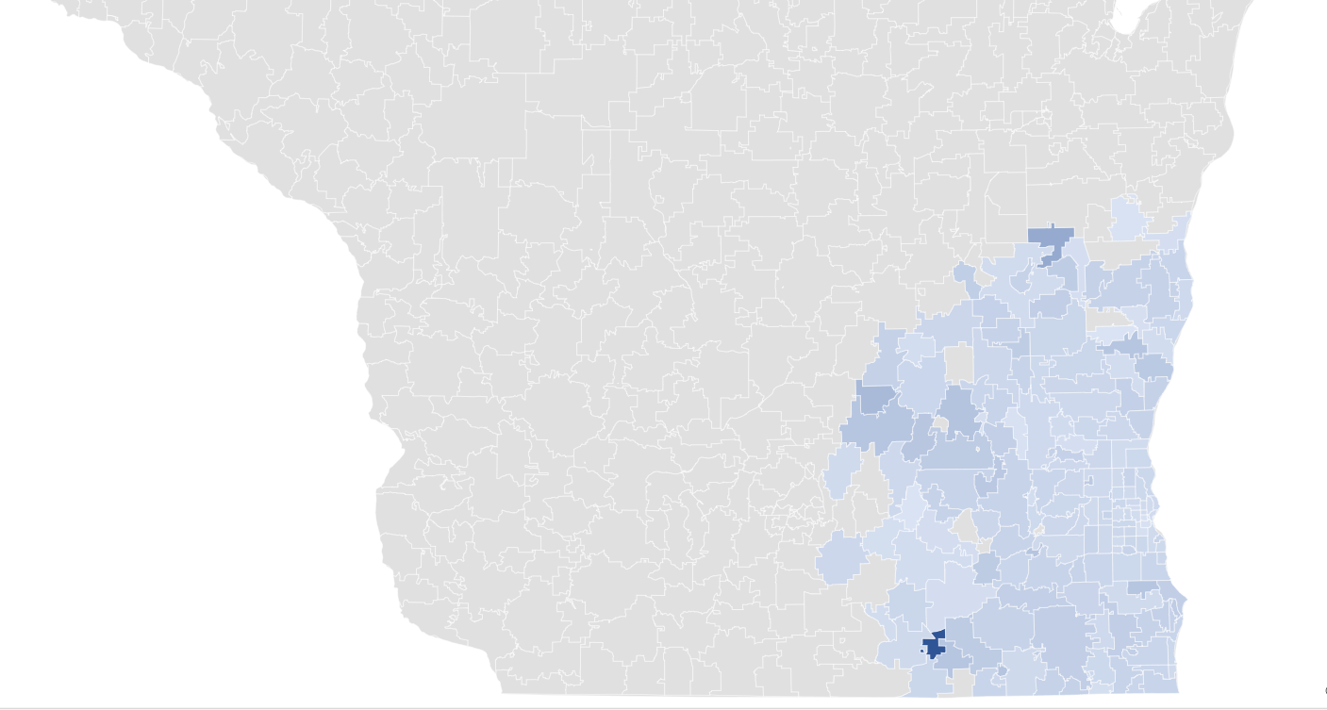
Density of MS per 100,000 of total hospital patients (within 100km)
City | Zip Code | Distance (KM) | Total MS | MS per 100,000
Avalon | 53505 | 78 | 1 | 4000
Malone | 53049 | 95 | 9 | 1661
Fall River | 53932 | 91 | 1 | 1220
Hingham | 53031 | 66 | 1 | 1111
Juneau | 53039 | 65 | 10 | 940
North Prairie | 53153 | 32 | 11 | 927
Williams Bay | 53191 | 67 | 6 | 917
Darien | 53114 | 76 | 3 | 906
Caledonia | 53108 | 26 | 15 | 903
Columbus | 53925 | 87 | 2 | 897

Slide 19
Discussion
We report disproportional densities of MS patients cared for within a single large academic center in Southeast Wisconsin
Patients were clustered near the hospital center, as expected
However, we noted several areas further away with higher densities that cannot be solely explained by proximity

Slide 20
Discussion
Wisconsin is disproportionately impacted by some environmental factors such as decreased vitamin D due to lower sun exposure
More precise differences within Southeast Wisconsin cannot be solely explained by these environmental factors which affect the entire state

Slide 21
Discussion
The examination of precise prevalence measurements within the United States is difficult due to the lack of unified healthcare records, recent estimates of MS are 363 cases per 100,000 population
Our overall density in Southeast Wisconsin was 240 per 100,000
76 ZIP codes out of 171 within 100 kilometers of the MS center showed a density higher than 240
This calls to investigation of local environmental factors
Wallin MT, Culpepper WJ, Campbell JD, et al. The prevalence of MS in the United States: A population-based estimate using health claims data. Neurology. 2019;92(10):e1029. doi:10.1212/WNL.0000000000007035

Slide 22
Discussion
Several recent studies have discovered high levels of aluminum in brain tissues of people with MS and other neurological disease
We noted clusters of MS patients near the ZIP code 53095, a location where a major aluminum factory operated until 2001
Exley C, Clarkson E. Aluminium in human brain tissue from donors without neurodegenerative disease: A comparison with Alzheimer’s disease, multiple sclerosis and autism. Scientific Reports 2020 10:1. 2020;10(1):1-7. doi:10.1038/s41598-020-64734-6
Mold M, Chmielecka A, Rodriguez MRR, et al. Aluminium in Brain Tissue in Multiple Sclerosis. International Journal of Environmental Research and Public Health. 2018;15(8). doi:10.3390/IJERPH15081777
Linhart C, Davidson D, Pathmanathan S, Kamaladas T, Exley C. Aluminium in Brain Tissue in Non-neurodegenerative/Non-neurodevelopmental Disease: A Comparison with Multiple Sclerosis. Exposure and Health. 2020;12(4):863-868. doi:10.1007/S12403-020-00346-9/FIGURES/2
Lukiw WJ, Kruck TPA, Percy ME, et al. Aluminum in neurological disease – a 36 year multicenter study. Journal of Alzheimer’s disease & Parkinsonism. 2019;8(6). doi:10.4172/2161-0460.1000457

Slide 23
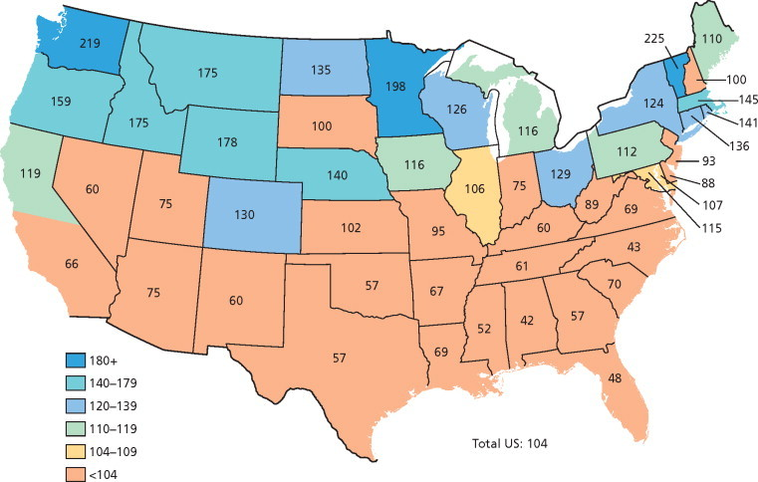
Discussion
Outside of Wisconsin, there are multiple geographic areas with high prevalence of MS which also have nearby aluminum plants
Compston & Confavreux, 2006
Numbers based on Case–control ratios (× 100) for multiple sclerosis by state of residence at entry into active duty for white male veterans of the Second World War.
Notes:
Although this data is old and may not provide accurate measurements, we can use this to assess geographic differences

Slide 24
Washington & Pacific Northwest
Supplied 40 percent of the nation’s aluminum in the 1980s
Washington was also the site of a major aluminum plant, possibly a contributing factor to MS development

Slide 25
Sardinia
Mediterranean island near Italy
Prevalence estimates of MS are 299/100,000.
The site of an aluminum plant until 2012, warranting further investigation in this population

Slide 26
Brescia & Lazio, Italy
Disproportionate MS prevalence relative to other regions in Italy
Study revealed metal contamination of garden soil with aluminum in Brescia
Large aluminum recycling center is located in Lazio, Italy, which also happens to be a region with a high prevalence of MS
Ferri R, Hashim D, Smith DR, et al. Metal contamination of home garden soils and cultivated vegetables in the province of Brescia, Italy: Implications for human exposure. Science of The Total Environment. 2015;518-519:507-517. doi:10.1016/J.SCITOTENV.2015.02.072
Bargagli AM, Colais P, Agabiti N, et al. Prevalence of multiple sclerosis in the Lazio region, Italy: use of an algorithm based on health information systems. Journal of Neurology. 2016;263(4):751. doi:10.1007/S00415-016-8049-8

Slide 27
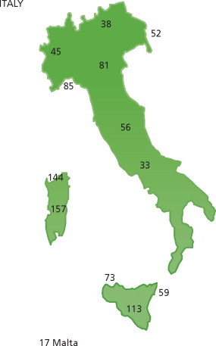
Italy
Brescia
Lazio
Sardinia
Compston & Confavreux, 2006

Slide 28
Other Possible Associations
Northern Ireland, prevalence of MS estimated around 200 per 100,000 → contains aluminum recycling factory
Germany, prevalence of MS estimated around 150 per 100,000 → explosive rise in German aluminum production and processing in the 1950s
Several other observational links can be made regarding the presence of aluminum handling in regions with high prevalence of MS

Slide 29
Possible Explanation?
Aluminum is used as an adjuvant to boost the immune responses to vaccines
Perhaps exposure to high levels of the metal can result in overactive and uncontrolled immune responses to other known risks (such as EBV)
HogenEsch H, O’Hagan DT, Fox CB. Optimizing the utilization of aluminum adjuvants in vaccines: you might just get what you want. npj Vaccines 2018 3:1. 2018;3(1):1-11. doi:10.1038/s41541-018-0089-x

Slide 30
Conclusions
First study to examine prevalence and clusters of MS patients in Southeast Wisconsin
Noted clusters of MS patients near the ZIP code 53095, a location where a major aluminum factory operated until 2001

Slide 31
Conclusions
Recent literature shows possible associations between MS and aluminum, as well as epidemiological data
Further investigations are essential to determine if exposures should be avoided or treated.
Although no conclusive links can be made, our findings call for further investigations for potential environmental exposures which could be contributing to the disproportionate distribution of MS cases in Southeast Wisconsin

Slide 32
Future Directions
Assess MS density of all patients within our hospital → further control for proximity and patient-base bias
Investigate other locations with aluminum exposure and high cases of MS
Measure aluminum burden in MS patients to assess for disease onset and severity

Slide 33
Acknowledgement
We’d like to thank the entire research team, the Medical College of Wisconsin, and the patients involved in this study for helping us progress MS research

Slide 34
Thank You For Listening! Questions?
MS
EBV
Vitamin D
Smoking
Unknown?
Genetics
Aluminum?

