Slide 1


FEASIBILITY, SAFETY, AND PATIENT PERCEPTIONS OF A 13-WEEK TELEWELLNESS PROGRAM IN MS DURING COVID-19
Hina Garg, PT, MS, PhD, NCS
Charlotte Rutherfurd, PT, DPT
Jared Labrum PTA
Bet Hawley PTA
Emily Gard, DPT
James Davis, DPT
Affiliations: Rocky Mountain University of Health Professions

Slide 2

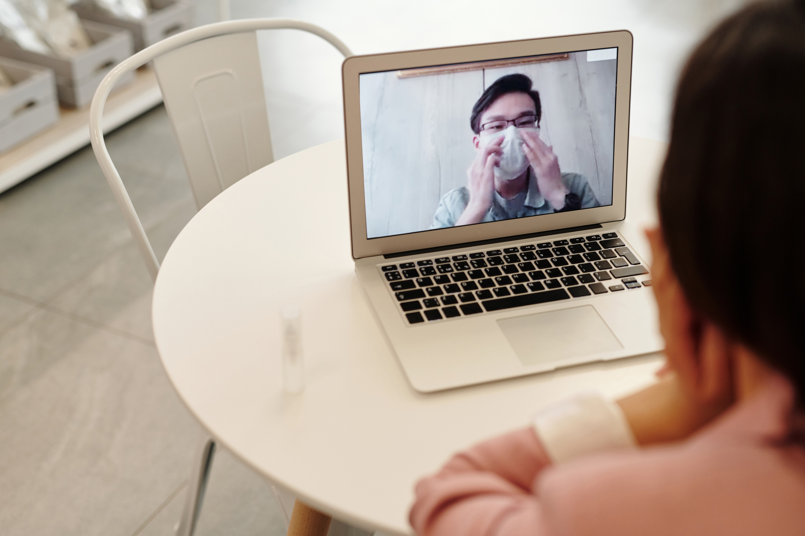

BACKGROUND
Decreased social support and levels of physical activity in people with MS
Barriers of exercise participation:
  Transportation
  Time
  Finances
  Access to services

Slide 3



STUDY AIMS
To investigate the feasibility, safety, and initial outcomes of a 13-week group telewellness exercise program in individuals with MS
(2) To identify participant and provider perceptions of the telewellness exercise program

Slide 4


METHODS
01
Seventeen Individuals with MS
  Mean [SD] age= 53.5 [12.3]
  BMI= 28.2 [7.1]
  Disease severity = 29.7% reported severe or very severe state
02
Thirteen-week group telewellness exercise program
  Aerobic, resistance, balance, and flexibility
  Low, medium, and high-level function groups
03
Pre- and post-training functional status questionnaires and semi-structured interviews

Slide 5


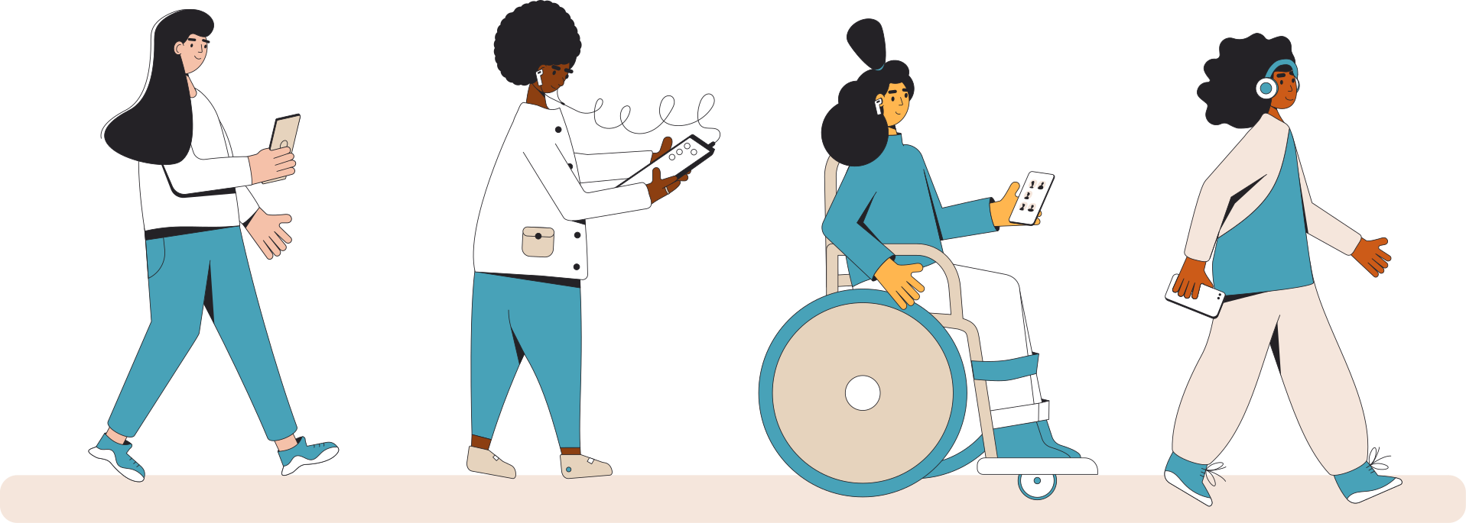
ASSESSMENT METHODS
Feasibility
Safety
Training-related changes
Participant perceptions
Provider perceptions
Adherence to prescribed dose
Number of adverse events
Thematic analysis
Thematic analysis
Within-group differences in functional status
Notes:
Computer adaptive test to determine an individual’s level of functional status given certain personal factors such as age, gender, acuity etc
Qualitative data was coded and triangulated using thematic analysis.

Slide 6




QUANTITATIVE RESULTS
FUNCTIONAL STATUS
AT 0 AND 13 WEEKS
FEASIBILITY
79% Adherence
SAFETY
Minimal adverse events reports
FOTO 0
FOTO
PREDICTED
FOTO 13
TRAINING-RELATED CHANGES
Changes (p<.05) in functional status post-training [effect size=0.62]
100% achieved predicted functional status (p>.05)

Slide 7

QUALITATIVE
RESULTS
Physical and social benefits
Participant Themes
Limitations
Suggested Improvements

Slide 8

PARTICIPANT THEMES, SUBTHEMES, AND QUOTES
01
BENEFITS
Counters transportation difficulties
Increased personal accountability to exercise
Convenience
Social Interaction
02
LIMITATIONS
1. “It’s super helpful to not have to calculate travel time and energy into getting to and from the clinic”
Safety concerns
Technological concerns
Environmental concerns
Lack of in-person social contact
Lack of in-person skilled help
2. “Number one disadvantage was when the video cuts out”
03
SUGGESTED IMPROVEMENTS
3. “I guess if we had, not like a circulation of stuff, but like, check it out or something”
Assistance with technology
Check out equipment for home
Staff training specifically for telehealth

Slide 9

QUALITATIVE
RESULTS
Clinical Challenges
Technology Challenges
Provider Themes
Initial Implementation Challenges
Safety Challenges
Benefits of telehealth
Solutions to Problems

Slide 10

PROVIDER THEMES, SUBTHEMES, AND QUOTES
01
INITIAL IMPLEMENTATION
Suitable telehealth software
Significant change to established clinic process
Required support from several parties
02
CLINICAL FACTORS
Lack of clinical set-up for telehealth
Lack of protocols for telehealth
Limitation in modalities/outcome measures
1. “we didn't have any like standardized procedures or any standardized paperwork.”
2. “...her house just wasn't big enough or organized in a way that she could go into a private room.”
03
TECHNOLOGY
Lack of appropriate technology
Limited technology literacy
Appropriate use of technology
3. "Individuals were still not familiar with Google, which was not what we had expected.”

Slide 11
PROVIDER THEMES, SUBTHEMES, AND QUOTES
04
SAFETY
Risk of falls
Unstable conditions/potential adverse events
05
SOLUTIONS TO PROBLEMS
Telehealth onboarding process
Increased repetitions with troubleshooting
Discover new methods to evaluate and treat
4. “I never felt confident pushing the person to develop certain errors… I didn't have my hands on them for safety."
5. "Delegation of tasks was important. Appropriate setup and practice for the patient to get familiar with technology was important.”
06
BENEFITS OF TELEHEALTH
Increased outreach to patients
Decreased no-show rate
Continuity of care
Increased adherence to plan of care
6. “It’s really a behavioral change that I see.”

Slide 12
SUMMARY OF RESULTS
Feasibility
Safety
Training-related changes
Participant perceptions
Provider perceptions
Adherence to prescribed dose
✓ 79% Adherence
Number of adverse events
✓ Minimal adverse events reports
Thematic analysis
✓ Themes: physical and social benefits, limitations, suggested improvements
Thematic analysis
✓ Themes: initial implementation, clinical factors, technology, safety, solutions, benefits of telehealth
Within-group differences in functional status
✓ Changes (p<.05) in functional status post-training [effect size=0.62]
✓ 100% achieved predicted functional status (p>.05)

Slide 13
CONCLUSION
FUTURE RESEARCH
13-week online group telewellness exercise program is feasible, safe, effective, and well-received by patients with MS and by providers
To determine telewellness effectiveness with randomized controlled designs
To design telewellness-specific clinical staff training
Notes:
A telewellness group program not only increases physical activity but also enhances social wellness in people with MS. Findings from this study suggest that group telewellness programs may be successful alternatives or supplements to in-clinic wellness programs.
Comprehensive online group exercise programs for individuals with MS would facilitate increased participation in physical activity by enhancing access to programs that are specifically designed to meet the wellness needs of this population.

Slide 14


REFERENCES
1. Laver KE, Adey-Wakeling Z, Crotty M, Lannin NA, George S, Sherrington C. Telerehabilitation services for stroke. Cochrane Database Syst Rev. 2020;1(1):CD010255. doi:10.1002/14651858.CD010255.pub3
2. Beit Yosef A, Jacobs JM, Shenkar S, et al. Activity performance, participation, and quality of life among adults in the chronic stage after acquired brain injury- The feasibility of an occupation-based telerehabilitation intervention. Front Neurol. 2019;10:1247. doi:10:1247. doi:10.3389/fneur.2019.01247
3. Chatto CA, York PT, Slade CP, Hasson SM. Use of a telehealth system to enhance a home exercise program for a person with Parkinson disease: A case report. J Neurol Phys Ther. 2018;42(1):22-29. doi:10.1097/NPT.0000000000000209
4. Cottrell MA, Hill AJ, O'Leary SP, Raymer ME, Russell TG. Service provider perceptions of telerehabilitation as an additional service delivery option within an Australian neurosurgical and orthopaedic physiotherapy screening clinic: A qualitative study. Musculoskelet Sci Pract. 2017;32:7-16. doi:10.1016/j.msksp.2017.07.008
5. Bhuva S, Lankford C, Patel N, Haddas R. Implementation and patient satisfaction of telemedicine in spine physical medicine and rehabilitation patients during the COVID-19 shutdown. Am J Phys Med Rehabil. 2020;99(12):1079-1085. doi:10.1097/PHM.0000000000001600
6. Zhu C, Williamson J, Lin A, et al. Implications for telemedicine for surgery patients after COVID-19: Survey of patient and provider experiences. Am Surg. 2020;86(8):907-915. doi:10.1177/0003134820945196
7. Campbell J, Theodoros D, Russell T, Gillespie N, Hartley N. Client, provider and community referrer perceptions of telehealth for the delivery of rural paediatric allied health services. Aust J Rural Health. 2019;27(5):419-426. doi:10.1111/ajr.12519
8. Mammen JR, Elson MJ, Java JJ, et al. Patient and physician perceptions of virtual visits for Parkinson's Disease: A qualitative study. Telemed J E Health. 2018;24(4):255-267. doi:10.1089/tmj.2017.0119

Slide 15


THANK YOU!

