Slide 1

Epstein Barr Virus, but not Herpes Simplex Viruses, is associated with Multiple Sclerosis (MS)
Presentation by Jakob T. Zehms, MS1
Authors: Jakob Zehms*, Mokshal H. Porwal*, Samantha O’Dell, DeAnna Finnessy, Amber Salter and Ahmed Z. Obeidat
* Jakob Zehms and Mokshal H. Porwal contributed equally to this project

Slide 2
Disclosures
Dr. Obeidat received personal compensation for participation in scientific advisory boards, steering committees, and/or for speaking engagements from Alexion pharmaceuticals, Biogen, Biologix, Bristol Myers Squibb, Celgene, EMD Serono, Genentech, GW Pharma, Horizon pharmaceuticals, Novartis (local and global), Sanofi/Genzyme, TG therapeutics, Viela Bio. Consultant fee for serving as a scientific reviewer for Exploration-Hypothesis Development Award (EHDA) peer review panel of the 2020 Multiple Sclerosis Research Program (MSRP) for the Department of Defense Congressionally Directed Medical Research Programs (CDMRP). Honoraria from Medscape, WebMD, and MJH Life Sciences.
Dr. Obeidat serves as a site PI for studies funded (directly paid to MCW) by National MS Society/PCORI; Atara biotherapeutics, Biogen, Celgene, Bristol Myers Squibb, EMD Serono, Genentech, GW pharma, and Novartis. Sub-I on studies funded by AbbVie and Sanofi/Genzyme.
Dr. Obeidat received research funds from Central for immunology, Research Affairs committee and Neuroscience research center.
Dr. Obeidat holds unpaid positions:
The editorial board of the International Journal of MS care - IJMSC
The advisory committee of the Americas Committee for Treatment and Research in Multiple Sclerosis - ACTRIMS
The board of governors of the Consortium of MS centers – CMSC.
The board of directors of Global Music and Wellness – GMW.
As the Chair for MS professionals in Training special interest group through the CMSC
The steering committee for Artists working in Education

Slide 3
Objectives
Review the current understanding of multiple sclerosis and its complicated etiology
Assess literature correlating infection by Herpes Viruses including HSV-1 HSV-2 and EBV with the pathogenesis of multiple sclerosis
Present our findings correlating EBV seropositivity with a diagnosis of MS
Discuss future implications of EBV results in clinical care and diagnosis

Slide 4
Complicated diagnostics in multiple sclerosis
Multiple sclerosis (MS) is an immune-mediated, demyelinating and neurodegenerative disease of the central nervous systems (CNS).
No biomarkers for diagnosis with high enough specificity/sensitivity
Many MS mimickers (e.g., Neuromyelitis Optica, MOG associated disease, CNS infections, metabolic disorders, genetic leukodystrophies)
Current Diagnostic Procedure
Revised 2017 McDonald’s Criteria
Clinical history and physical exam
Supportive cerebrospinal fluid
Supportive ancillary testing (e.g., MRI, OCT, VEP)
Notes:
Intent to simplify/clarify, facilitate earlier diagnosis, preserve specificity/promote appropriate application to decrease misdiagnosis
Applied primarily to typical demyelinating syndromes (Optic Neuritis, Intranuclear Ophthalmoplegia, Cerebellar Syndrome, or Transverse Myelitis)
MRI clarifications: ≥3 mm in long axis, periventricular lesions abut ventricles, juxtacortical abut cortex (can count cortical lesions)
Unique Oligoclonal Banding is technically 2 or more; however, some labs still use 4 or more criteria
Validation studies typically in age <50, Caucasian US/Canada/Europe

Slide 5
Foundation of MS Diagnosis
The identification of a syndrome typical of MS-related demyelination
Objective evidence of central nervous system involvement
Demonstration of dissemination in space
Demonstration of dissemination in time
No better explanation other the MS
Slide by Dr. Ahmed Obeidat M.D./PhD.

Slide 6
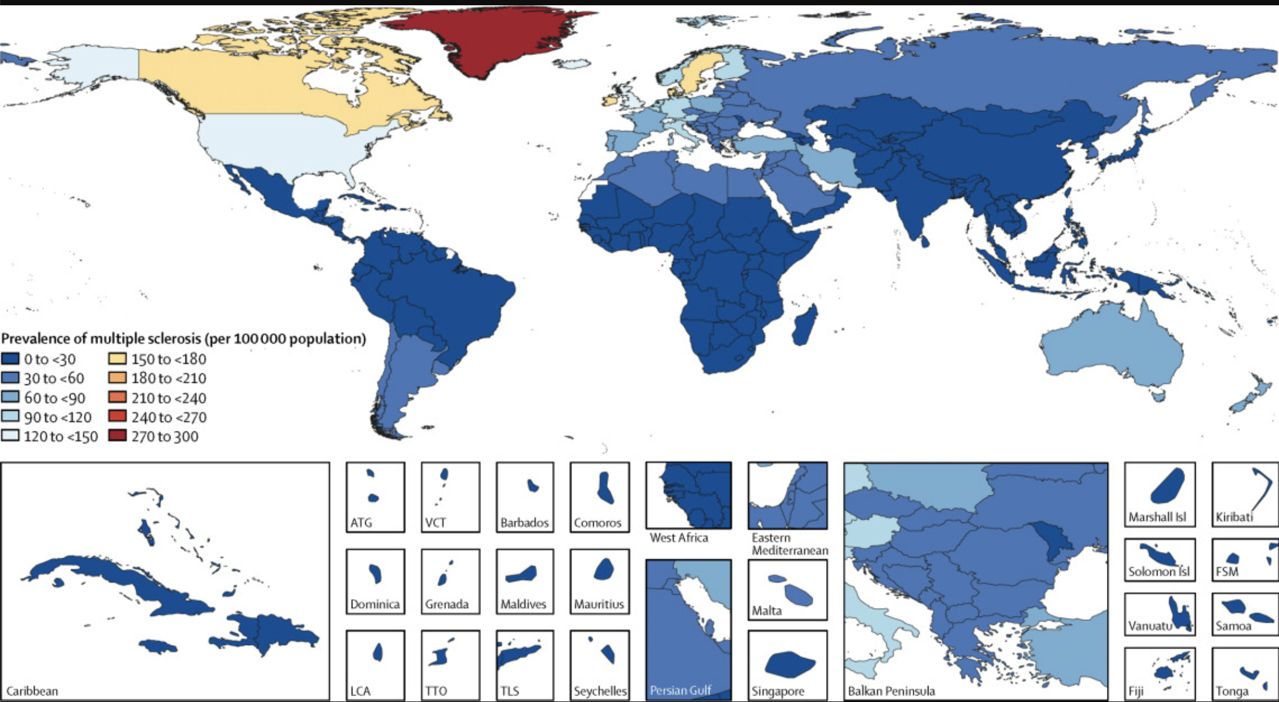
Etiology of Multiple Sclerosis - Environment
MS prevalence increases with geographic latitude¹
Vitamin D as a possible explanation?
Vitamin D plays an important role in MS pathogenesis¹
Moderates demyelination and potentiates remyelination²
Halts oligodendrocyte apoptosis in rat models²
Stenager, Egon. “A Global Perspective on the Burden of Multiple Sclerosis.” The Lancet Neurology, vol. 18, no. 3, 2019, pp. 227–228., https://doi.org/10.1016/s1474-4422(18)30498-8.
1)O'Gorman C, Lucas R, Taylor B. Environmental risk factors for multiple sclerosis: a review with a focus on molecular mechanisms. Int J Mol Sci. 2012. 2)Goudarzvand M, Javan M, Mirnajafi-Zadeh J, Mozafari S, Tiraihi T. Vitamins E and D3 attenuate demyelination and potentiate remyelination processes of hippocampal formation of rats following local injection of ethidium bromide. Cell Mol Neurobiol. 2010.

Slide 7

Etiology of Multiple Sclerosis –
Genetic
Monozygotic twin studies show 25% concordance rate for MS³
Three-quarters of risk is through other mechanisms
Multiplicative model suggested with >1500 loci possibly eliciting small effects¹
1)O'Gorman C, Lucas R, Taylor B. Environmental risk factors for multiple sclerosis: a review with a focus on molecular mechanisms. Int J Mol Sci. 2012. 3) Mumford CJ, Wood NW, Kellar-Wood H, Thorpe JW, Miller DH, Compston DA. The British Isles survey of multiple sclerosis in twins. Neurology. 1994;44(1):11-15.

Slide 8
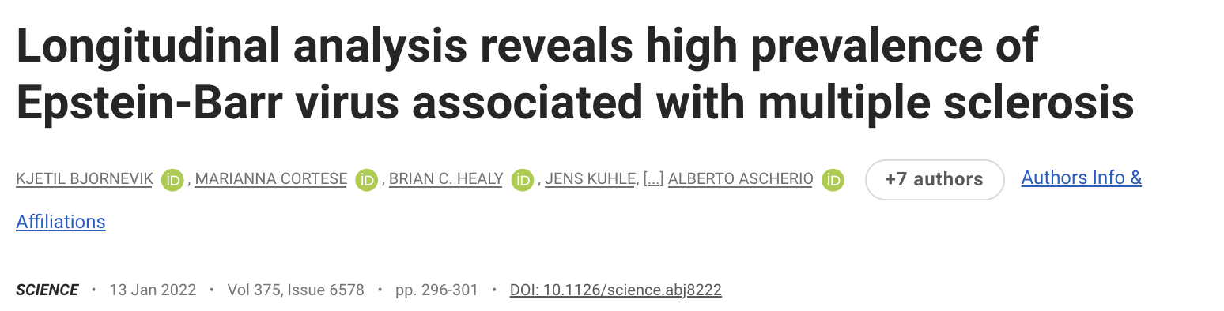

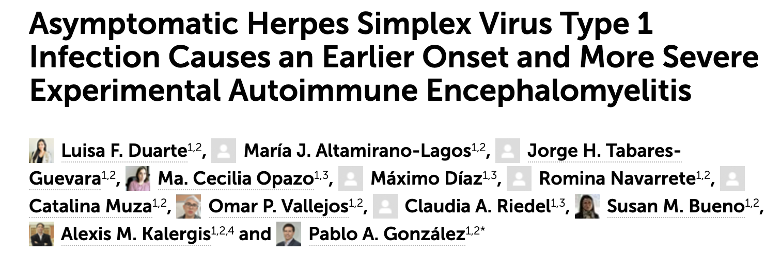
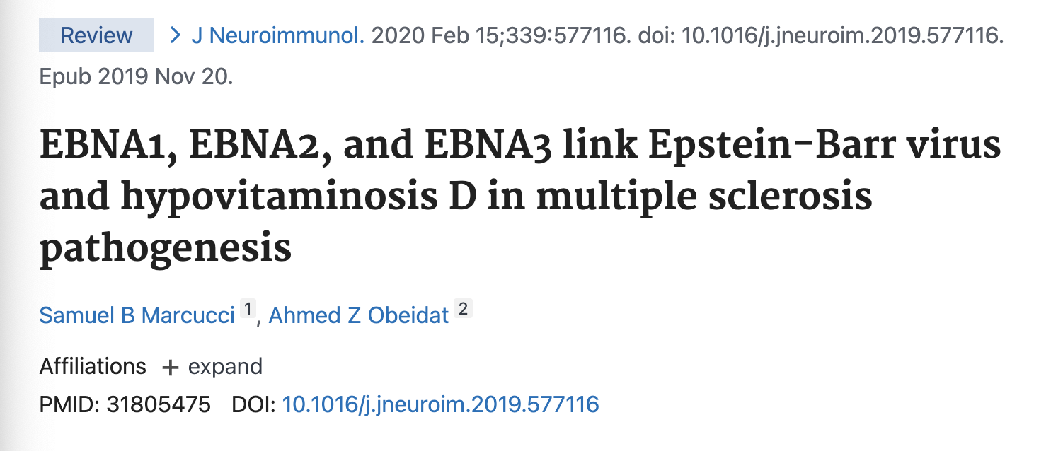
Etiology of Multiple Sclerosis - Viral
Herpes Simplex Virus - 1, Herpes Simplex Virus - 2, and Epstein-Barr Virus are three viruses of interest in the pathogenesis of Multiple Sclerosis
https://www.science.org/doi/10.1126/science.abj8222
https://www.frontiersin.org/articles/10.3389/fnins.2022.817067/full
https://www.frontiersin.org/articles/10.3389/fimmu.2021.635257/full
https://pubmed.ncbi.nlm.nih.gov/31805475/
Notes:
Lots of notes for this page. Explanation of current understanding and results for each study.

Slide 9
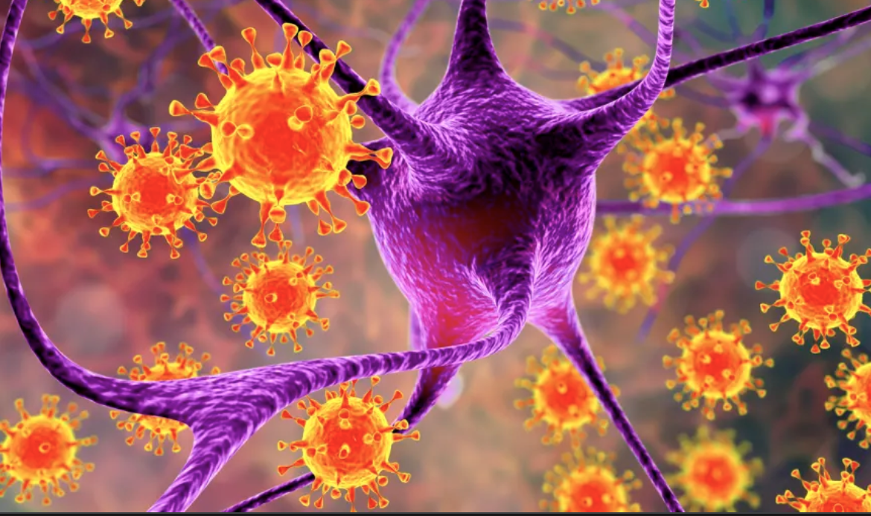
Etiology of Multiple Sclerosis
Why EBV?
Previous EBV infection is nearly universal in MS-patients⁴
This is compared to ~90% for the general population
Mimicry (cross-reactivity) found between Epstein-Barr nuclear antigen 1(EBNA1) with cell adhesion molecule expressed in glial cells of the CNS⁵
Recent study theorizes multimodal mechanism implicating hypovitaminosis D, genetic susceptibility and EBV infection in MS pathogenesis⁶
https://www.healthcentral.com/slideshow/ms-epstein-barr-virus-connection
4. Bjornevik K, Cortese M, Healy BC, et al. Longitudinal analysis reveals high prevalence of Epstein-Barr virus associated with multiple sclerosis. Science. 2022;375(6578):296-301.
5. Lanz, TV, Brewer RC, Ho PP, et al. Clonally expanded B cells in multiple sclerosis bind EBV EBNA1 and GlialCAM. Nature. 2022;603(7900):321-327.
6. Marcucci SB, Obeidat AZ. EBNA1, EBNA2, and EBNA3 link Epstein-Barr virus and hypovitaminosis D in multiple sclerosis pathogenesis. J Neuroimmunol. 2020;339:577116.

Slide 10
Molecular mimicry or infectious activation?
Current mechanism for EBV involvement is being researched
Possible autoreactivity elicited due to EBNA1 attachment to cell adhesion molecules in glial cells of the CNS⁶
Possible that infection with EBV triggers MS through transformation of memory B-cells with associated autoreactive immune response⁶
6. Marcucci SB, Obeidat AZ. EBNA1, EBNA2, and EBNA3 link Epstein-Barr virus and hypovitaminosis D in multiple sclerosis pathogenesis. J Neuroimmunol. 2020;339:577116.

Slide 11
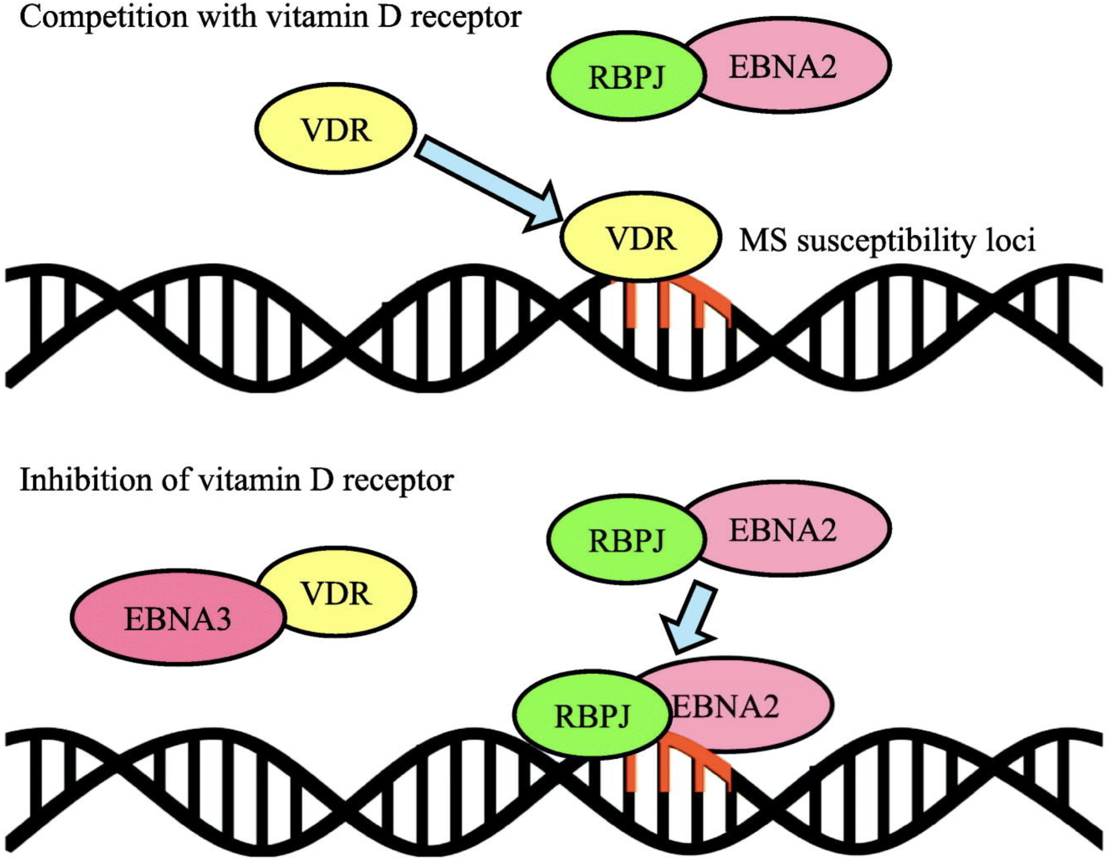
Implications of EBV-MS Mechanism
Possibility for biomarkers as a diagnostic tool
Intersection of genetics, infection, and environment
Vaccine could increase or decrease prevalence of MS
Depends on mechanism
Marcucci SB, Obeidat AZ. EBNA1, EBNA2, and EBNA3 link Epstein-Barr virus and hypovitaminosis D in multiple sclerosis pathogenesis. J Neuroimmunol. 2020;339:577116.

Slide 12



Goal of Our Study
To investigate the prevalence of Herpes Simplex Viruses (HSV-1 / HSV-2) and Epstein-Barr Virus (EBV) seropositivity in MS patients compared to non-MS neurologic control.

Slide 13
Methods
Cross-sectional, single-center cohort study at the Froedtert Hospital and Medical College of Wisconsin
Retrospective review of clinical serological data was reviewed for both MS-patients and non-MS-patients following in the neuroimmunology clinic.
Patients with available serologic IgG data for EBV capsid antigen (EBVCA), EBNA, HSV 1, or HSV2 between July of 2018 and December of 2021 were included in the analysis
Frequency of positive IgG was calculated for each virus and compared between MS and non-MS controls
Chi-square or Fisher Exact tests were applied, and P was set at <0.05

Slide 14
Biomarkers for Herpes Viruses
EBVCA
Does not distinguish between active, latent, or previous infection
Positive titer indicates a previous or current EBV infection
EBNA
(molecular mimicry)
Unable to diagnose acute EBV infection
Positive titer indicates previous EBV infection
HSV1 and HSV2
IgG for HSV-1 and HSV-2 positive 2-3 weeks after acute infection
Does not distinguish between active or latent infection
Positive titer indicates previous or latent infection

Slide 15
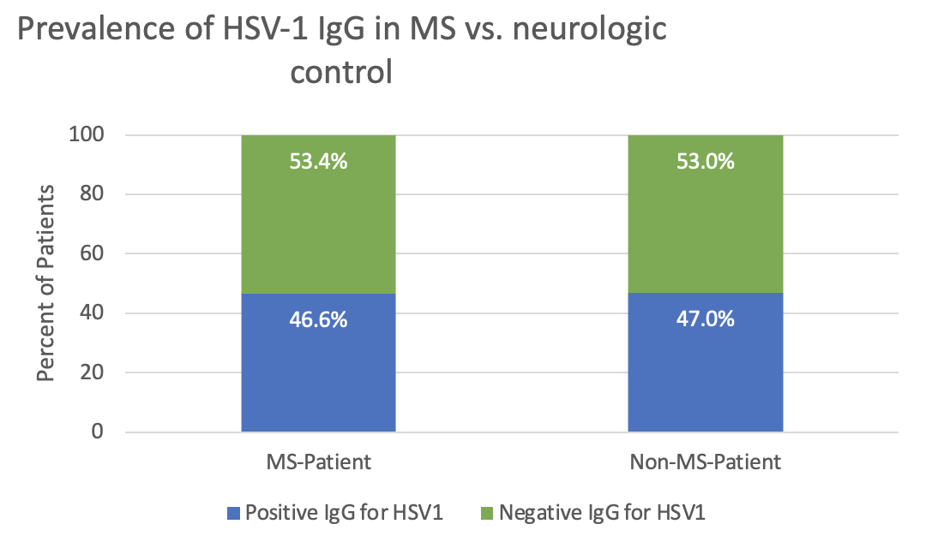
Results – HSV1
Figure 1.
Serum HSV1 IgG was tested in 231 patients
(116 with MS; 115 non-MS)
Seropositivity was confirmed in 54 (46.6%) MS patients versus 54 (47%) non-MS, p=0.95
No statistical difference found between MS patients and neurologic controls
Mean age for Participants with MS: 44.56 y/o
Mean age for Participants without MS: 49.94 y/o

Slide 16
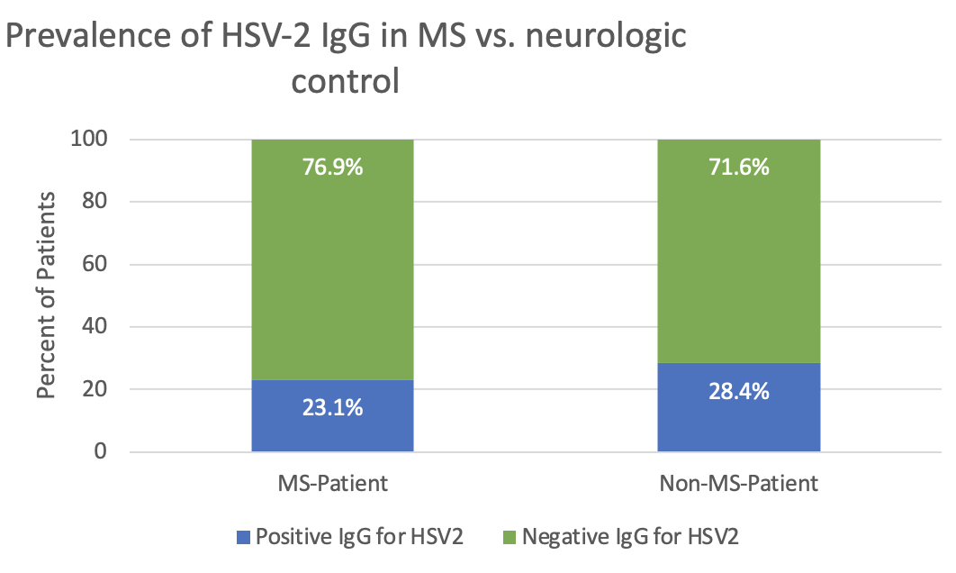
Results – HSV2
Figure 2.
Serum HSV2 IgG was tested in 233 patients (117 with MS; 116 non-MS).
Seropositivity was confirmed in 27 (23.1%) MS patients versus 33 (28.4%) non-MS, p=0.35.
No statistical difference found between MS patients and neurologic controls
Mean age for Participants with MS: 46.00 y/o
Mean age for Participants without MS: 50.03 y/o

Slide 17
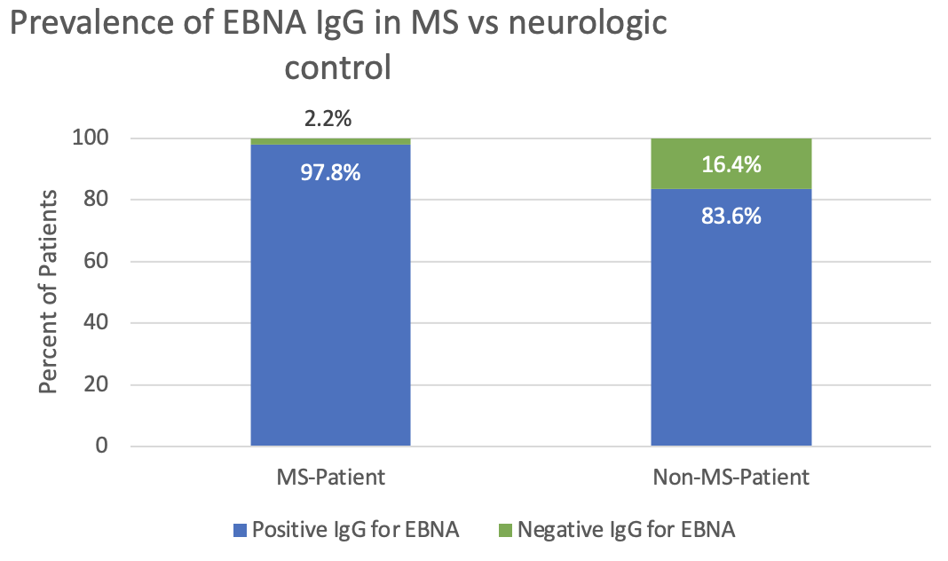
Results – EBNA
Figure 3.
Serum EBNA IgG was tested in 100 patients (45 with MS; 55 non-MS).
Seropositivity was confirmed in 44 (97.8%) MS patients versus 46 (83.6%) non-MS, p=0.02 (Fisher Exact).
Significant statistical difference (P=0.02) between MS patients and neurologic controls
Mean age for Participants with MS: 38.78 y/o
Mean age for Participants without MS: 49.89 y/o
Notes:
Make sure to look at age for this slide

Slide 18
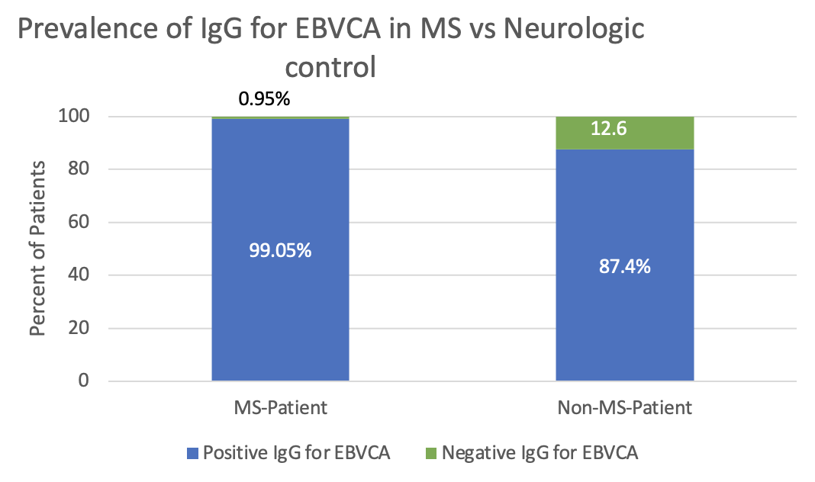
Results – EBVCA
Figure 4.
Serum IgG for EBVCA was tested in 209 patients (106 with MS; 103 non-MS).
Seropositivity was confirmed in 105 (99.05%) MS patients versus 90 (87.4%) non-MS, p=<0.0008.
Significant statistical difference (p<0.0008) between MS patients and neurologic controls
Mean age for Participants with MS: 42.76 y/o
Mean age for Participants without MS: 47.79 y/o

Slide 19
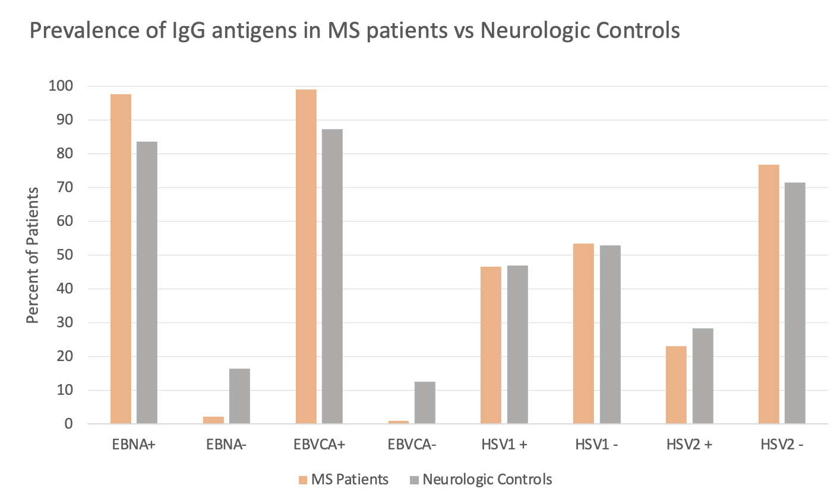
Results Summary
Figure 5.
We found there was a significantly larger proportion of MS patients with a positive EBNA IgG titer compared to neurologic controls (p=0.02)
We found there was a significantly larger proportion of MS patients with a positive EBVCA IgG titer compared to neurologic controls (p=<0.0008)
The proportions of patients with positive HSV1 and HSV2 IgG titers were not significantly different between MS patients and neurologic controls (p=0.95, p=0.35 respectively)

Slide 20
Discussion and Implications
Cannot rule out EBNA mediated mechanism of MS pathogenesis
Significant support for EBV involvement in pathogenesis of MS – “necessary but not sufficient”
Eliminated a source of variation by other autoimmune and/or demyelinating diseases by using neurologic controls in place of generic (e.g., healthy controls)

Slide 21


Limitations in Time and Space
We are unable to determine the time or status of infection for the various HVs through IgG titers alone
Time between infection and MS pathogenesis was not determined
Study includes data solely from patients treated in southeastern Wisconsin at the Froedtert Hospital and The Medical College of Wisconsin
Multifocal etiology indicates possible influence by genetics and environment
21

Slide 22

Questions or Comments

Slide 23
Acknowledgments
I want to convey a heartfelt appreciation to everyone involved in this project. A special thanks to our team including Mokshal H. Porwal, Samantha O’Dell, DeAnna Finnessy, and Amber Salter and to the incredible mentor Ahmed Obeidat M.D./PhD.
Additionally, I want to thank the Foundation of the Consortium of Multiple Sclerosis Centers for hosting my team and I at this conference. The work pursued here is of vital importance and we feel privileged to be able to contribute.
Notes:
Add images and mention collaborators and sources of funding

Slide 24
Thank You!
Notes:
Add images and mention collaborators and sources of funding

Slide 25
References
1. O'Gorman C, Lucas R, Taylor B. Environmental risk factors for multiple sclerosis: a review with a focus on molecular mechanisms. Int J Mol Sci. 2012. 2. Goudarzvand M, Javan M, Mirnajafi-Zadeh J, Mozafari S, Tiraihi T. Vitamins E and D3 attenuate demyelination and potentiate remyelination processes of hippocampal formation of rats following local injection of ethidium bromide. Cell Mol Neurobiol. 2010.
3. Mumford CJ, Wood NW, Kellar-Wood H, Thorpe JW, Miller DH, Compston DA. The British Isles survey of multiple sclerosis in twins. Neurology. 1994;44(1):11-15.
4. Bjornevik K, Cortese M, Healy BC, et al. Longitudinal analysis reveals high prevalence of Epstein-Barr virus associated with multiple sclerosis. Science. 2022;375(6578):296-301.
5. Lanz, TV, Brewer RC, Ho PP, et al. Clonally expanded B cells in multiple sclerosis bind EBV EBNA1 and GlialCAM. Nature. 2022;603(7900):321-327.
6. Marcucci SB, Obeidat AZ. EBNA1, EBNA2, and EBNA3 link Epstein-Barr virus and hypovitaminosis D in multiple sclerosis pathogenesis. J Neuroimmunol. 2020;339:577116.

