Slide 1
Effects on Quality of Life, Disease Impact and Physical Activity of a Day Wellness Program for People Living with Multiple Sclerosis Before and During the COVID-19 Pandemic
Tiffany Malone, MSW, MSCS
Program Manager- MS Achievement Center
2022 Annual Meeting of Consortium of Multiple Sclerosis Centers
Platform Presentation- DXM12
June 2, 2022

Slide 2
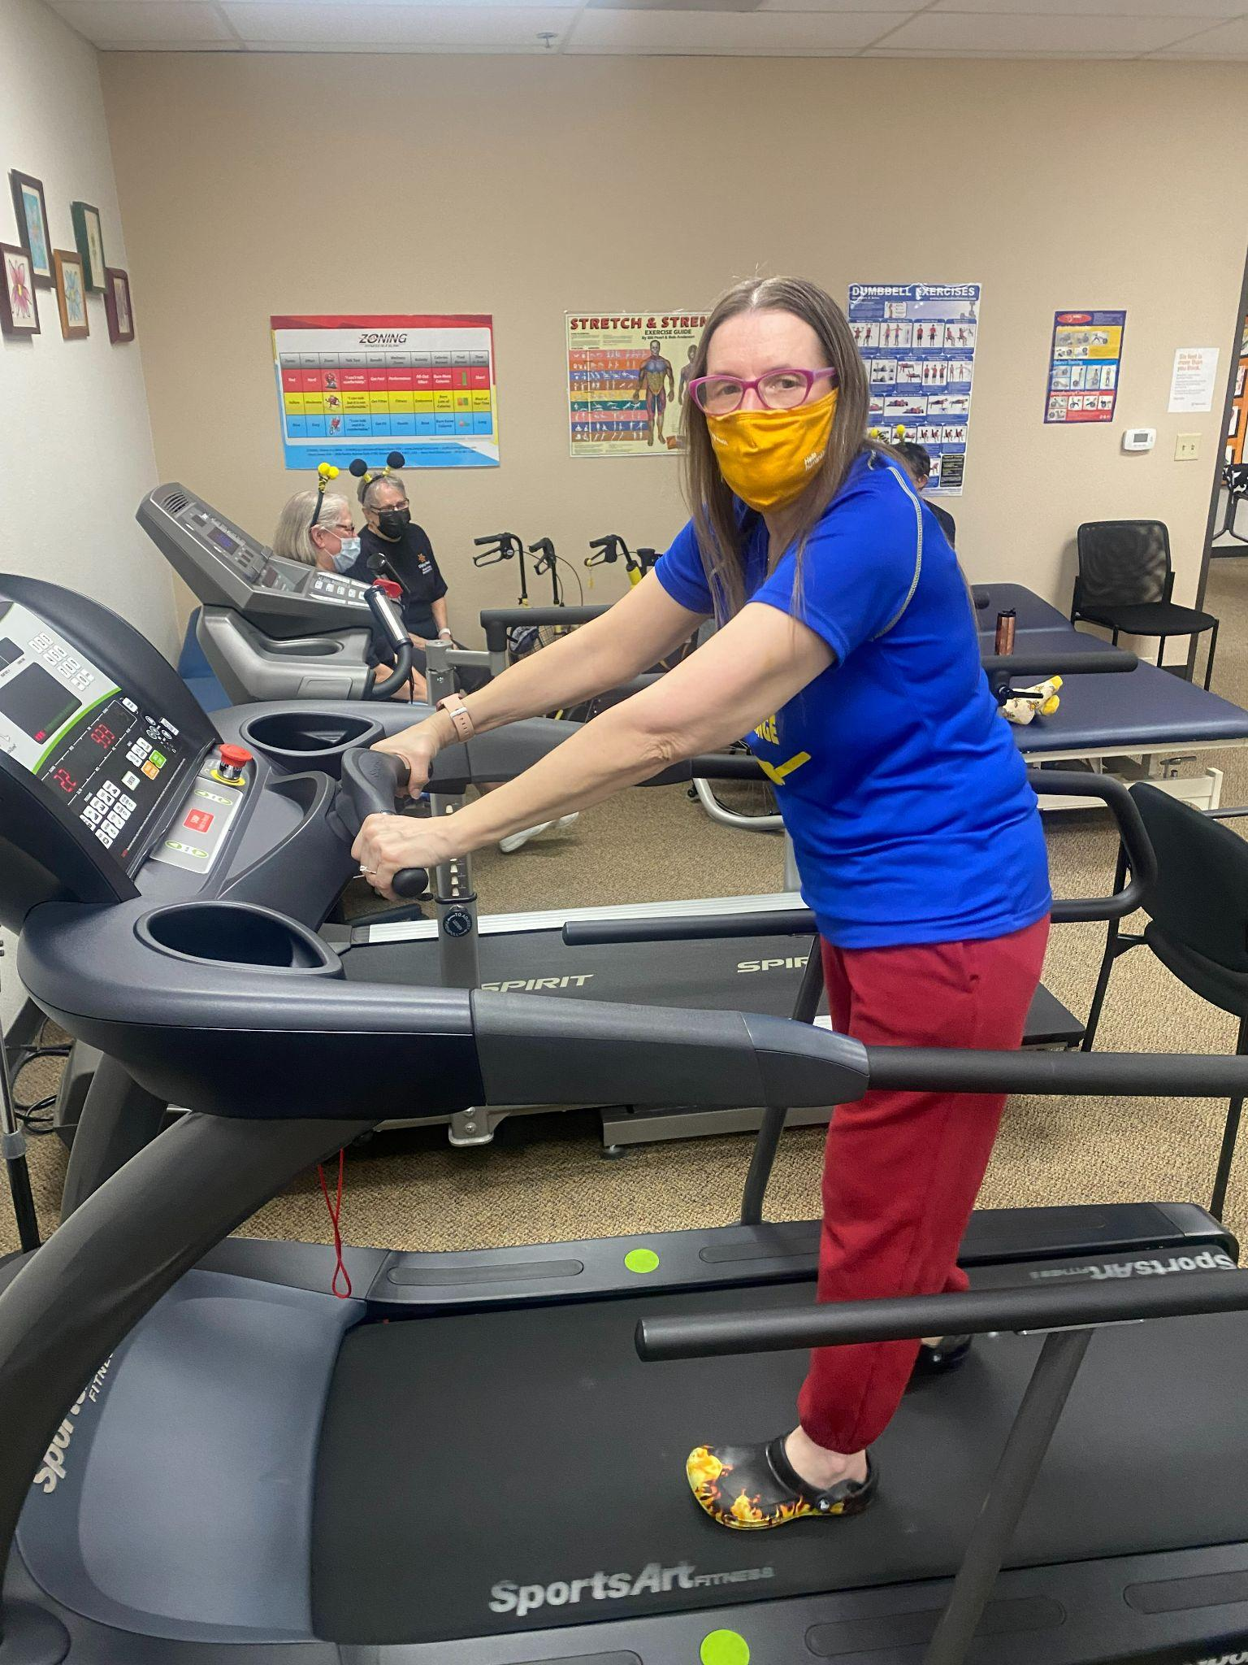
Multiple Sclerosis Achievement Center
Mission
Provide education and support for physical, cognitive and emotional well-being to people living with multiple sclerosis and their loved ones
Goals
Focus on quality of life for people living with a chronic disease
Decrease caregiver stress and burden
Decrease secondary complications
Decrease unnecessary healthcare utilization
Encourage self management of disease and health

Slide 3
Operational Models

Slide 4
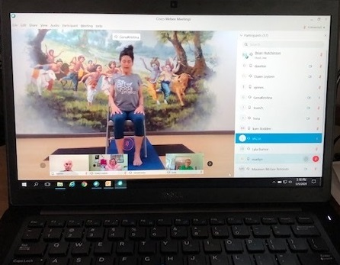
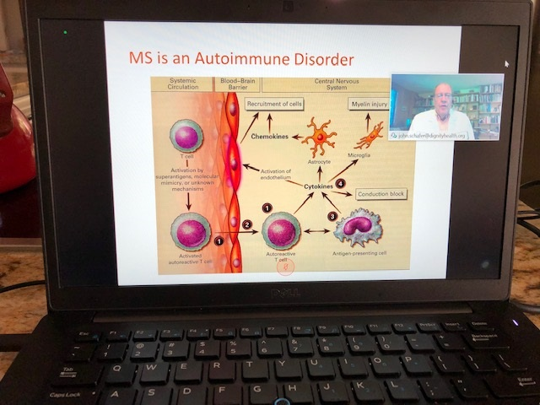
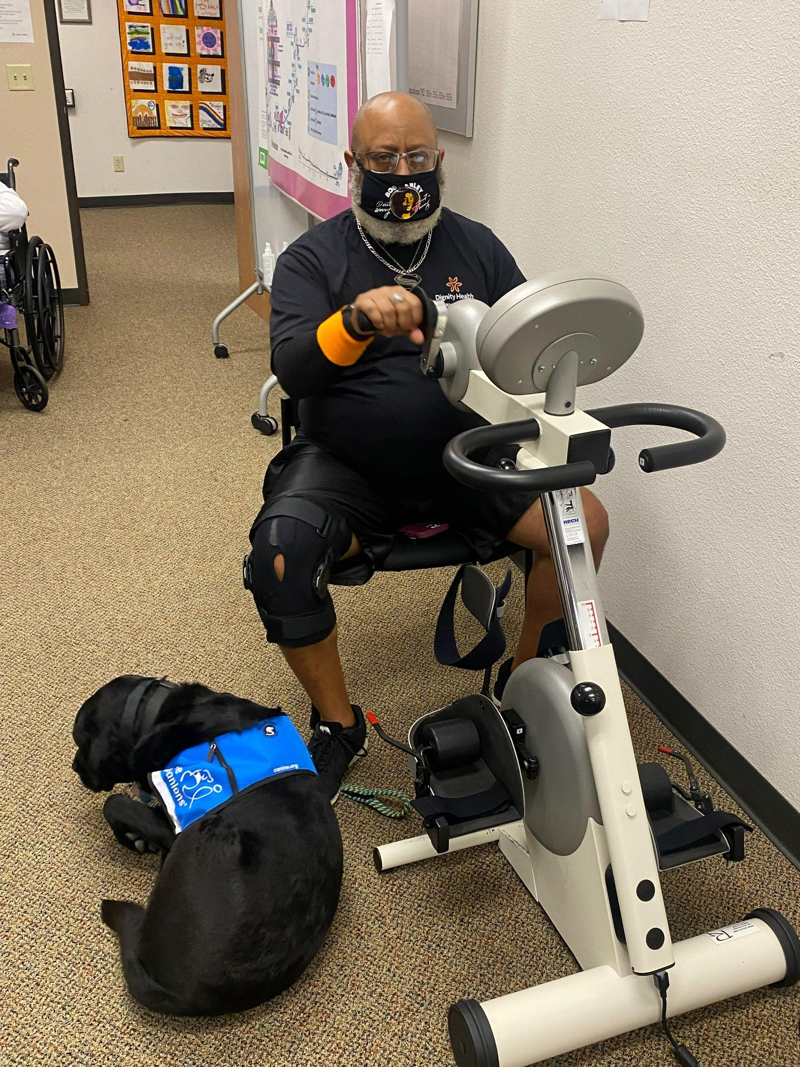
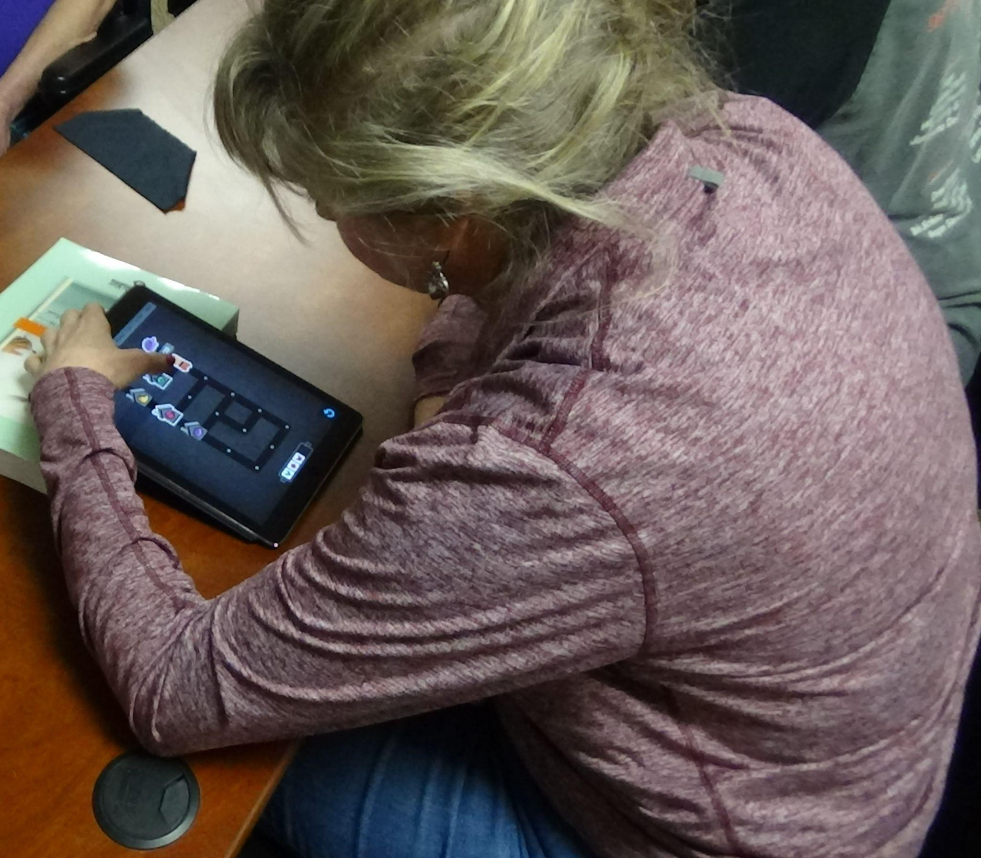
Empowered to Achieve & Achieving Wellness Programs
Participants attend one day per week
Hybrid format offered during the reporting period
Activities include:
-Individualized & Group Exercise
-Cognitive Stimulation
-Socialization & Emotional Support
-Education
-Recreational Activities*
*Many activities were provided virtually while community outings & in-person social events were suspended due to the pandemic.

Slide 5
Program Outcomes

Slide 6
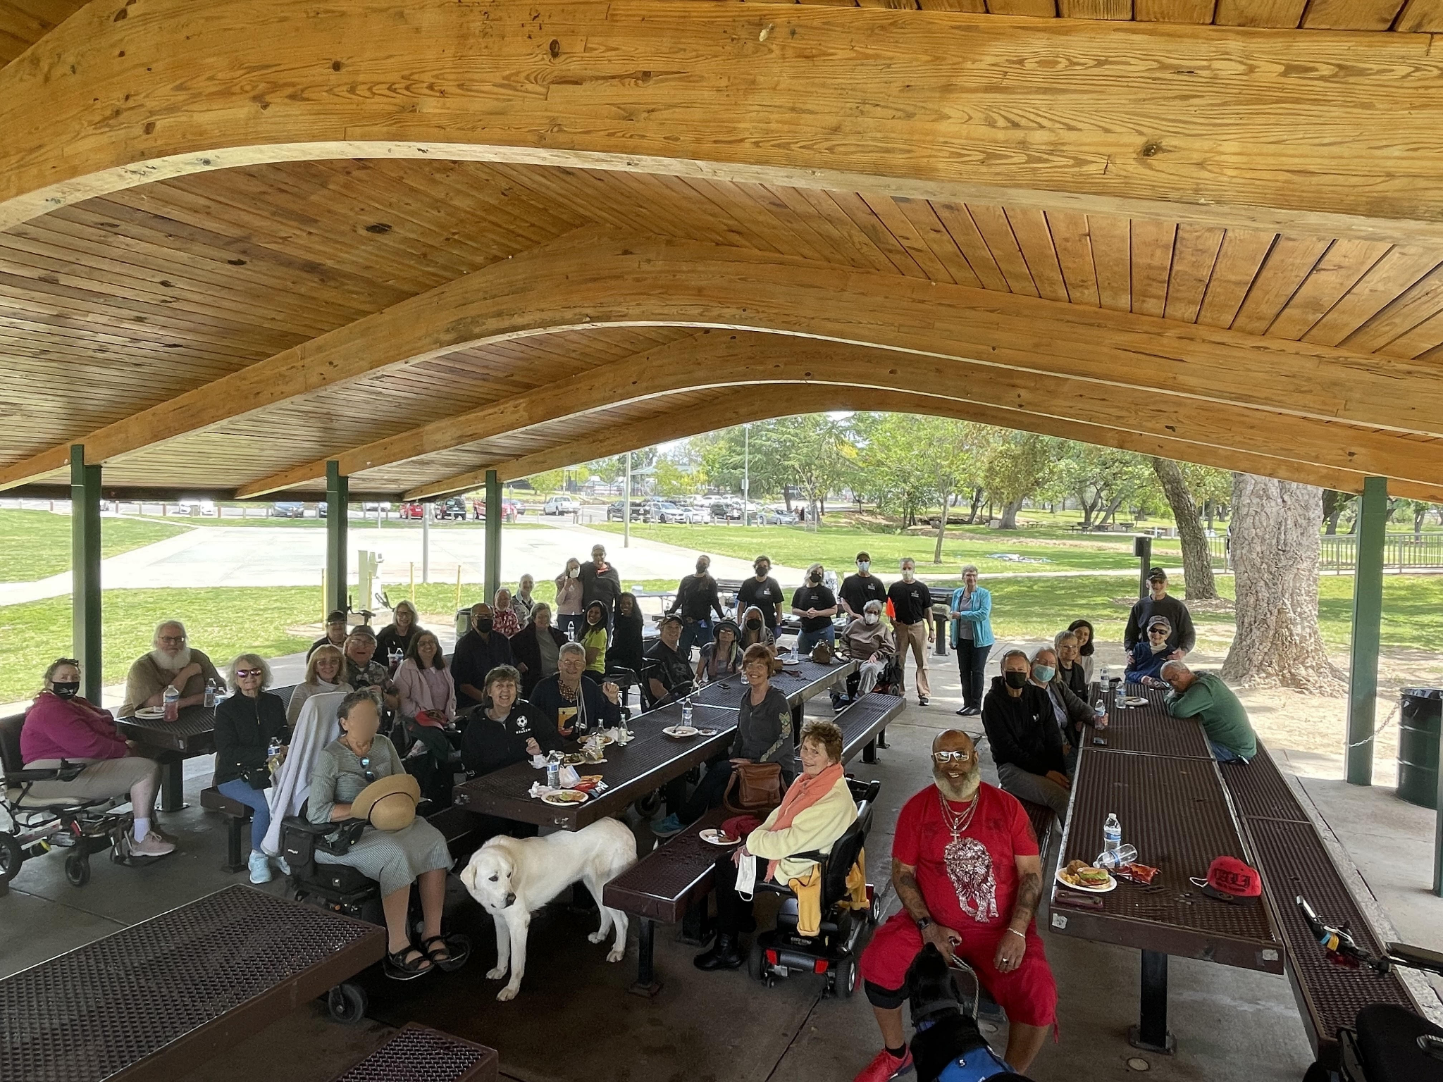
Multiple Sclerosis Achievement Center Demographics
37 Female (71%) and 15 Male (29%)
36 White, not Hispanic (69%)
3 LGTBQ+ (7%)
33 Married/Domestic Partnership (63%)
3 Employed (6%)
Average age = 63 years old
Average length of MS diagnosis = 23 years
Average length of enrollment at the MSAC = 64 months
Demographics based on analyzed data set

Slide 7
Program Measures
Multiple Sclerosis Self Efficacy Scale (MSSE)
Multiple Sclerosis Impact Scale-29 (MSIS-29)
NeuroQoL sections for Anxiety, Depression, Emotion & Behavior, Positive Affect, Cognition, Ability to Participate, and Social Roles
Godin Leisure Time Exercise Questionnaire (GTLEQ)
*Program Measures are collected at baseline (initiation of program) and one time per year thereafter during the month of January. Data reported is from 2017-2021.

Slide 8
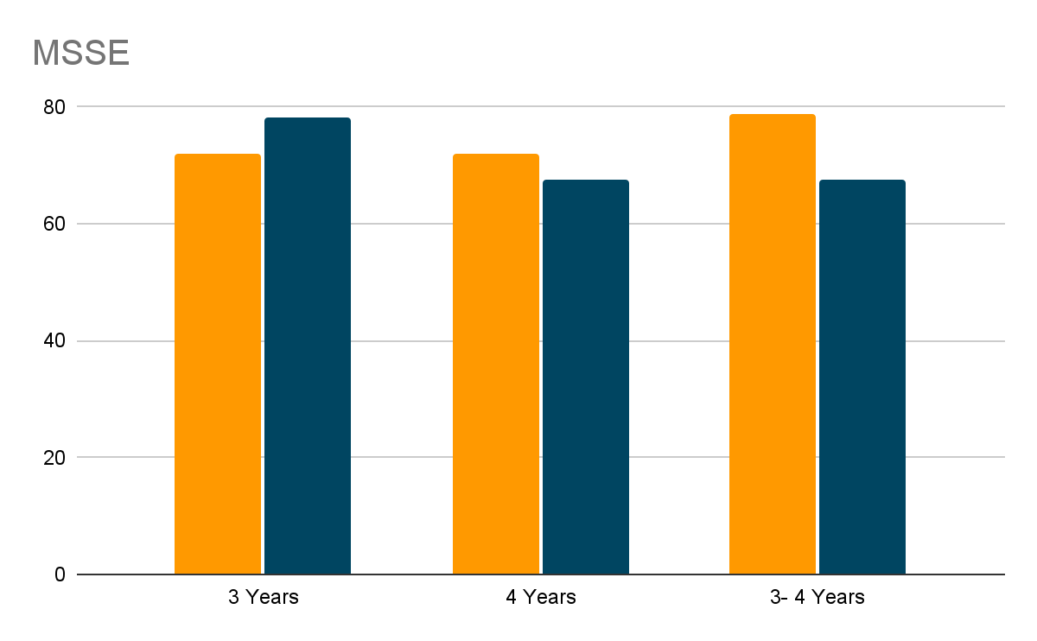
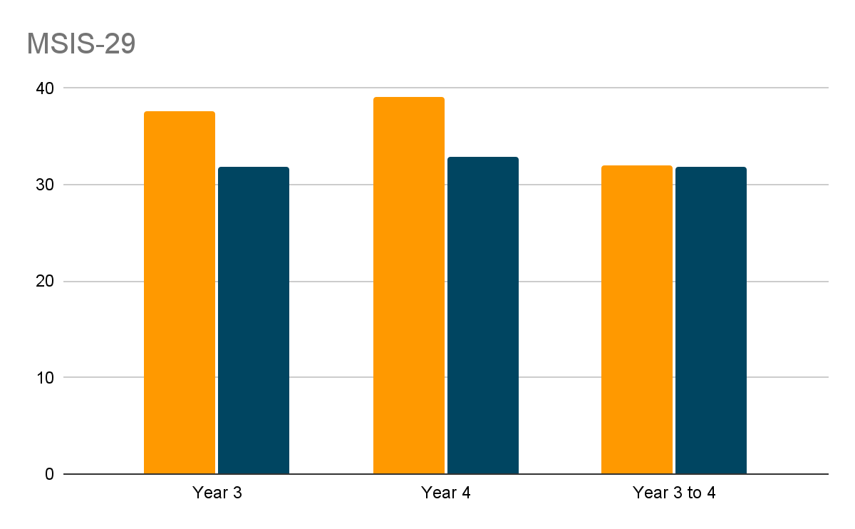
Three and Four Year Outcomes
p=.02
*
p=.18
p=.0001
*
p=.01
*
p=.02
*
p=.03
*
p=.89
p=.15
p=.03
*

Slide 9
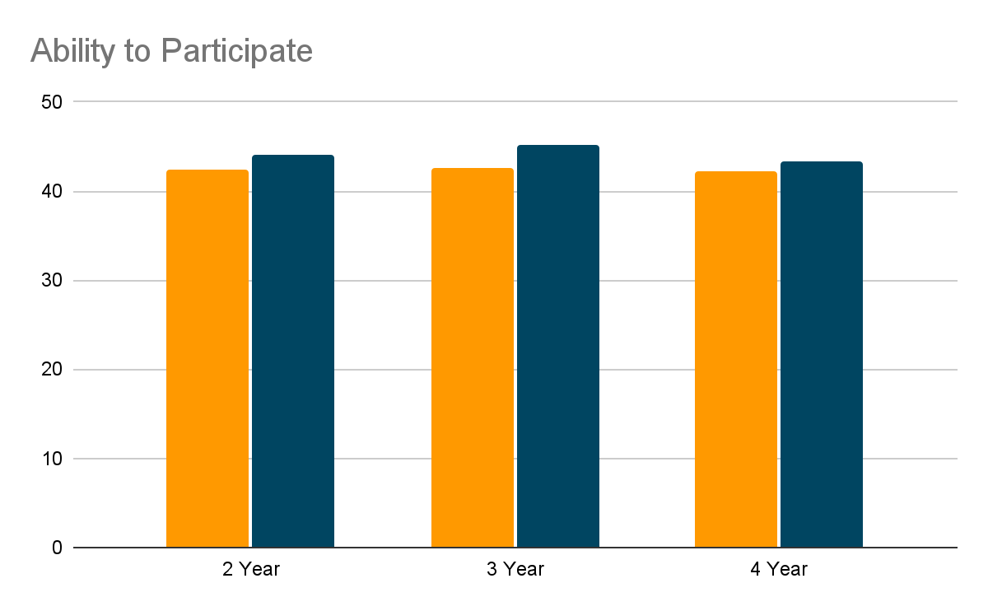
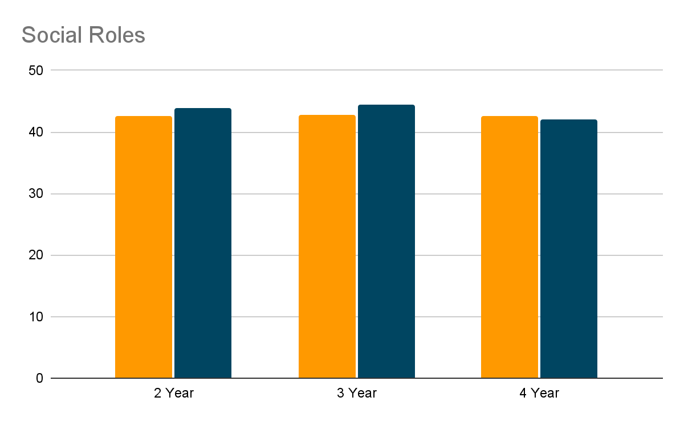
Two, Three and Four Year Outcomes- NeuroQoL
p=.02
*
p= .004
*
p=.004
*
p=.27
p= .001
*
p= .54

Slide 10
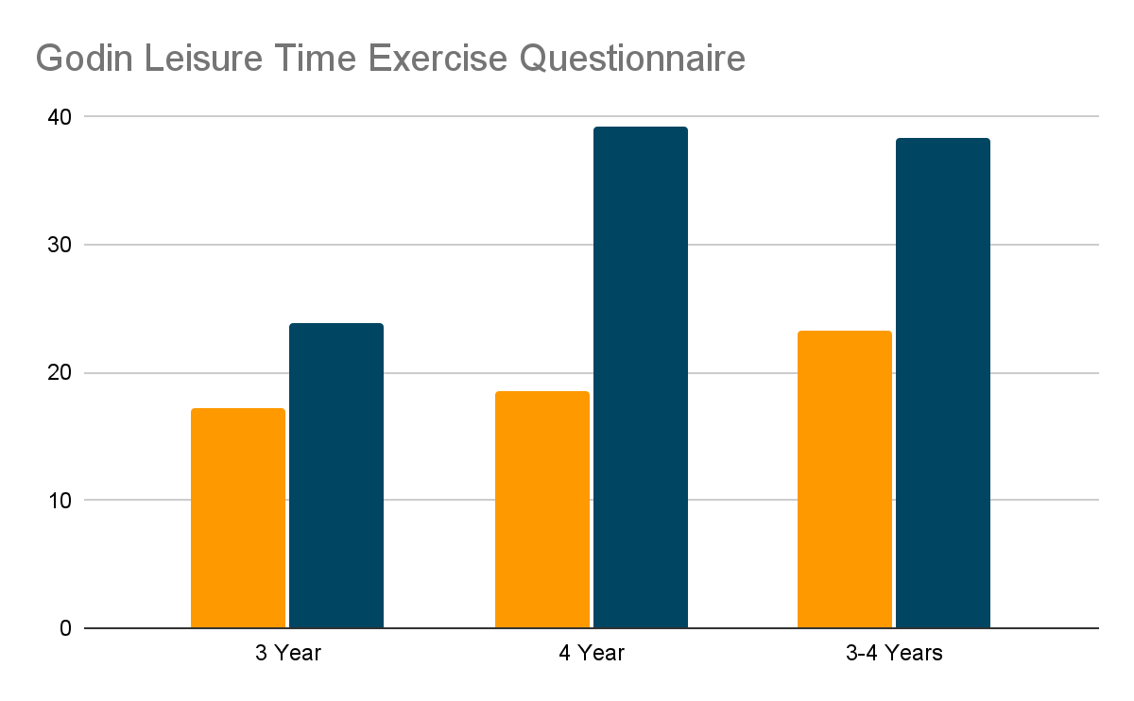
Three and Four Year Outcomes- Godin
p=.00001
*
p=.005
*
p= .14

Slide 11
Conclusions
Participants in a one day per week wellness program showed significant improvements in:
Patient reported disease impact through the MSIS-29 after three and four years
Participation in physical activity during leisure time as reported through the Godin Leisure Time Exercise Questionnaire after four years
Declines noted during year four:
Self-efficacy
Ability to participate
Social roles
Improvements in areas of self-efficacy, ability to participate, and social roles had been noted through year three; however, negative changes were noted during the pandemic period
Significant changes were not noted for the other measures collected during this reporting period

Slide 12
Limitations
Not a true baseline for some of the participants
No use of a control group
Survey responses were collected online during the pandemic, so we cannot guarantee the respondent
MSAC members do not exclusively participate in MSAC activities; some participated in other types of interventions during this reporting period

Slide 13
Summary
Overall, individuals who participate in a weekly, structured day wellness program have shown significant improvements in quality of life
Changes were seen more quickly in Social Domains than measures of self-efficacy and disease impact, followed by behavior change (physical activity)
The impact of the COVID-19 pandemic led to decreased social connection and reduction of in-person interventions which may have contributed to the decline of some of the progress that had been made over the previous reporting years
Further analysis is recommended to determine the long-term impact of this pandemic and to determine if the transition back to full in-person programming and social connections will positively impact these outcomes

Slide 14
Thank You

